Slide 1
What is History Day?
Program that allows students to conduct research on a world, national, state, or local topic.
This year’s theme: “Conflict and Compromise in History”
“It is not just a day, it is an experience.”

Slide 2
Topics
Students can choose any topic they wish, as long as it relates to the theme.
Try not to choose a topic from the last 25 years.

Slide 3
Categories
Exhibit
Performance
Documentary

Slide 4
Annotated Bibliography
Required for ALL Categories
Will contain all sources that provided usable information for your entry.
Must explain what the source provided and how it was used in the entry.
MLA or Turabian style bibliography required.

Slide 5
Process Paper
Required for ALL entries except historical paper
Maximum of 500 words

Slide 6
Process Paper
Process paper will explain:
how the topic was chosen
how research was conducted
how the entry type was selected and created
how the entry reflects/relates to the theme

Slide 7
**Exhibit**
*Individual OR Group*

Slide 8
Exhibit
A visual and verbal representation of research and interpretation of a topic’s impact on history
Like a museum exhibit
Provide captions for visuals

Slide 9
Size Requirements
May be no larger than :
40” wide x 30” deep x 6’ high
Circular or rotating exhibits must be no more than 30 inches in diameter
Tables on which an entry is placed do not count in overall height

Slide 10
21.3”
40”
30”
21.3”
40”
6 ft
6 Ft
30”

Slide 11
Credits of visual sources
Students will include a brief credit, on the exhibit itself, for all visual sources (e.g., photographs, paintings, charts, graphs, etc.).
These do NOT count toward the student-composed word count.
They also must fully cite these sources in their annotated bibliography.

Slide 12
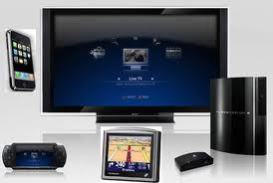
Media
Media used in an exhibit can not run for longer than 3 minutes.
Viewers and judges must be able to control media devices.
Devices must fit in the size limits of the exhibit.
Electricity cannot be guaranteed.

Slide 13
Word Limit
500 word limit** for all text
Titles
Subtitles
Timelines
Media
**Student-composed words
Put the number of student-composed words on exhibit and number of words in process paper on title page of the process paper.

Slide 14
**Performance**
*Individual or Group*

Slide 15
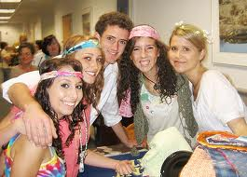
Performance
A performance is a dramatic portrayal of research and a topic’s significance in history.
Must be original in production not a
reenactment.

Slide 16
Time
Must not exceed 10 minutes in length
Timing starts immediately after the announcement of the title.
Student(s) allowed an additional 5 minutes to set up and 5 minutes to clean up.

Slide 17
Media Devices
Media is permitted:
Slides
Tape Recorders
Computers
Students must run all
equipment
Remember it is about the history not just the drama

Slide 18
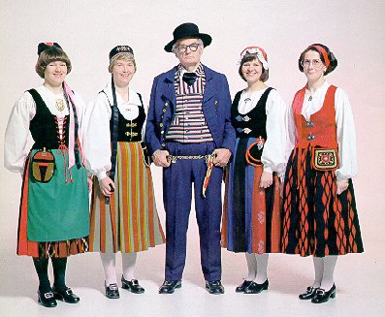
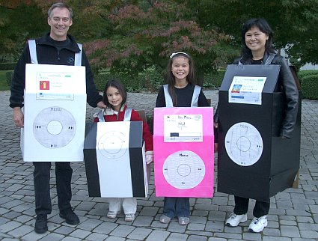
Costumes
Costumes may be purchased or created.

Slide 19
Word count
Put the number of words in process paper on its title page.

Slide 20
**Documentary**
*Individual or Group*

Slide 21
Documentary
A documentary reflects the student’s ability to use audiovisual equipment and communicate a topic’s significance. Presentations should use primary materials as well as original elements.

Slide 22
Time
May not exceed 10 minutes in length.
Students will have 5 minutes to set up and 5 minutes to clean up.
Time will start when first audio is heard or visual is seen.
Students must operate all equipment!

Slide 23
Involvement/Production
Student must run all equipment.
All entries must be student-produced
Narration
Voice-Overs
Dramatization
* This does not include interviews of participants in a historical event
Follow all copyright rules!

Slide 24
Computer Entries
Must provide the judges with a DVD or flash drive of the entry for further review.
Put the name of the entry on the DVD/flash drive.
If possible, save as a Quick Time movie.
Failure to leave a copy with the judges will make the documentary ineligible for the runoff round.
The copy of the documentary will not be returned.

Slide 25
Word count
Put the number of words in the process paper on the title page.

