Slide 1
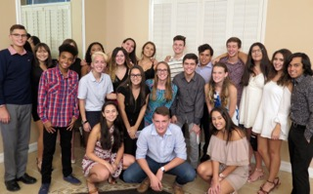
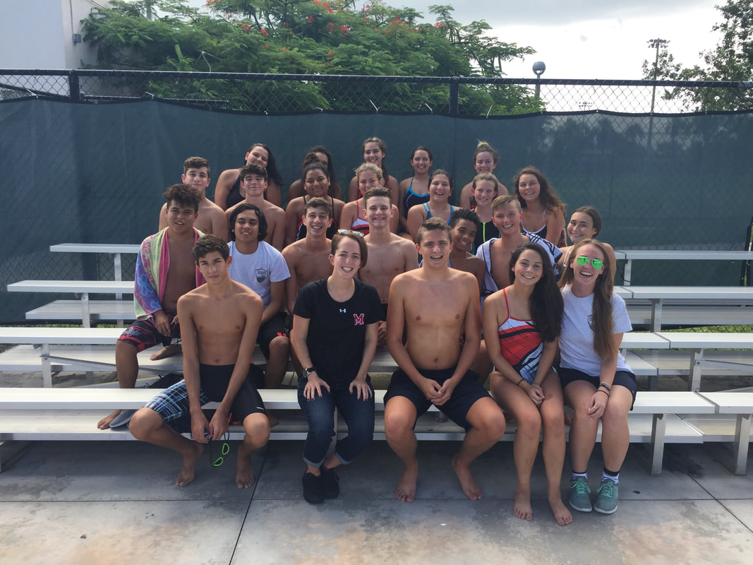
Monarch High Swim Team
- Sign in
- Get a set of the By-laws
- Get a calendar
- Begin to fill out info sheet

Slide 2
Coaches & Captains
Coach Edwards: Room 536
Coach Leslie: Room 251
Girls’ Captain: Zoe
Boys’ Captain Justin

Slide 3
General Information:
This is a coed team. Although boys and girls compete separately, their practices and meets are combined.
Practice is Monday – Friday, 3:30 p.m. – 5:00 p.m.
Mon. – Thurs.: Practice is at the Deerfield Aquatic Center (501 SE 6th Ave, Deerfield Beach, FL 33441)
Friday: Practice at Monarch High School from 3:10 – 4:10
In order to be as informed as possible, parents and athletes must actively check their corresponding Group Me messages.
For additional information, please use Coach Edwards’ website as a resource: https://mscoachedwards.weebly.com/
If you would like additional information on Broward County Swimming & Diving rules and requirements, schedules, or more then please visit https://www.fhsaa.org/sports/swimming-diving . This website will also have information later in the season with athletes’ placements in district, regional, and state meets.

Slide 4
Rules & Expectations
Participating in Monarch Athletics is a privilege and should be treated as such.
RESPECT.
Swimmers must be successful and diligent students.
Role models in the pool and out of the pool.
Swimmers must be on time to practice.
CAP, GOOGLES, WATER BOTTLE, ready to go!
Swimmers must put forth their best effort at meets and at practice!
This is a team.
Possible consequences: extra conditioning or excused from the team.

Slide 5
Attendance Policy
Swimmers are allotted three excused absences for practices.
Doctors appointments, injuries, approved reasons in advance
After three excused absences, all absences will count as unexcused.
For all absences (excused or unexcused) swimmers must fill out an Absence Form for the records.
Unexcused absences are not tolerated.
Consequences may vary for having an unexcused absence for practice. Depending on how many absences and the punctuality of the athlete. The athlete could be (1) required to swim in the 500 in the upcoming meet, (2) not be allowed to swim at the next meet, but be required volunteer at it, or (3) dismissed from the team.
Swimmers should not miss any meets. Meets are once a week.
If a swimmer misses more than one meet, they may not receive a varsity letter.
By policy, if a swimmer misses more than two meets then they are not allowed to compete at Districts; thus, ending their season, and they may be removed from the team.
This only applies to swimmers who are in swim clubs!
If you practice regularly in a swim club, then you are not required to attend practice. You are required to attend any meetings that may be scheduled, and all the meets.
Practice is Monday – Friday
Monday – Thursday: Pool Fridays: Dryland
Students may drive to practice, but there is a bus that will take students to practice every day after school.

Slide 6
Monarch Swimming Absences Form (Example)
Swimmer:
Date of absence:
Excused Unexcused
Reason for absence:
Consequence:
Absent Number: | Excused: Unexcused:

Slide 7
Parents:
Parents are welcome to come to practices, but please do not communicate with your swimmer during practice.
Please be a member of the parent Group Me to be as informed as possible.
All parents are encouraged to come to the meets.
Each parent is requested to bring snacks to a meet. There will be a sign-up sheet, so parents can coordinate who will bring what and when. Parents are encouraged to bring additional snacks on unassigned days if eligible.
If there is something you would like to discuss, please contact the coaches.
Swim Mom:
Mrs. Spalluto
nicholespalluto@comcast.net

Slide 8
Requirements:
Minimum GPA 2.0
No school attendance = No swim meets
Pay a one-time due of $85
Bring the following materials every day: water bottle, cap, googles, swim suit, and dry land clothes (shirt, shorts, sneakers)
Ride the bus to meets.
Swim the 500 at a minimum of 1 meet.
TRY YOUR BEST!
Swim a 50-meter freestyle in under 35 seconds.
Swim a 500-meter freestyle without stopping.
Complete a legal flip turn.
Swim all strokes (fly, breast, back, free).
Dive properly off a standard block

Slide 9
Athletic Packet:
Fill out Monarch Athletic Packet
Go to: https://www.browardschools1.com/monarch
Click on “Athletics”
“Click Here for Monarch High School Athletics Packet Download”
Complete it, turn it in to Ms. Ulrich, receive a yellow card, turn that into Ms. Edwards by May 7th

Slide 10
NEED ALL OF THIS FOR MAY 7th:
Turn in Athletic Packet & receive Yellow Card
Read through By-laws; have parents sign
Fill out medical information sheet
Need: competitive swim suit, googles, swim cap, and WATER BOTTLE for practice

Slide 11
Important Dates:
May 7th: Conditioning begins
NEED TO TURN IN ATHLETIC PAPERWORK.
MUST HAVE YELLOW CARD TO BEGIN PRACTICE.
May 14th & 15th:
Perform requirements
May 16th: New Member meeting
After practice
May 18th: Parent Meeting
At school after Dry land

