Slide 1
Ancient Greece
People living in Greece lived in small farming villages. As these villages evolved, people built walls and a marketplace (agora), and developed governments.
Each city-state (poleis) were believed to be protected by a particular God or Goddess.
People belonging to the poleis owed their Gods and Goddess reverence, respect, and sacrifice.
Example: The people of Athens were protected by Athena.

Slide 2
Sparta
One unique city-state, Sparta, (also protected by Athena) was famously known as a warrior society. Spartans were taught that dying in battle was the greatest glory in life. It was the biggest poleis as well.

Slide 3
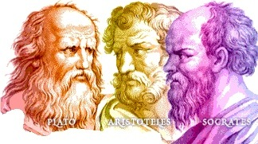
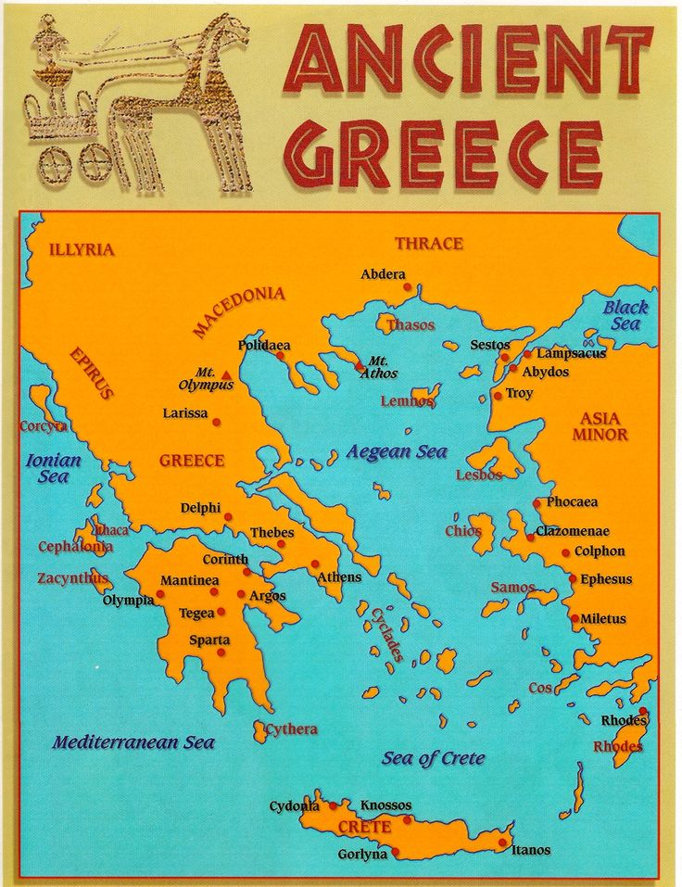
Ancient Greece:
The Greeks prided themselves on power of the mind; Philosophers like Socrates, Aristotle, & Plato preached truth, justice, reason, & democracy.
Land was the most important source of wealth, which motivated men to conquer territory for Greece from the Mediterranean to Asia. However, as the conquered they began to be self-ruled.

Slide 4
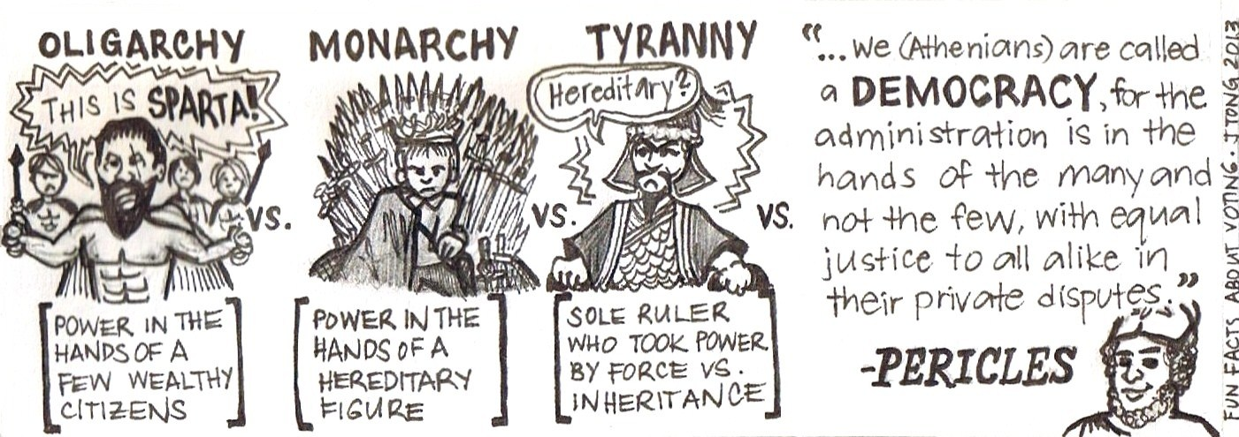

Slide 5
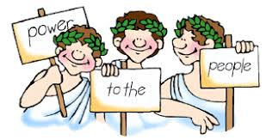
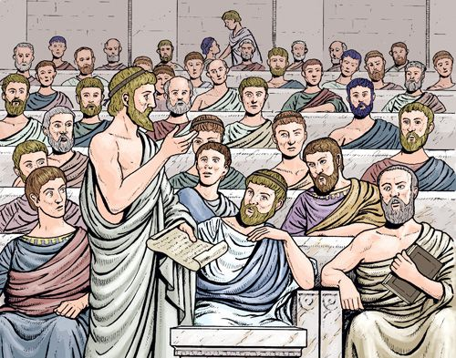
Democracy!
In 507 B.C. the Athenian leader, Cleisthenes, introduced a system of political reform that he called demokratia (democracy!), or “rule by the people.” This system was comprised of three separate institutions: the ekklesia, a sovereign governing body that wrote laws; the boule, a council of representatives from each Atenian tribe; and the dikesteria, the popular courts.

Slide 6
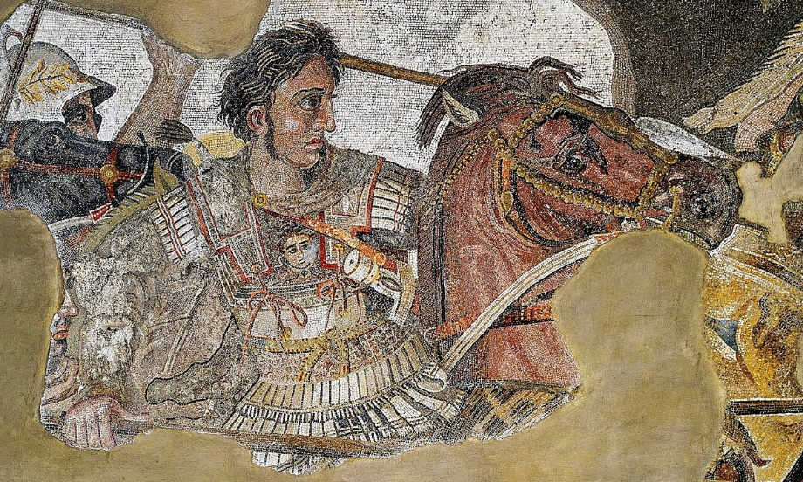
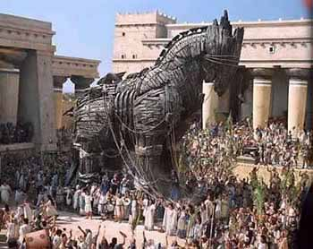
Alexander the GREAT
­At the age of 18, Alexander of Macedonia was cavalry commander. After his father, King Philip II, passed away, he was king at age 20.
He was tutored by Aristotle.
He had the support of the Macedonian Army to conquer Persia and Egypt by the age of 26.
This is why he is remembered as Alexander the Great. His conquests created a legend that would provide the standard by which other leaders measured their careers, and his tombs was one of the most visited.
Alexander the Great’s conquests, the Trojan War, and the philosophes from Ancient Greece have influenced the world today.

