Slide 1
Ancient Rome
Last notes of unit 1!

Slide 2
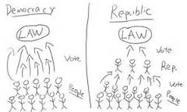
Ancient Rome
Starting as a small city-state, Rome took control of central Italy after overthrowing the Etruscans.
Vowing to never be ruled by a king, they created the Roman Republic, where the people elected officials.
Rome occupied all of Italy by 270 BC by using a combination of force & diplomacy. Just a century later, their influence spread from Spain to Egypt.

Slide 3
Julius Caesar…
Expansion brought both wealth & corruption into Rome. Self-interest began to replace honor.
Example: Julius Caesar was a great Military leader who showed the whole world how powerful Rome was. This led him to take over all Roman city states and became the first dictator of Rome, which made him go from being loved to being hated..

Slide 4
Sorry… No video. Too large to download ☹ try youtube!
Eventually, a powerful Roman general named Octavian restored order in Rome. After taking complete control he became known as Caesar Augustus, Ancient Rome’s first emperor.
Under the new Roman Empire, Augustus stabilized the economy & government, ushering in Pax Romana, a 200 year era of peace.

Slide 5
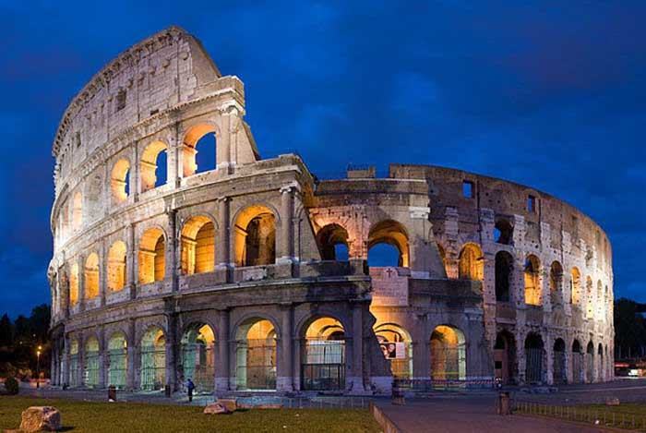
Ancient Rome
Rome unified almost all of Western Europe by spreading the Latin Language and Christianity.
Rome fell to the Germanic peoples. These backwards barbarians attacked successful forward societies and forced them into feudalism.
Although Rome fell, it left behind a legacy of justice, unity, power, greatness, & civilization that shapes western society to this day.

