Slide 1
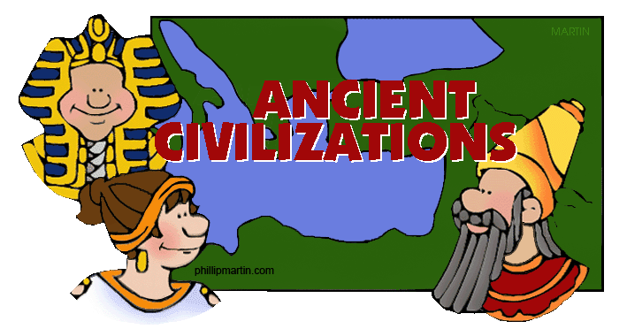
Unit 1:

Slide 2
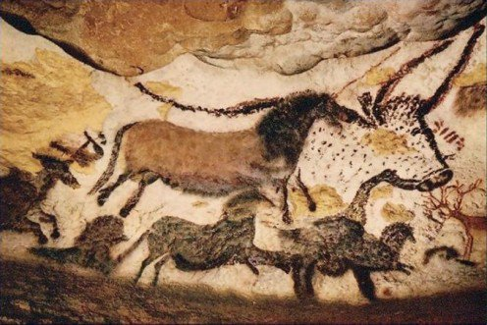
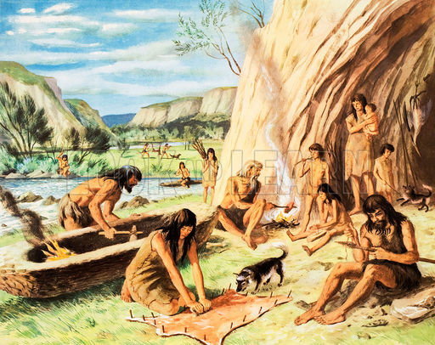
Toward Civilization
According to historians, the earliest period of time dates back to about 2.6 million years ago.
The first period of human existence is known as the Paleolithic Period or the Old Stone Age.
During this time, nomads roamed the earth. Men were hunters and women were gathers.
They kept records and communicated via cave paintings. They used simple tools and learned to build fires.

Slide 3
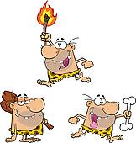
Toward Civilization
The Paleolithic Period ended around the end of the last ice age. With the beginning of agriculture, the Neolithic Period began
Humans no longer needed to travel for food; they began to settle in villages, leading to increased populations and the rise of civilizations.
Sorry… No Ice Age video. Too large to upload ☹

Slide 4
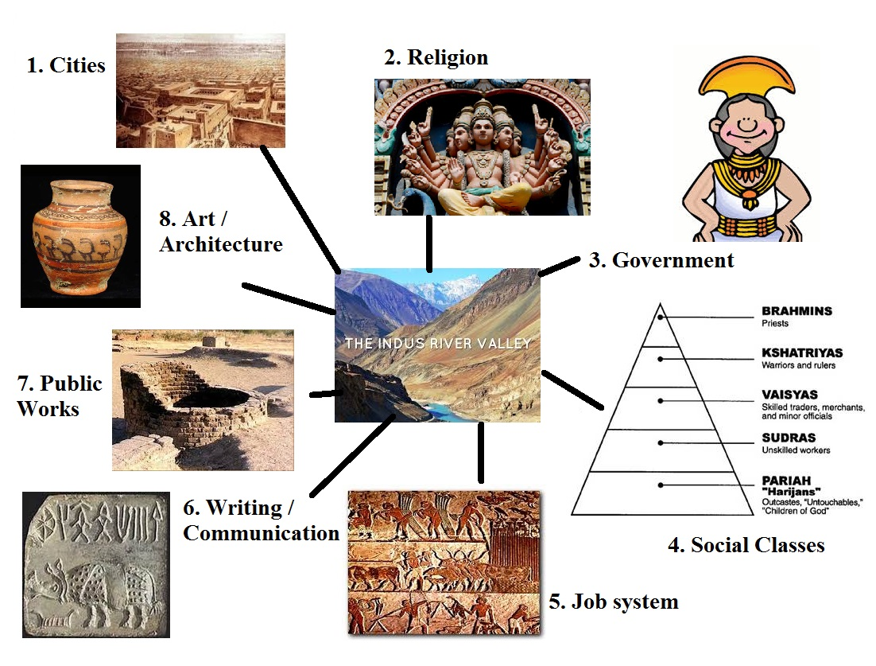

Slide 5
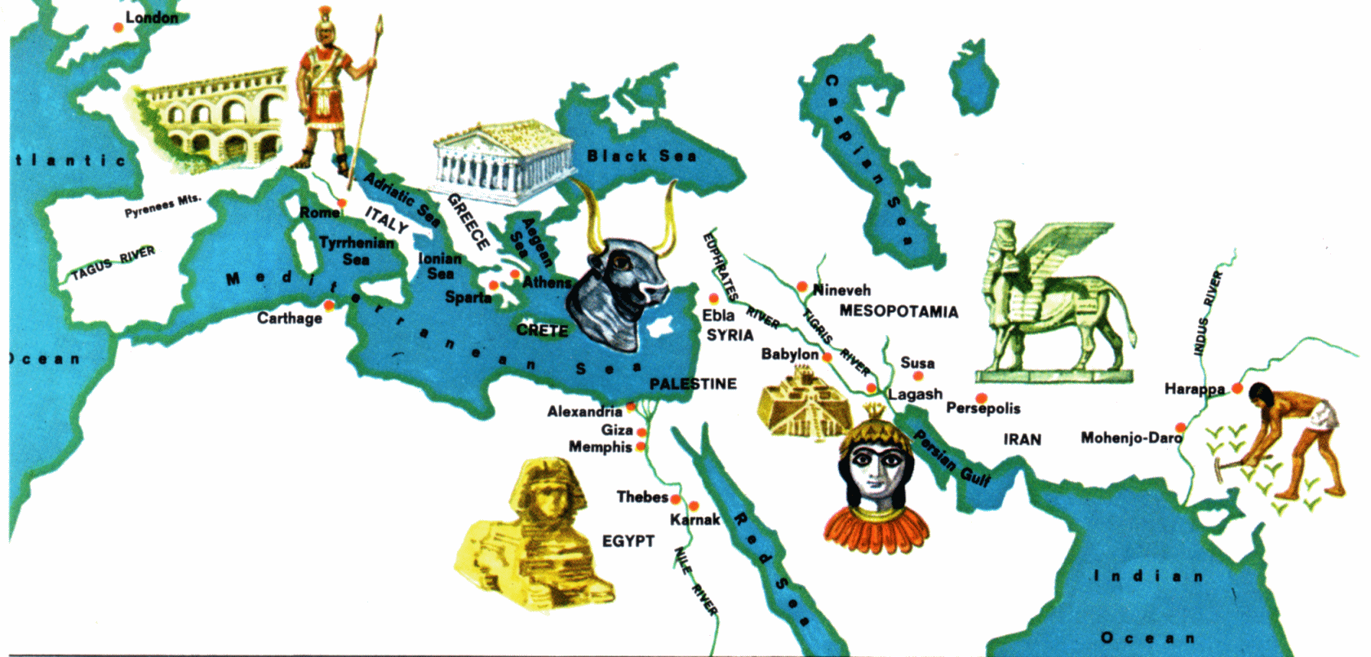
Toward Civilization
Cities began to emerge mostly near river valleys.
Governments arose because challenges like farming in a river valley required leadership.
Writing emerged because of the new projects, and they needed to be recorded.
As ancient rulers gained more power,
they began building empires by
conquering territories.

Slide 6
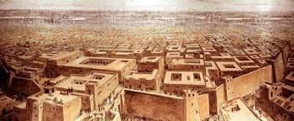
Indus River Valley
1. India’s earliest civilizations emerged in the Indus River valley around 2600 B.C.
Two major religions developed in Ancient India, Hinduism and Buddhism.
New ideas such as enlightenment and reincarnation were part of the belief systems.
Members of the ancient Indian society were part of a caste system, in which you were told how and where to live, how to earn a living, and what economic class they were in.

Slide 7
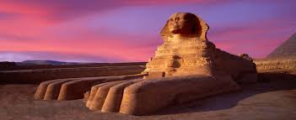
Egypt
2. The Egyptian Empire was one of the world’s first unified state in about 3100 B.C. It ran alongside the Nile, the world’s longest river.
Powerful Egyptian rulers, known as Pharaohs, ruled the upper class.
The upper class enslaved the majority of the population.
Slave labor was used to architect the pyramids.
Pyramids served as tombs to preserve the bodies of Egyptian rulers, who were viewed as living gods.

Slide 8
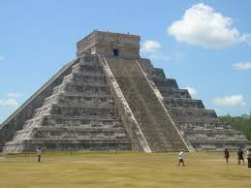
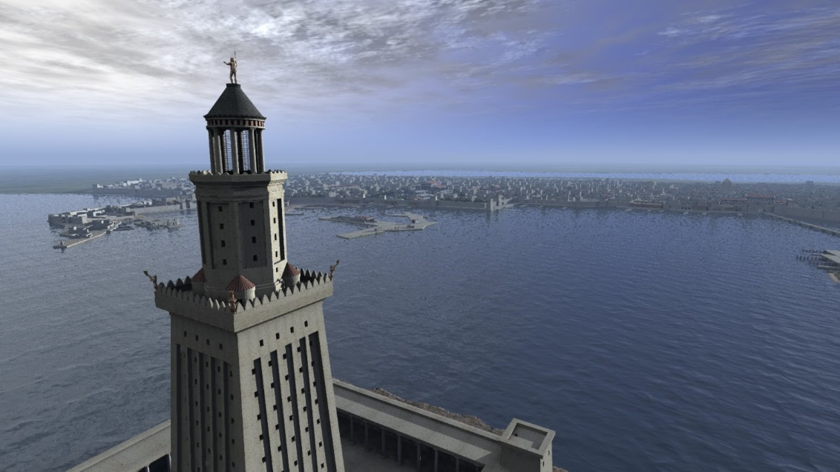
7 Wonders of the Ancient World…
1. Great Pyramid of Giza.
2. The Lighthouse of Alexandria.

Slide 9
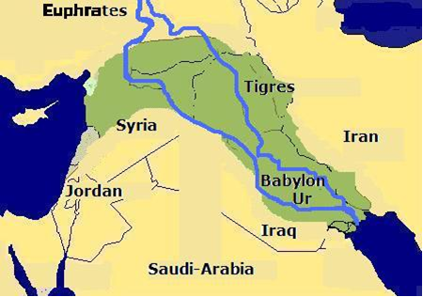
Mesopotamia
3. Control of the Tigris and Euphrates rivers led to the development of the Sumerian city-states, which were part of Mesopotamia.
Sumerians invented the earliest form or writing cuneiform.
Scribes were specially trained people who knew how to read and write, maintained records for the kingdom.

Slide 10
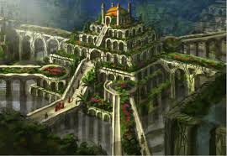
In Babylon, you can find another wonder of the ancient world: The Hanging Gardens.
The most popular theory is that the gardens were built by King Nebuchadnezzar II to make his wife happy. She was homesick for the plants and gardens of her homeland. King Nebuchadnezzar II ruled Babylon from 605BC, for a period of 43 years.
Several ancient Greek and Roman writers wrote about the gardens… even though there is no proof that they actually existed, they are considered to be one of the Seven Wonders of the World. It is called the Hanging Gardens because the gardens were built high above the ground on multi-level stone terraces. The plants weren't rooted in the earth like a traditional garden. If it existed it was likely the most beautiful man-made gardens ever created.

Slide 11
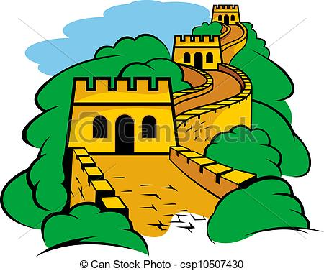
China
4. China’s most influential philosopher, Confucius preached for respect for parents, social order, and good government. His ideas influenced all aspects of Chinese life.
Shi Huangdi was one of ancient China’s powerful and most important leaders. He spent 20 years conquering and uniting China’s warring states, as well as building the Great Wall of China, which is one of the 7 modern wonders of the world.

Slide 12
Mesoamerica
5. The first civilization is Mesoamerica was the Olmec, known to be the “mother culture”.
6. Mayan farmers cleared rain forests to produce maize to feed their cities.
Priests held great power in their society.
Pyramid temples served as burial places
7. After the Mayans, Aztecs served hundreds of years, conquering Mexico.
Moctezuma, the Aztec emperor, brought the end to the Aztec empire.
He allowed Spanish Conquistadors in his land because he thought they were messengers from gods.
He realized too late they wanted land, gold, and to convert the natives people to Christianity.

Slide 13
Inca
The Inca empire came from the Andes Mountains in Peru.
They created one of the great road systems in history. They ran through mountains and deserts.

Slide 14
Civilization Assignment
Group 1 – Indus River Valley
Desk 1
Desk 2
Desk 5
Desk 6
Group 2 – Egypt
Desk 3
Desk 4
Desk 7
Desk 8
Group 3 - Mesopotamia
Desk 9
Desk 10
Desk 14
Desk 15
Group 4 - China
Desk 11
Desk 12
Desk 16
Desk 17
Group 5 - Olmec
Desk 13
Desk 18
Desk 23
Group 6 – Mayan
Desk 19
Desk 20
Desk 24
Desk 25
Group 7 - Aztec
Desk 21
Desk 22
Desk 26
Desk 27
Group 8 – Inca
Desk 28
Desk 29
Desk 30

