Slide 1
Unit 1 Civil War & Reconstruction
North & South Develop – New Political parties & decisions

Slide 2
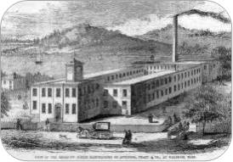
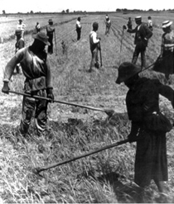
North & South develop
Since the Revolutionary war, the Northern and Southern sections of the U.S. had developed into two very different cultural and economic regions.
The North was industrialized, while the South and the West were focused on agriculture.
The South had a plantation economy that was dependent on the “peculiar institution”, which increased tensions between the regions.
The controversy over slavery grew worse as new territories and states were admitted to the union. Supporters of slavery sought an opportunity to create more slave states, while opponents remained equally determined to end slavery completely.

Slide 3
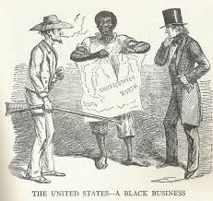
Civil War
What is the tone of this Political Cartoon?
What do the three different people in this cartoon represent?
What do you think is the message of this cartoon?

Slide 4
North & South Develop
In 1820 the U.S. Congress implemented the Missouri Compromise. It was a solution to Missouri requesting for admission to the Union as a slave state. This was an issue because that would upset the balance of slave and free states. To compromise, Congress granted Missouri’s demand but also added Maine as a free state. It also included an amendment that drew an imaginary line across the former Louisiana Territory, establishing a boundary for free and slave regions.
The Missouri Compromise was placed in jeopardy when California began to develop. California’s constitution was against slavery, but it was located below the Slave State line. Thus the Compromise of 1850 was introduced. California would be admitted as a free state, but a more effective fugitive slave law would be put in action. Additionally, popular sovereignty would be introduced. This gave residents of New Mexico and Utah territories the right to vote for or against slavery.

Slide 5
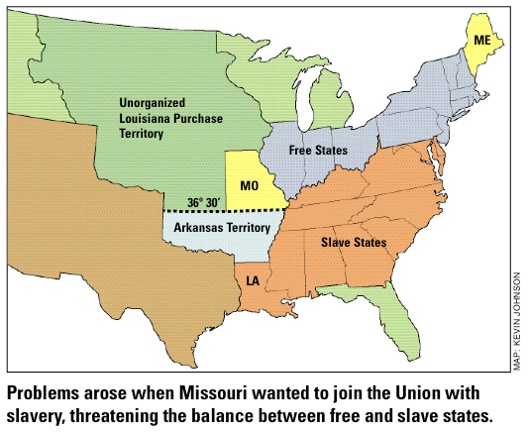
Missouri (MO) Compromise

Slide 6
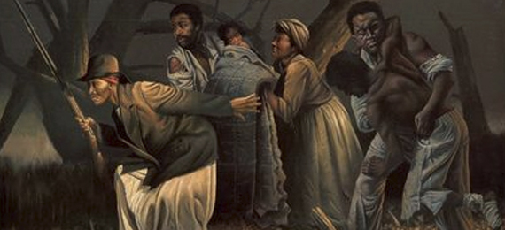
Underground Railroad
Under the enhanced Fugitive Slave Act, any alleged fugitive slave was not entitled to a trial and anyone convicted of helping one was liable for a fine of $1,000 and imprisonment for up to six months.
Escaping slavery was difficult and dangerous. It must be done at night with no sense of distance or direction just the assistance of the North Star.
African Americans and white abolitionists developed a secret network of people would hide fugitive slave. These escape routes became known as the Underground Railroad.

Slide 7
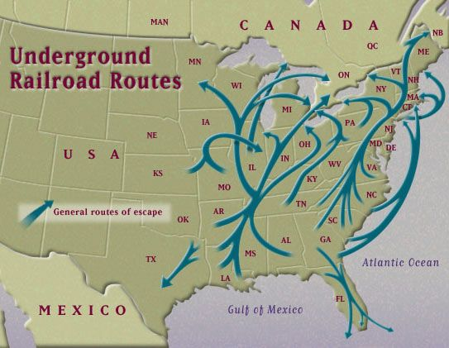
Underground Railroad
“Conductors” on the routes hid fugitives in secret tunnels and false cupboards, provided them with food and clothing, and escorted or direct them to the next “station.”
One of the most famous conductors was Harriet Tubman. After her owner died, she feared a rumor she was going to be sold. She decided to make a break from freedom and successfully reached Philadelphia. She then joined the Underground Railroad and in total made 19 trips back to the South and helped save over 300 slaves, including her own parents.

Slide 8
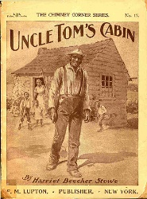
Underground railroad
While Tubman brought hope, Harriet Beecher Stowe brought horror. Stowe published hew novel Uncle Tom’s Cabin, which stressed that slavery was not just a political contest, but also a great moral struggle. It illustrated the intense terror that many slaves encountered. This book urged Northern abolitionist to increase their protests.

Slide 9
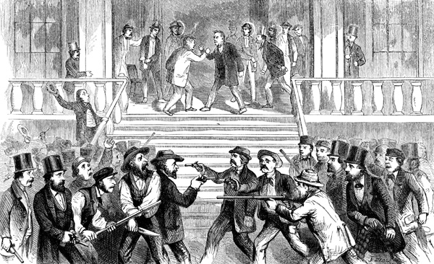
Bleeding Kansas
http://www.history.com/topics/bleeding-kansas
Nebraska and Kansas wanted to be added to the Union; however, they wanted to be added as slave states. Senator Stephen Douglas thought popular sovereignty should be placed in this territory like It was in New Mexico and Utah. He introduced the Kansas-Nebraska Act which would diminish the Missouri Compromise Line and allow these states to vote. It became law in 1854.

Slide 10
Bleeding Kansas
What decade did this occur in?
What is popular sovereignty?
Did Republicans back the Anti-Slavery or Pro-Slavery movement?
Did Democrats back the Anti-Slavery or Pro-Slavery movement?
Did Kansas enter the Union or the Confederacy?

Slide 11
Bleeding Kansas
Both sides saw that as an opportunity to flood people in to sway the vote, which proved Douglas thoughts that this would be peaceful wrong.
As people, primarily from Missouri, poured in, on May 21st, 1856 hooligans looted Lawrence, Kansas.
John Brown responded by orchestrating the murder of five proslavery settlers along the Pottawatomie Creek.
This sparked four months of partisan violence all across Kansas.
This caused violence in the senate as well. Charles Sumner (Mass. Sen.) verbally attacked slavery and singled out Andrew Butler (SC Sen.); Butler’s nephew then assaulted Sumner on the Senate floor!
John W. Geary managed to calm the “border war” with the help of the federal troops.
Kansas rejected the proslavery constitution.

