Slide 1
New Political Parties & decisions
Page 3 – 4

Slide 2
Political Parties
A popular party of the time was the Whig party. Originally organized in 1834, honored “King Andrew” Jackson, and name was borrowed from the British party that opposed royal privileges.
The new President, Franklin Pierce 1852, was a Democrat and his party supported the Compromise of 1850. Whigs were split on this issue so some became Democrats and supported Pierce.
The Free-Soldiers’ party feared slavery would drive down wages of white workers; therefore, anti-slavery.
The New Republican Party formed in 1854 and opposed slavery.
In 1854, James Buchanan, democrat, successfully averted secession.

Slide 3
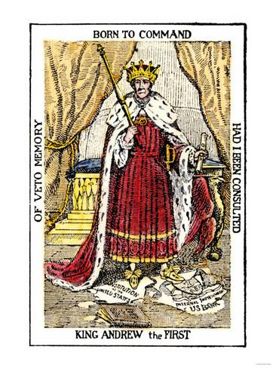
Andrew Jackson once justified his tendency to place personal prerogative above constitutional law or national policy by stating that “One man with courage makes a majority.” His critics replied with accusations of tyranny. The New York American condemned Jackson as a “maniac,” who would “trample the rights of our people under his feet.” The Whig convention of 1834 declared, “Your president has become your MONARCH.”
How has the artist portrayed him? Do you feel the artist supports President Jackson? Explain.
What is a presidential veto?
Should there be limits on presidential power beyond what is stated in the constitution? Why or why not?

Slide 4
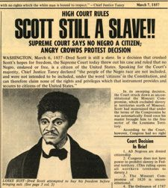
Dred Scott
In 1857, the Supreme Court faced the Dred Scott Decision. An owner took his slave to free territory to claim freedom.
The Supreme Court denied his freedom because according to the Constitution Dredd Scott is property not a person; therefore, he has no legal rights.
This angered the North and fed hope to the South for a guaranteed ruling to extend slavery.

Slide 5
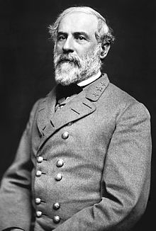
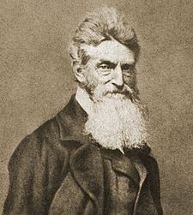
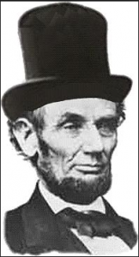
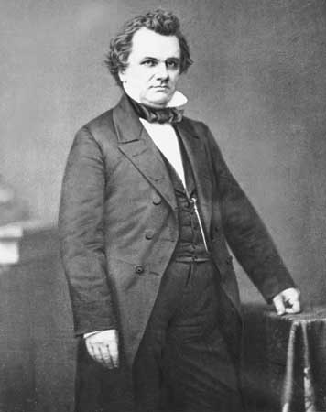
Harper’s Ferry
In 1859, John Brown led a slave uprising at Harper’s Ferry. His plan was to raid federal arsenal to arm the slaves. Robert E. Lee brought in Marines to stop Brown. Brown was captured, evicted, and later hanged and would serve as a martyr to the cause.
Senator Douglas and Abraham Lincoln were debating for the Presidency. Douglas fought for popular sovereignty and Lincoln labeled slavery as immoral and wanted to amend the constitution.
Lincoln won the presidency without any southern electoral votes.

