Slide 1
Reconstruction
Unit 1 – Last page of notes!

Slide 2
President Lincoln’s Assassination
On April 14th, 1965: Feeling a sense of safety (5 days after Lee’s surrender) President Lincoln went to enjoy himself for a night at the Ford’s theater in Washington D.C.
During the show, John Wilkes Booth walked in and shot the President in the back of the head, stabbed his body guard in the shoulder and ran. Booth broke his leg, but still managed to flee the capital.
A 23yr old doctor in the audience, Charles Leale, attempted to save the President, but he found the president paralyzed and struggling to breathe. He was declared dead the next morning.
Booth was a fugitive in a Virginia farmhouse for almost two weeks. Union troops found the farmhouse on April 26th and surrounded it. They set fire to it hoping the fugitives would come out and surrender. Booth remained inside forcing soldiers to come in after him; a sergeant shot Booth in the neck.

Slide 3
Emancipation Proclamation
The steps of reconstruction began during the civil war with Lincoln’s Emancipation Proclamation on January 1, 1863.
Originally, Lincoln was more focused on preserving the Union than the elimination of slavery.
But as slaves fled to join the Northern armies, Lincoln was convinced.
He issued all slaves “shall be then, thenceforward and forever free.”
http://www.history.com/topics/american-civil-war/emancipation-proclamation

Slide 4
Unit 1 Notes Questions 08/30
What did the Emancipation Proclamation declare?
What Presidential “Hat” or role could he use to help the slaves?
When would be the best time to issue the Emancipation Proclamation?

Slide 5
Reconstruction
Lincoln did not have a clear path of reconstruction. He proposed that some blacks deserved the right to vote, and the Ten-Percent Plan, but that was the most people knew before he was assassinated.
Andrew Johnson, Lincoln’s VP and now the President, was a firm believer in state’s rights. Under his Presidential Reconstruction, all land that had been confiscated by the Union Army and distributed to the freed slaves would revert to its prewar owners.
The south was required to uphold the 13th amendment (abolition of slavery), swear loyalty to the Union and pay off war debt.

Slide 6
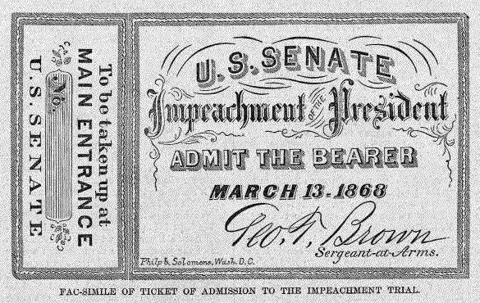
The First Impeachment
Due to Johnson’s leniency, many southern states in 1865 and 1866 successfully enacted a series of laws known as the “black codes,” which were designed to restrict freed blacks’ activity and ensure their availability as a labor force.
Angry in the North, Congress refused to seat those elected from the southern states.
Congress passed the Freedmen’s Bureau and Civil Rights Bills and sent them to Johnson for his signature. After Johnson vetoed the bills and a series of mistakes led to his impeachment.

Slide 7
Radical reconstruction
The Reconstruction Act of 1867, which temporarily divided the South into five military districts and outlined how governments based on universal (male) suffrage were to be organized.
Required southern states to ratify the 14th Amendment, which granted “equal protection” of the Constitution to former slaves.
In February 1869, Congress approved the 15th Amendment, which guaranteed that a citizen’s right to vote would not be denied “on account of race, color, or previous condition of servitude.”

Slide 8
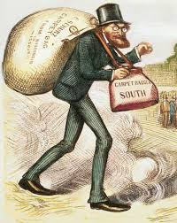
Scalawags & Carpetbaggers
The South was devastated from the war: Economy ruined – farms ruined, property values dropped, people were extremely poor, more than ¼ of the adult white male population died in the war;
Scalawags – white Southerners who joined the Republican Party hoping to gain political office, Carpetbaggers – Northerners who moved to the South after the war.
This cartoon from a Southern
Democratic newspaper depicts
German born Carl Schurz, a liberal Republican U.S. Senator from the State of Missouri who advocated legal equality for African Americans. Schurz is shown as a carpetbagger trudging down a dusty Southern road as a crowd of people watch his arrival.
Unit 1 Notes Questions 08/28+29/17:
What are the event(s) or issue(s) that inspired the cartoon?
Is Schurz shown in a positive or negative light? How can you tell?
Why do you think the cartoonist chose to place the crowd of onlookers at such a great distance from Schurz?

Slide 9
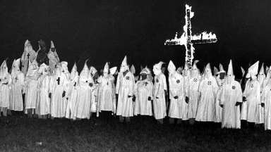
Radical Reconstruction Downfall
By 1870, all of the former Confederate states had been admitted to the Union, and the state constitutions during the years of Radical Reconstruction were the most progressive in the region’s history.
Then came the upset… an increasing number of southern whites turned to violence in response to the revolutionary changes of Radical Reconstruction. The Ku Klux Klan and other white supremacist organizations targeted local Republican leaders, white and black, and other African Americans who challenged white authority.

Slide 10
Goodbye Reconstruction
The administration of President Ulysses S. Grant took aim at the Klan and others who attempted to interfere with black suffrage and other political rights, white supremacy gradually reasserted its hold on the South after the early 1870s as support for Reconstruction diminished.
Racism was still a potent force in both South and North, and Republicans became more conservative
In 1874–after an economic depression plunged much of the South into poverty–the Democratic Party won control of the House of Representatives for the first time since the Civil War.

Slide 11
Goodbye Reconstruction
Democrats took control of Mississippi in 1875 with violence, and Grant refused to send federal troops; thus, marking the end of support for Reconstruction.
President Rutherford B. Hayes compromised with Democrats; in his exchange for his election, Democrats would be guaranteed control the entire South.
The Struggle to deal with the revolution ushered in by slavery’s extinction would continue in the South and elsewhere. A century later, the legacy of Reconstruction would be revived during the civil rights movement of the 1960s.

