Slide 1
Culture in the 1930s
Unit 5 Notes (Pg. 8 – 9)

Slide 2
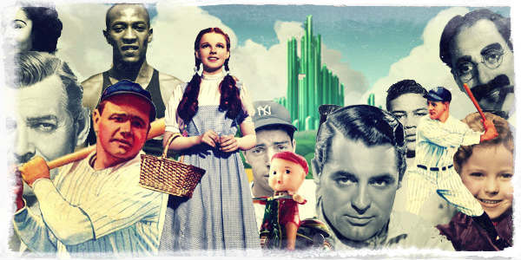
Objectives
Motion pictures, radio, arts, and literature blossom during the New Deal.
What was the Federal Art Project?
What role did the radio play in American homes during the Depression?

Slide 3
Movies are a Hit
Although the 1930s were a difficult time for many Americans, it was a profitable and golden age for the motion picture and radio industries.
In the late 1930s about 65% of the population goes to movies once a week.
Films offer an escape from reality: show the wealth, romance, and fun
More than ever before, people across the country and around the world shared cultural experiences
Perhaps the most famous film of the era was Gone With the Wind
Especially popular were comedies and realistic gangster

Slide 4
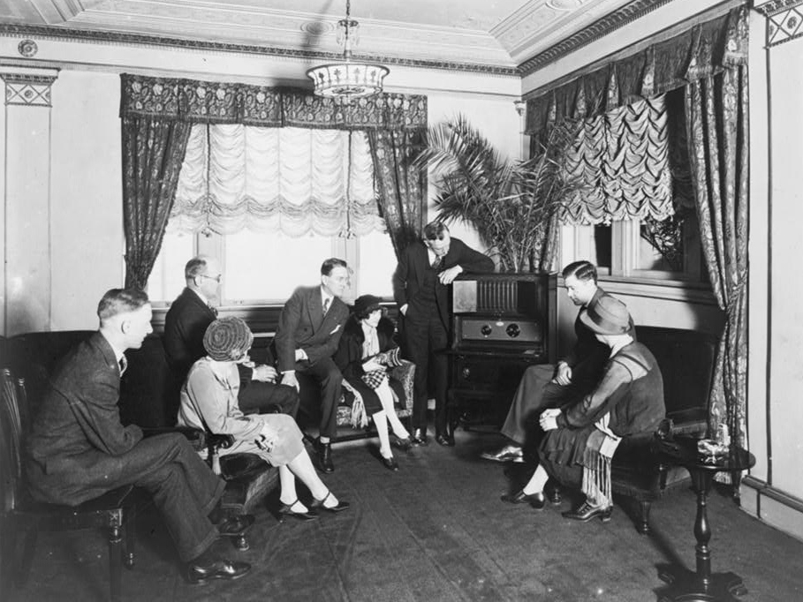
Radio Entertains
Nearly 90% of American households owned a radio.
One of the most famous actor, director, producer, writer was Orson Welles The broadcasts revealed the power of radio at a time when Americans received fast-breaking news over the airwaves.

Slide 5
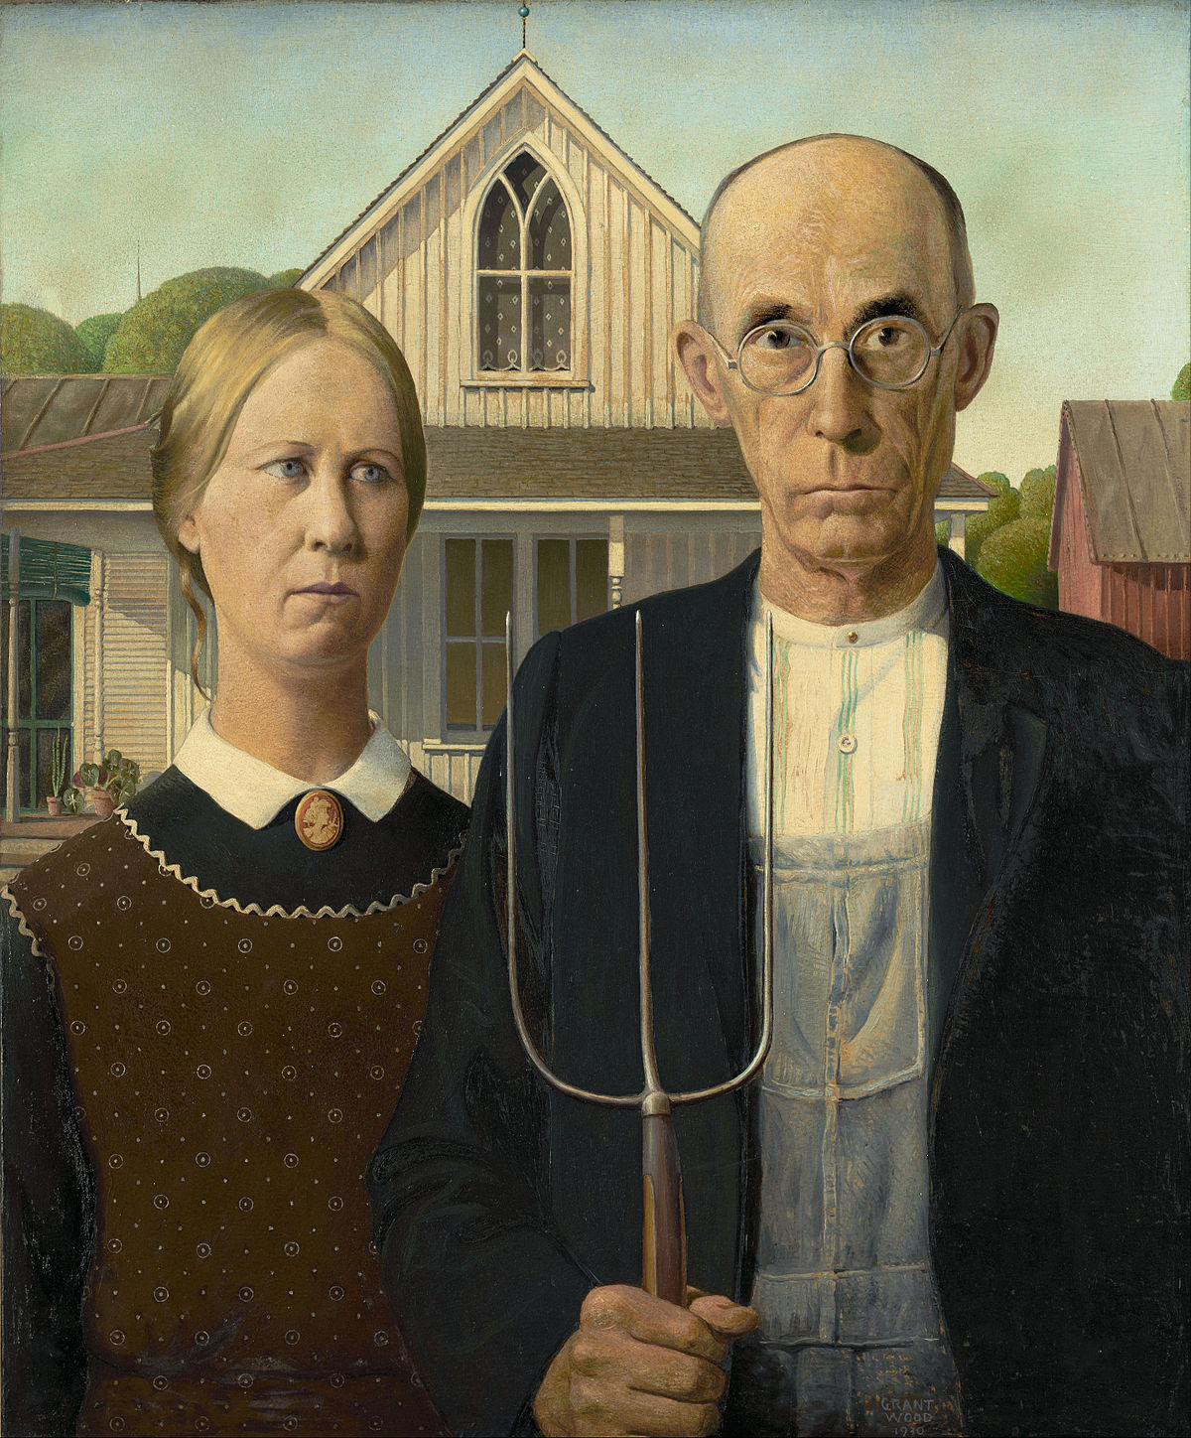
The Arts in Depression America
The Federal Art Project (FAP) paid artists a living wage to produce public art; aimed to increase public appreciation of art and­ to promote positive images of American society.
Most portray dignity of ordinary working people. I.E. Grant Wood and the American Gothic

Slide 6
Folk Songs of America
Famous songwriter and singer Woody Guthrie used music to capture the hardships of America. Focused on the Great Plains region. Most notable song was “This Land Is Your Land”

Slide 7
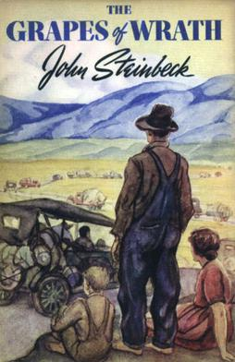
Diverse writers depict American Life
Many writers received support from the Federal Writers’ Project.
Helped people like Richard Wright, an African-American complete a novel about a young man trying to survive in a racist world, Native Son.
John Steinbeck wrote The Grape of Wrath about the Dust Bowl migrants.

Slide 8
Unit 5 notes Questions
14. What role did popular movies serve during the 1930s?
They kept people informed about events around the world.
They allowed leaders to communicate to different audience.
They instructed people on how to participate in the New Deal programs.
They gave people a break from the hardships of the Great Depression.
15. Why did Woody Guthrie become popular during the 1930s?
People could relate to his songs about hard times and hope.
His songs dealt with historical themes many people could understand.
Leaders used his songs in their political campaigns.
His sons reinforced isolationist views about world events

Slide 9
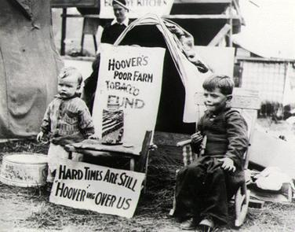
The End of The new Deal
The New Deal affects American society not only in the 1930s, but also in the decades that follow.
By 1937, although the Great Depression did not end, the president did not favor deficit spending and the federal government had already gone deeply into debt.
FDR faces pressure from Congress to scale back on New Deal programs.
By 1939, the New Deal was over.
More focused on the possibility of a war, massive spending on guns, tanks, ships, airplanes, and other war supplies.

Slide 10
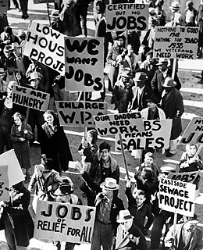
New Deal Programs Endure
Although it was over, many programs remained and continue to stabilize the economy.
FDIC regulates banking. Today it insures individual accounts in US federal banks for up to $250,000.
SEC regulates investment – enforces laws regarding stocks and bonds.
Social Security – important legacy because the federal government as assumed some responsibility for the social welfare of its citizens.
Wagner Act (NLRB) still mediates labor disputes, set standards, ban child labor, permit unions

Slide 11
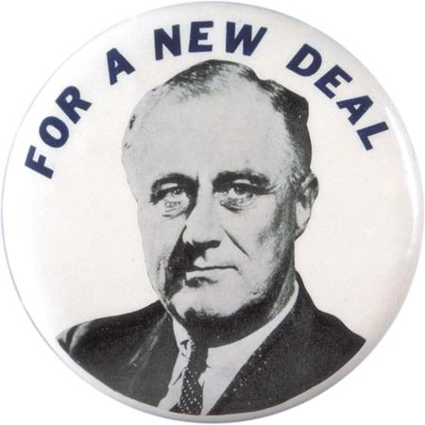
Legacy of the New Deal
The greatest impact of the New Deal is perhaps the extent to which it expanded the power of the federal government.
By infusing the nation’s economy with millions of dollars, creating federal jobs, attempting to regulate supply and demand, and increasing government involvement in settling labor and management disputes, New Deal reforms gave the government (especially the President) a more active role in shaping the economy.
It changed the relationship between the government and the citizens.

