Slide 1
US History
EOC Review

Slide 2
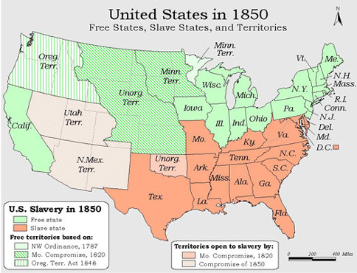
Civil War / Reconstruction
Sectional Issues
North | South
Supported the rights of the federal govt. Protective tariff Prevent spread of slavery west Industrial | Supported states rights Lower tariffs Support popular sovereignty to solve slavery issue Agricultural

Slide 3
Civil War and Reconstruction
Northern Advantages | Southern Advantages
- Larger Military - Transportation- Railroads - Industrial Resources | - Generals- Robert E. Lee, Stonewall Jackson Fighting on their own soil Fighting to preserve their way of life

Slide 4
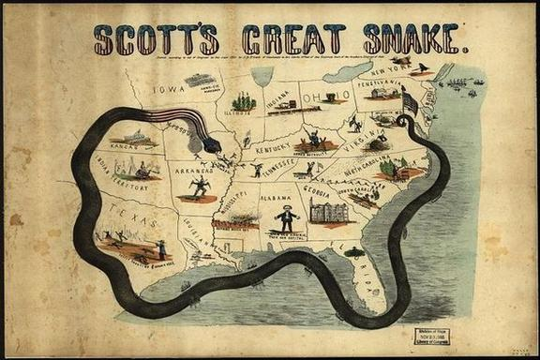
Civil War / Reconstruction
Anaconda Plan
Northern plan to blockade Southern ports,
seize the Mississippi, divide
the Confederacy and
capture Richmond

Slide 5
Civil War and Reconstruction
Key Groups and People-
Abraham Lincoln – President of the Union (North)
Radical Republicans – support rights of freedmen
Thaddeus Stevens, Wade Davis
Freedmen’s Bureau – helped Freedmen, built schools
Ulysses S. Grant – Union general, corruption scandal during Presidency
Hiram Rhodes Revels – first African American elected to Congress

Slide 6
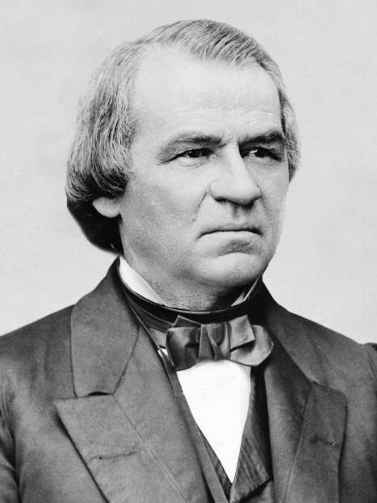
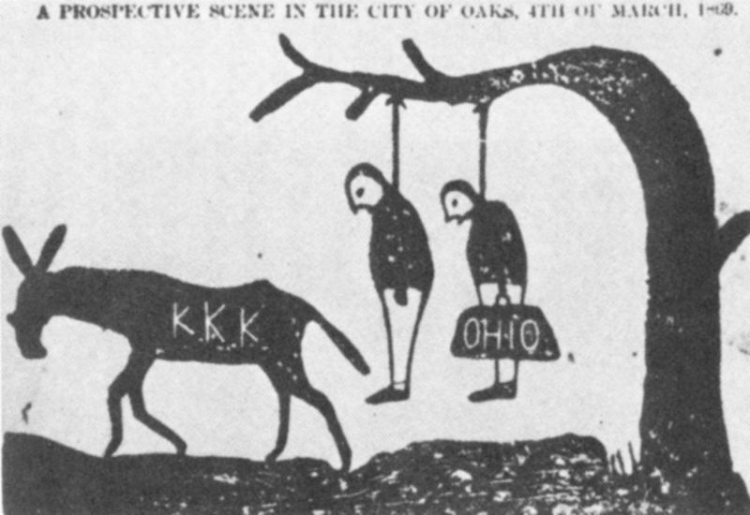
Civil War and Reconstruction
Challenges to Reconstruction
Andrew Johnson – Vice President who succeeds Lincoln, Democrat from the South, against the Radical Republicans
Ku Klux Klan – terrorist group

Slide 7
Civil War and Reconstruction
Who were the Carpetbaggers? Scalawags?
Carpetbaggers – Northerners who came to the south for political and economic advantages.
Scalawags – Southerners who sided with Northern Republicans and supported Reconstruction.

Slide 8
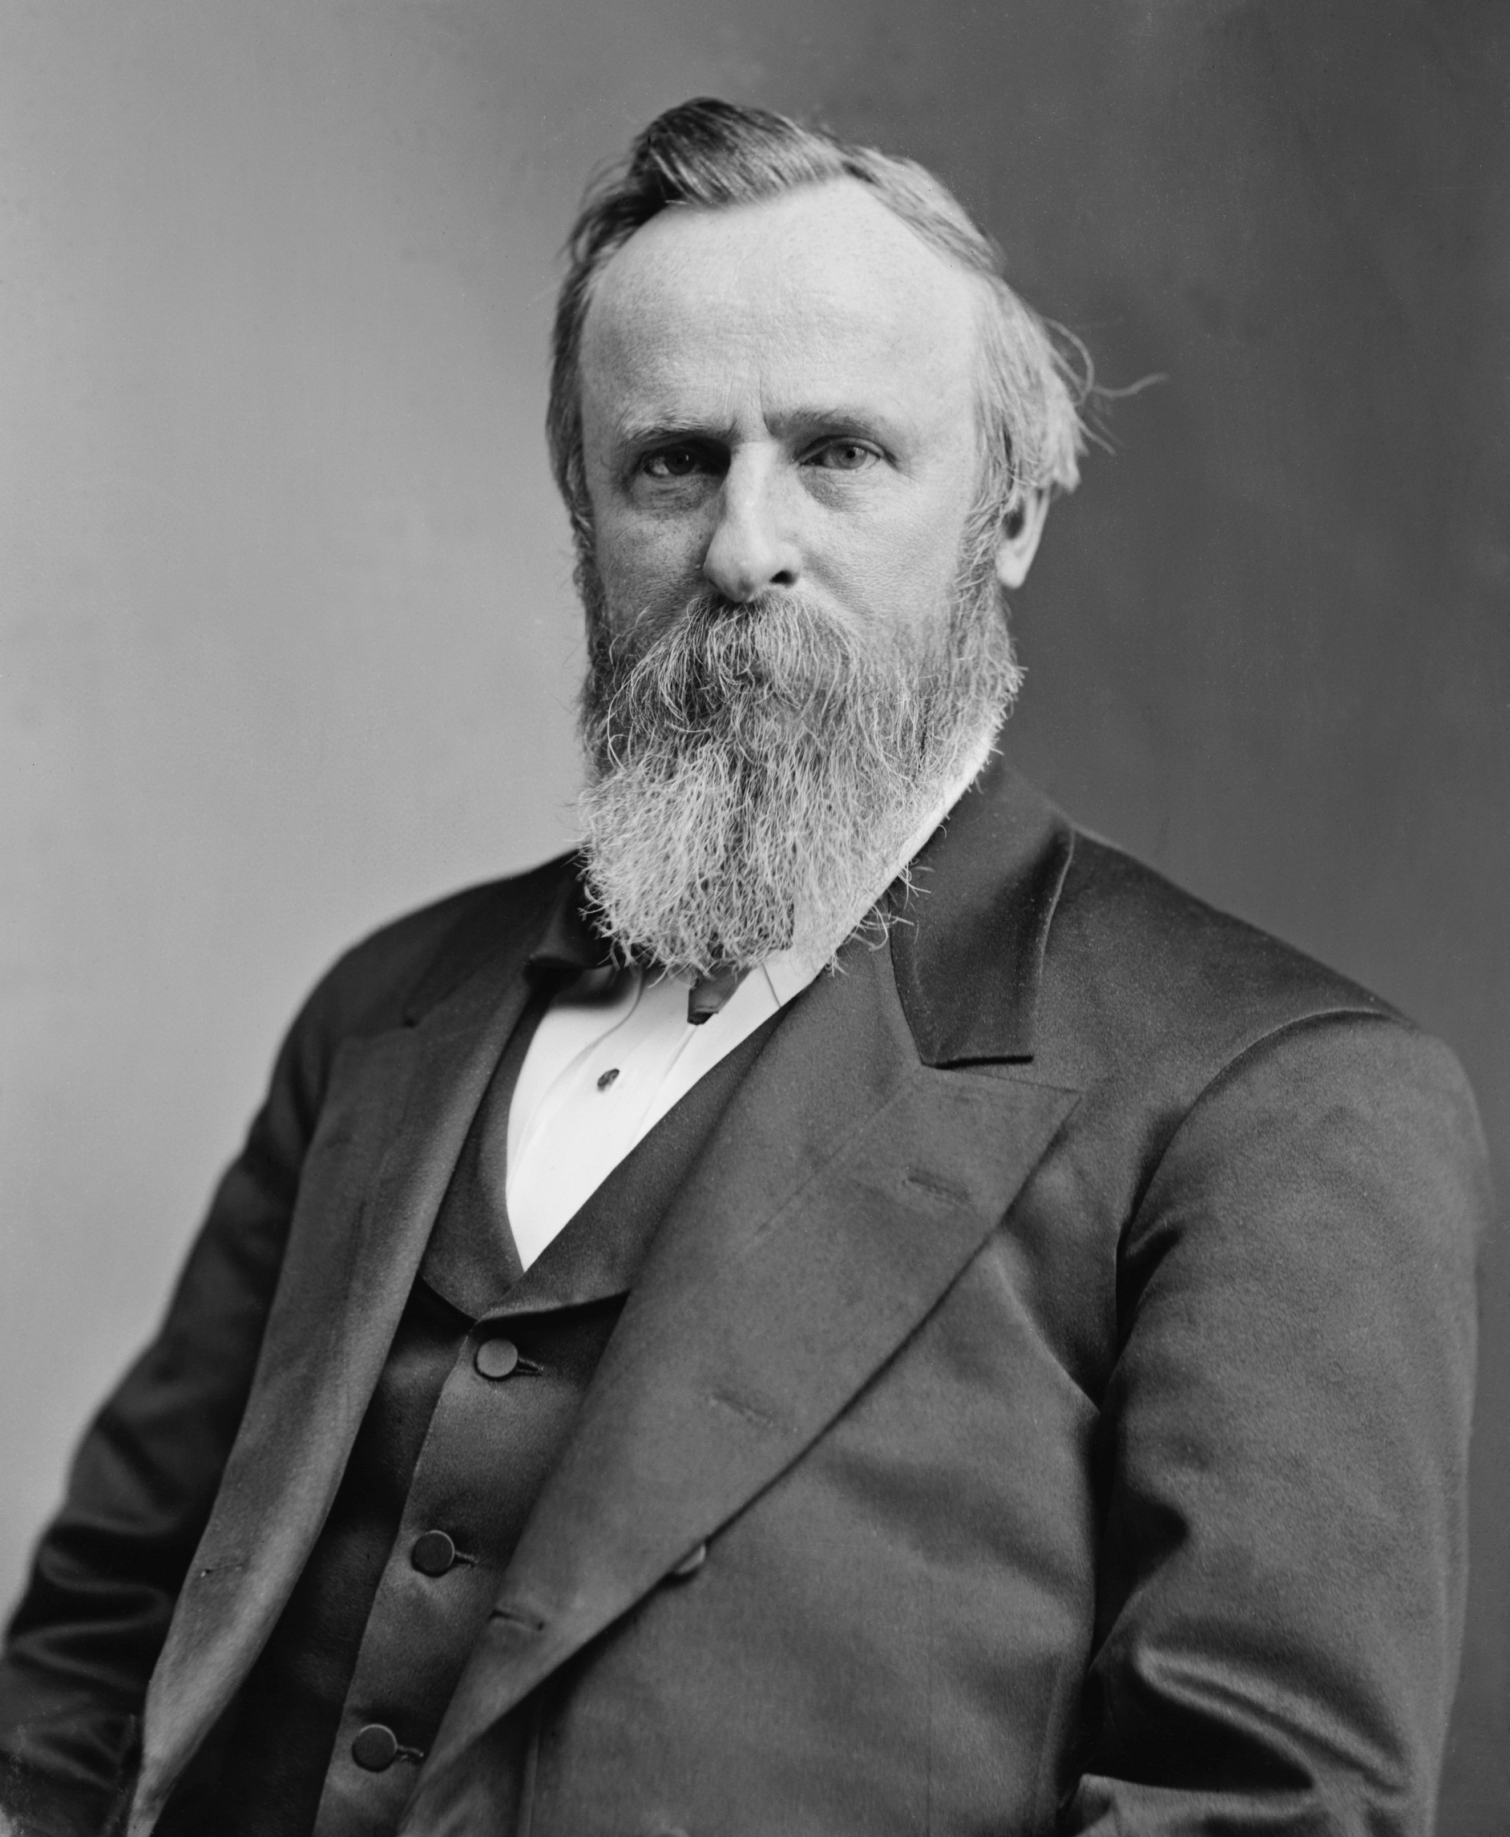
Civil War and Reconstruction
How did Reconstruction end?
It ended with the Compromise of 1877-
where all federal troops were pulled from the South and Congressional Reconstruction
ended.
Hayes becomes the President

Slide 9
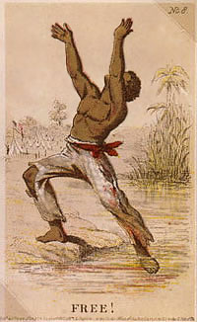
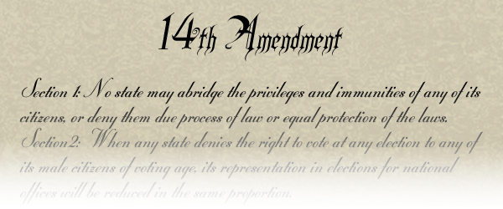
Civil War and Reconstruction
13th Amendment | 14th Amendment | 15th Amendment
Freed the slaves | Gave African Americans citizenship | Gave African American males the right to vote

Slide 10
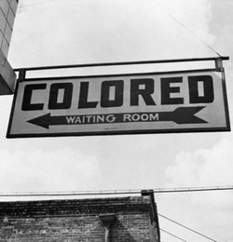
Civil War and Reconstruction
What were Black Codes?
Laws in the United States after the Civil War that limited civil rights and civil liberties of African Americans
Jim Crow – legalizes segregation
Apartheid

Slide 11
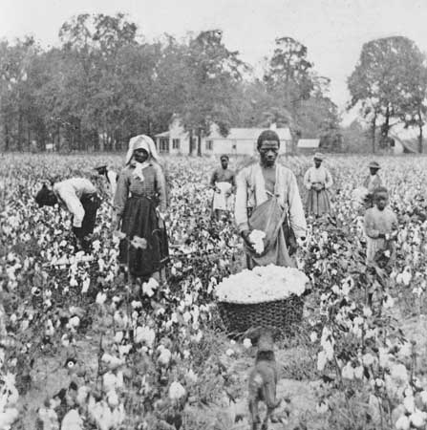
Civil War and Reconstruction
What was sharecropping?
A system in which a farmer tended a portion of a planter’s land in return for a share of the sale of crops
Kept many southern whites and blacks in debt

Slide 12
Civil War and Reconstruction
Homestead Act
Offered 160 Acres of land after farming five years
Encouraged westward settlement
Reservation System
Forced natives onto Reservations

Slide 13
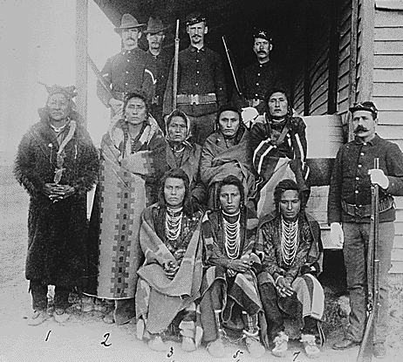
Civil War and Reconstruction
What was the Dawes Act?
A law passed in 1887 that divided reservation land into family plots
It attempted to take away traditional Indian culture and assimilate them into white society.

Slide 14
Civil War and Reconstruction
What was the Plessy v. Ferguson case about?
It legalized segregation (separate but equal) in America until Brown v. Board of Education in 1954.

Slide 15
Civil War and Reconstruction
Civil Rights Act 1866
Passed over Johnson’s veto, grants freemen rights to citizenship, and overturns black codes

Slide 16
Practice Question #1
Which event was the catalyst for the secession of the first seven Southern states?
A. Passage of a higher protective tariff
B. Issuance of the Emancipation Proclamation
C. The election of Abraham Lincoln
D. the shipment of Union supplies to Ft. Sumter

Slide 17
Practice Question #2
The Anaconda Plan - “So as to envelope the insurgent States and bring them to terms, with less bloodshed then by any other plan”.
What was the main objective of the plan described in General Scott’s letter?
A. To attack and bring under control a few key Southern cities
B. To disrupt Southern supply lines by controlling and railroad junctions in the South
C. to sign treaties with Britain and France to prevent them from assisting the South.
D. To suffocate the South by controlling the Mississippi River and the southern ports

Slide 18
Practice Question #3
Black Codes
Jim Crow Laws
What phrase completes the diagram on the left?
Discriminated against African Americans
Required racial segregation in all public places
Provided American’s of all races equal rights under the law
Denied African Americans freedom of movement and basic civil rights
?

Slide 19
Practice Question #4
The excerpt below is from the Supreme Court’s decision in Plessy v. Ferguson (1896).
Laws permitting, or even requiring, the separation of the races do not place a badge of inferiority upon one group over another. Thus, it is not a violation of the Fourteenth Amendment.
What practice is this ruling uphold?
A. Job training for freedom
B. Free public schooling for all races
C. Racial segregation in public places
D. African-American participation in politics

Slide 20
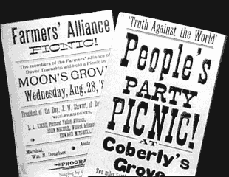
Industrial Revolution
What were the goals of the Populist Party?
Known as People’s Party, this political party formed in 1891 to advocate for a larger money supply (coinage of “free silver”), and government ownership of railroads.

Slide 21
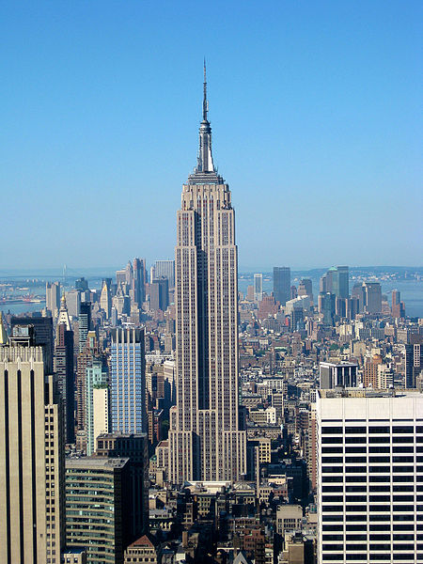
Industrial Revolution
What were some 19th century inventions?
Elevators – James Otis
Bessemer Process – Carnegie
Sky scrapers
Mass transit
Light bulb - Edison
Telephone - Bell
Railroad – Vanderbilt, Rockefeller, Carnegie
Automobile / Assembly Line – Henry Ford

Slide 22
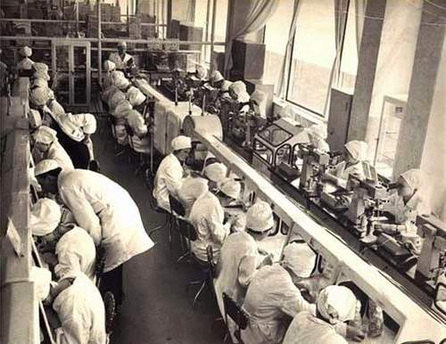
Industrial Revolution
What were the impacts of industrialization?
Time Zones
Mass Production
Farmers move to cities to work in factories
Pollution
Rise of big business- monopolies
Beginning of the labor movement

Slide 23
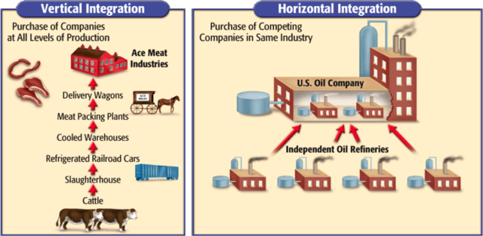
Industrial Revolution
What were vertical and horizontal integration?

Slide 24
Industrial Revolution
Government Regulation
Sherman Anti-trust Act
Break up monopolies, failed, used against labor unions
Interstate Commerce Commission
Regulated interstate railroads

Slide 25
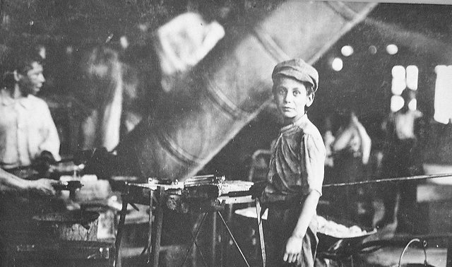
Industrial Revolution
Child Labor
Textile mills
Coal Mines
Paid less than adults
1 out of 5 worked
Deprived of education
and nutrition

Slide 26
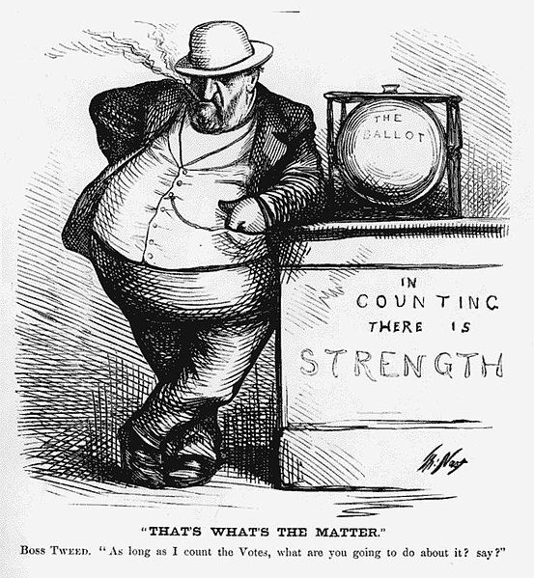
Industrial Revolution
Political Bosses/Machines
A political machine is an organization controlled by a boss that gets citizens to vote for its candidate on election day
People worked for the machine in exchange for political favors and rewards
Ex. Boss William Tweed ran Tammany Hall, NYC

Slide 27
Industrial Revolution
What is Social Darwinism?
A belief that the best and most qualified will survive in business
What is the government policy of hands-off business regulation?
Laissez Faire

Slide 28
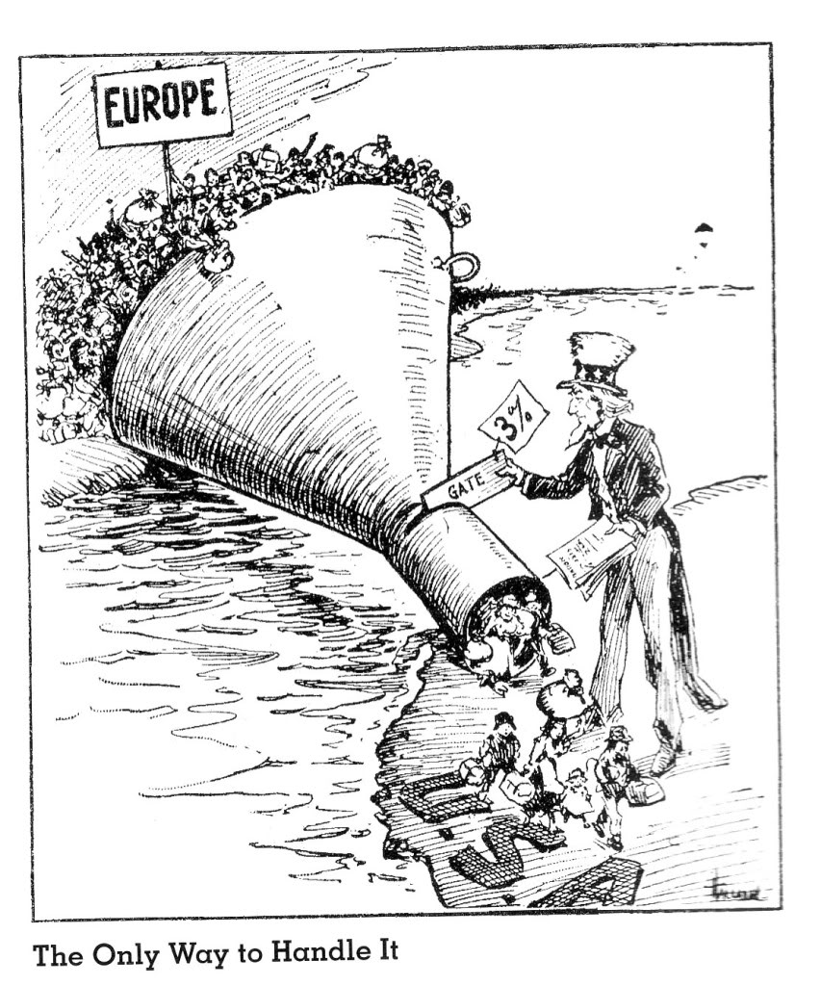
Industrial Revolution
Who were nativists?
A person who favors native born Americans over immigrants
Portrayed hostility, hatred, and distrust of new immigrants

Slide 29
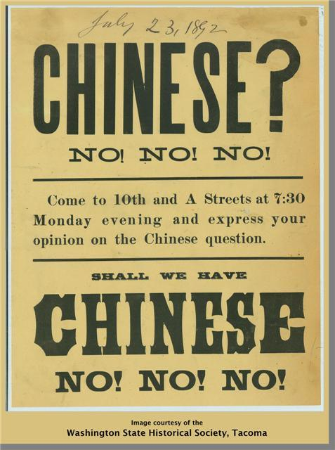
Industrial Revolution
What was the Chinese Exclusion Act?
1882 law that prohibited the immigration of Chinese laborers
What was the Gentlemen's Agreement with Japan?
Law limiting how many Japanese immigrants were allowed

Slide 30
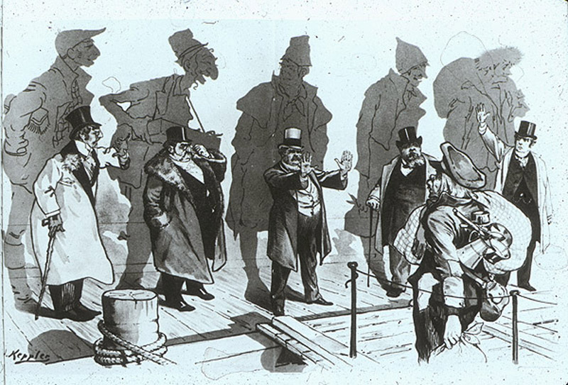
Industrial Revolution
Old Immigrants | New Immigrants
Northern and Western Europe Came in small numbers Mostly Protestant Farmers Spoke English Easily Assimilated | Southern and Eastern Europe Came in large numbers Varying religions (Jews, Catholics, Orthodox) Construction workers/ factory jobs Few spoke English Not easily assimilated
Both came for economic reasons!!!

Slide 31
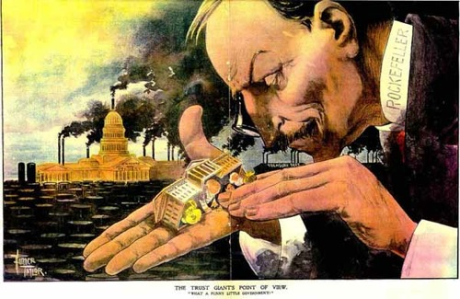
Industrial Revolution
Who came up with the term “Gilded Age”?
Mark Twain
What does it mean?
Post- Reconstruction era characterized by a façade of prosperity

Slide 32
Industrial Revolution
Muckrakers
Journalists who exposed problems of the Gilded Age
Ida Tarbell – “History of the Standard Oil Company”
Upton Sinclair – The Jungle, meat packing
Jacob Riis – How The Other Half Lives
Jane Addams – Hull House and Settlement House movement
Gifford Pinchot controversy
Chief of US Forestry Service, resulted in conservation of forests
Pres. Taft fired him, launched attacks, resulted in rift between T. Roosevelt and Taft, split of Republicans

Slide 33
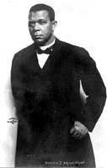
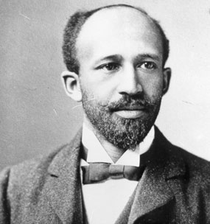
Industrial Revolution
Booker T Washington | W.E.B. DuBois
Gradual Change Blacks should earn their rights Vocational job training Economic gains rather than legal ones | Immediate Change Given Rights Higher Education Founded the NAACP, National Association for Advancement of Colored Peoples

Slide 34
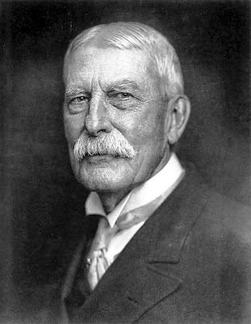
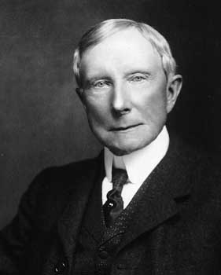
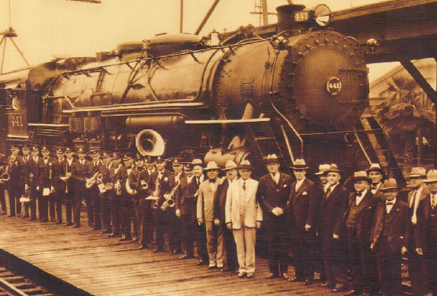
Industrial Revolution
Who built the Florida East Coast Railroad?
Henry Flagler John D. Rockefeller

Slide 35
Practice Questions
5. Which group favored the passage of the Chinese Exclusion Act of 1882?
Imperialist in Congress
Nativists on the West Coast
Progressives from the Midwest
Anarchists who immigrated from Europe

Slide 36
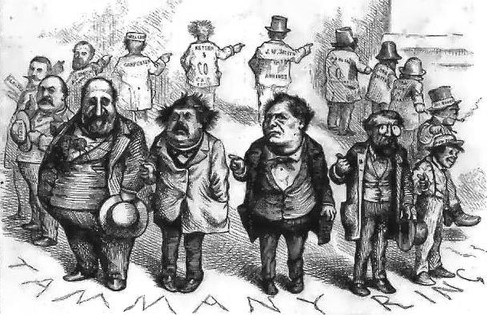
Practice Questions
6. The cartoon at the right by Thomas Nast was published in 1871. Which problem is addressed in the cartoon?
New citizens were often unable to exercise voting rights
City governments were providing inadequate services to residents
Political machines were profiting from kickbacks on public contracts
The deadlock between political parties was costing tax payers money
Who stole the people’s money? Twas him.

Slide 37
Practice Questions
7. How did the “New Immigrants” differ from the “Old Immigrants”?
A. Most of them were protestant
B. Most of them spoke very little English
C. They came seeking new economic opportunities
D. They were generally accepted by native born Americans

Slide 38
Practice Questions
The excerpt below is from William Jennings Bryan’s speech at the Democratic Convention in 1896.
Having behind us the producing masses of this nation and the world, supported by the commercial interests, the laboring interests, and the toilers everywhere, we will answer their demand for a gold standard by saying to them: “You shall not press down upon the brow of labor this crown of thorns; you shall not crucify mankind upon a cross of gold.”
Based on this speech, what did Bryan demand in his subsequent campaign for Presidency?
The acquisition of colonies to increase employment opportunities
The creation of a national park system to protect the nations wildlife
A policy of bimetallism that would help farmers by raising crop prices
Higher tariffs to protect American manufacturers from foreign competition

Slide 39
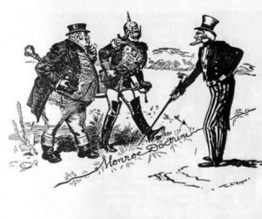
World Affairs Through WWI
What was the Monroe Doctrine?
Foreign policy that discouraged European intervention in the Western Hemisphere

Slide 40
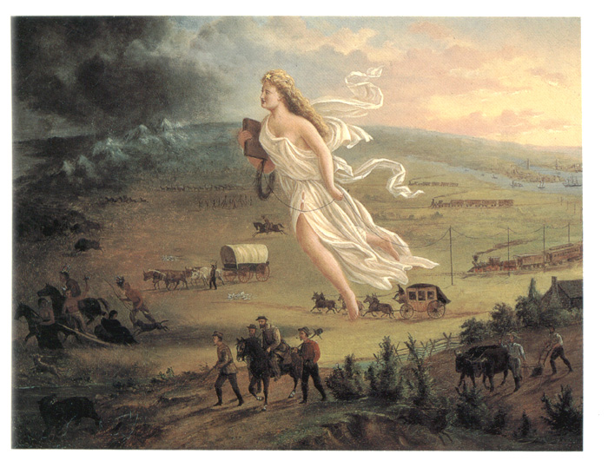
World Affairs Through WWI
What was Manifest Destiny?
Belief that westward expansion of the US was not only inevitable but a God-given right

Slide 41
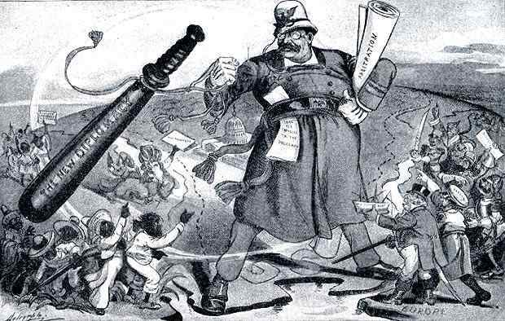
World Affairs Through WWI
What was the Roosevelt Corollary?
America can intervene when it seems necessary to maintain stability in the Western Hemisphere.
An extension of the Monroe Doctrine!

Slide 42
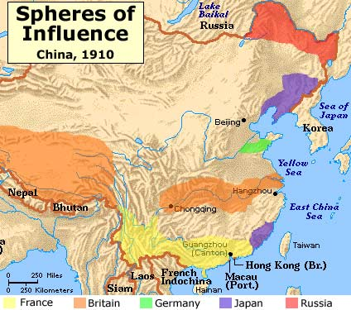
World Affairs Through WWI
What was the Open Door Policy?
Established equal trading rights in China for all nations.
Helped increase American trade in China.

Slide 43
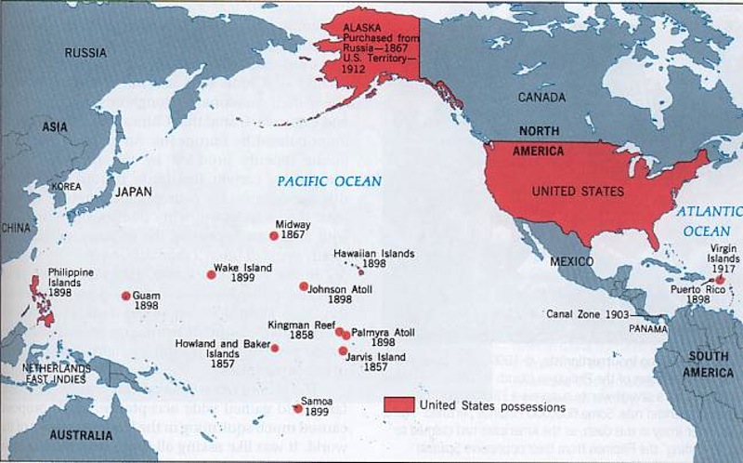
World Affairs Through WWI
Where were American imperialistic efforts focused in the Pacific?
China, Japan, Hawaii, Philippines, Panama

Slide 44
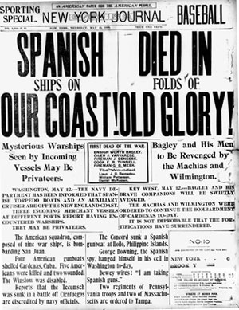
World Affairs Through WWI
What was yellow journalism?
Sensational headlines and exaggerated stories in order to sell newspapers or support a cause.
Who are examples of yellow journalists?
Joseph Pulitzer, William Randolph Hearst
“You furnish the pictures and I’ll furnish the war.”
William Randolph
Hearst

Slide 45
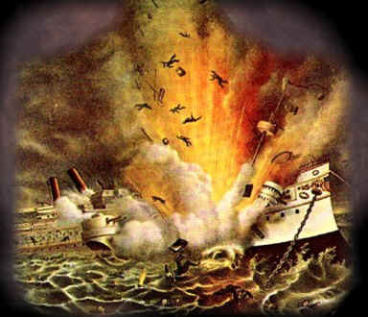
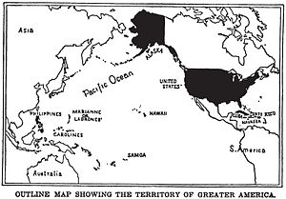
World Affairs Through WWI
What event led to the Spanish-American War?
The sinking of the USS Maine
Imperialist beliefs that stronger nations should control weaker ones
What were the results?
America gained the Philippines, Puerto Rico, and Guam

Slide 46
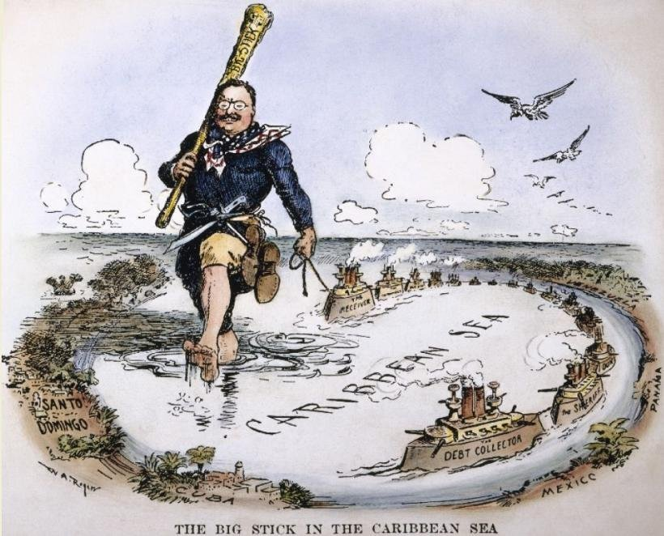
World Affairs Through WWI
What was Roosevelt’s “Big Stick” policy?
“Speak softly and carry a big stick.” US sends troops to the Caribbean, known as “America’s lake”. Resented by Latin Americans

Slide 47
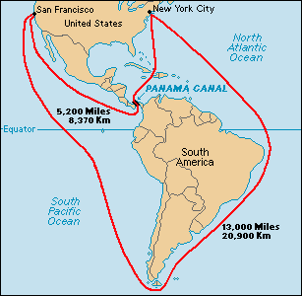
World Affairs Through WWI
Panama Canal / Yellow Fever
US supports Panamanian independence from Columbia; granted 10 mile strip of land to build the canal
Mosquitos carried malaria and yellow fever More than 10 years to complete, thousands of lives, and $400 million

Slide 48
World Affairs through WWI
Sussex Pledge
Germany agrees not to sink anymore merchant ships without prior warning(1916)
British continued to use convoys, groups of merchant ships traveling together, protected by 1 or more battleships.

Slide 49
World Affairs through WWI
Long Term Causes
M – Militarism
A – Alliances
I- Imperialism
N – Nationalism
Immediate Causes
Assassination of Archduke Frantz Ferdinand

Slide 50
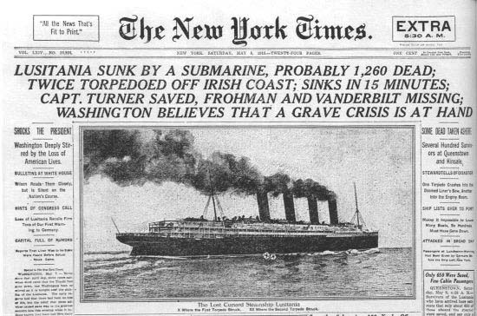
World Affairs Through WWI
Why did the US enter WWI?
German policy of unrestricted submarine warfare
Sinking of the Lusitania
Zimmerman Note

Slide 51
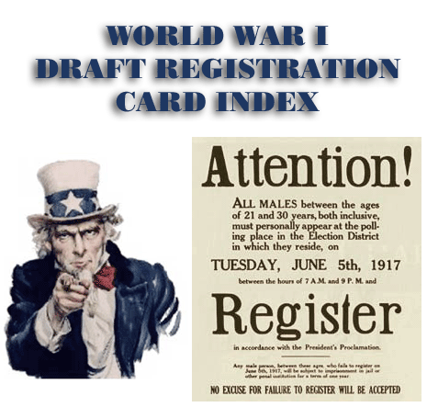
World Affairs Through WWI
How was America impacted during WWI?
1. Selective Service Act- draft
2. War Industries Board- committee to coordinate war industry production
3. Committee of Public Information- government agency that encouraged support for the war
4. Espionage Act – Schenk v. United States, clear and present danger established

Slide 52
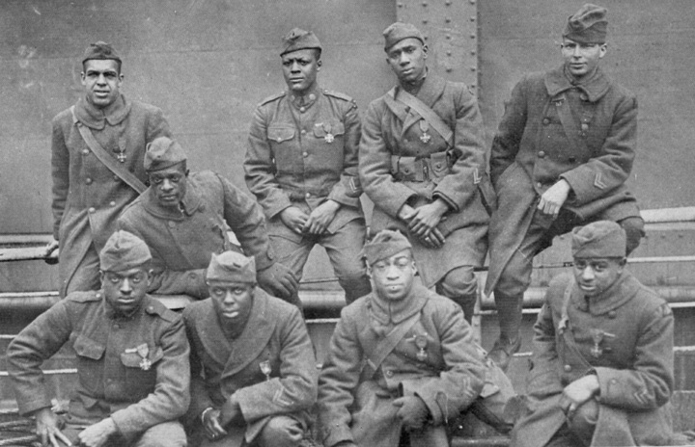
World Affairs Through WWI
What was the experience of African American soldiers during WWI?
Fought in segregated units
What was the Great Migration?
A great movement of African Americans from the rural south to the industrial north.

Slide 53
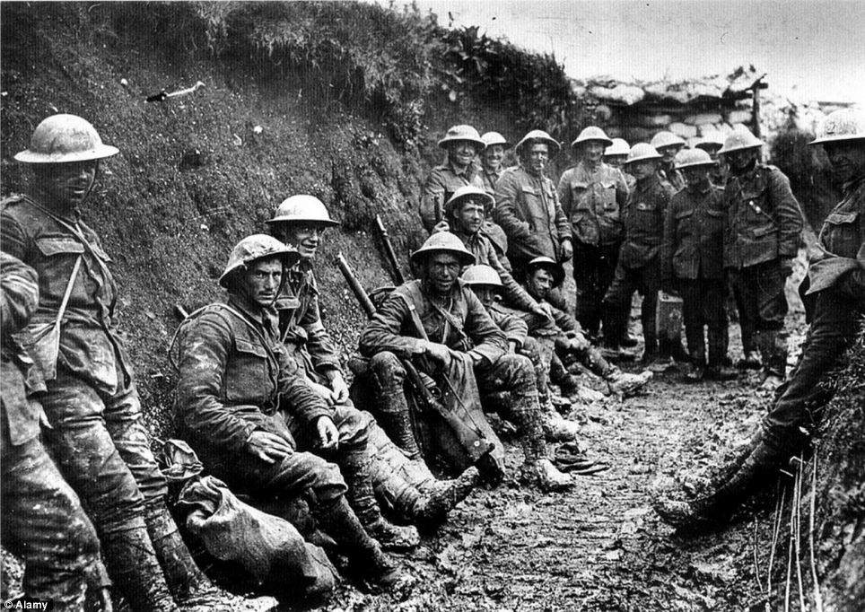
World Affairs Through WWI
New Technology
Submarines (U-Boats)
Airplanes
Tanks
Flame Throwers
Poisoned Gas / Chemical
Trenches

Slide 54
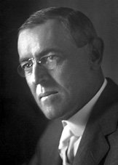
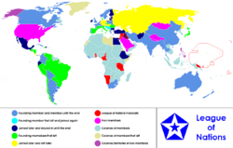
World Affairs Through WWI
What were Wilson’s 14 Points?
A list of terms for resolving WWI and future wars
- Included the creation of the League of Nations, freedom of the seas, disarmament

Slide 55
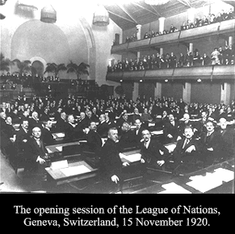
World Affairs Through WWI
What was the League of Nations?
A world organization to promote peaceful cooperation between countries
US never joins!

Slide 56
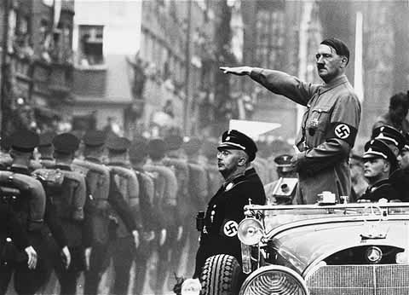
World Affairs Through WWI
What was the Treaty of Versailles?
The treaty ending WWI that punished Germany
Germany had to accept responsibility for the war, pay heavy reparations, disarm
Rejected by the US Senate

Slide 57
Practice Questions
9. Why is the Spanish American war of 1898 often considered a major turning point in US History?
It revealed that the United States had become a world power
It marked the first American victory over a European power
It demonstrated the need for better communications in war time
It showed American support for European economic interests in East Asia

Slide 58
Practice Questions
10. The diagram below provides details about the United States involvement in the Philippines during the early 1900’s.
Which phrase completes the diagram?
A. The US Senate refuses to annex the Philippines
B. Filipino leaders invite the US to annex the Philippines
C. American businessmen over through the local ruler of he Philippines
D. US forces fight a three year war against Filipino rebels seeking independence.
Spain leaves Philippines under Treaty of Paris
??
United States establishes colonial government in the Philippines.

Slide 59
Practice Questions
11. Why did the United States ultimately fail to ratify the Treaty of Versailles in 1919?
Many Senators opposed the sever sanctions that the treaty placed on Germany.
Many Senators feared the League of Nations would involve the US in foreign wars.
Many Senators felt the League of Nations would interfere with American plans in the Philippines.
Many Senators predicted that the membership in the new League of Nations would be too expensive.

Slide 60
Practice Questions
12. The excerpt below is from Supreme Court Justice Oliver Wendell Holmes’ opinion in Schenck vs. the United States, 1919.
The question in every case is whether the words used are used in such circumstances and are of such a nature as too create a clear and present danger that they will bring about the substantive evils that Congress has a right to prevent.
Based on the excerpt, which statement would Oliver Wendell Holmes have agreed with?
A. Freedom of speech is not absolute
B. Prayer in public schools in unconstitutional
C. Immigration from other countries cannot be permitted during wartime
D. Criticism of policies of allied countries must be temporarily prohibited in war time.

Slide 61
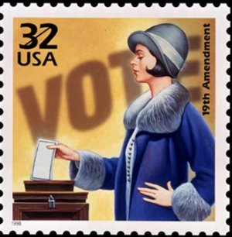
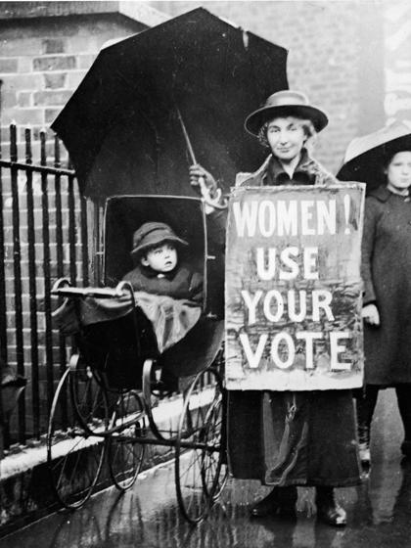
Roaring Twenties and the Great Depression
What was the 19th Amendment?
Granted women the right to vote, as reward for women’s efforts in the war.
Efforts made by the National Women’s Suffrage Association (NAWSA)

Slide 62
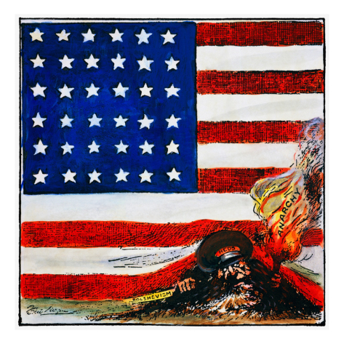
Roaring Twenties and the Great Depression
What was the first Red Scare?
1920s reaction against socialism and communism in America
Fear of communism after the Bolshevik Revolution

Slide 63
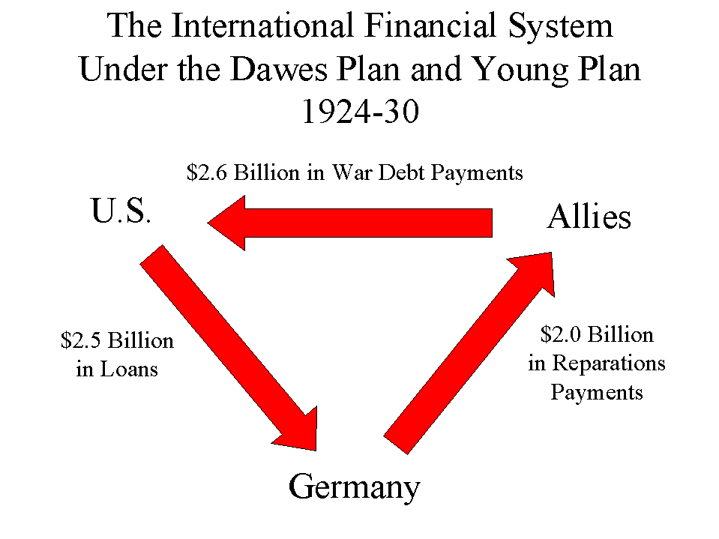
Roaring Twenties and the Great Depression
Describe 1920’s foreign economic policy.
Dawes Plan- US loans to Germany so they could make reparation payments to Britain and France, who would repay their debts to the US.

Slide 64
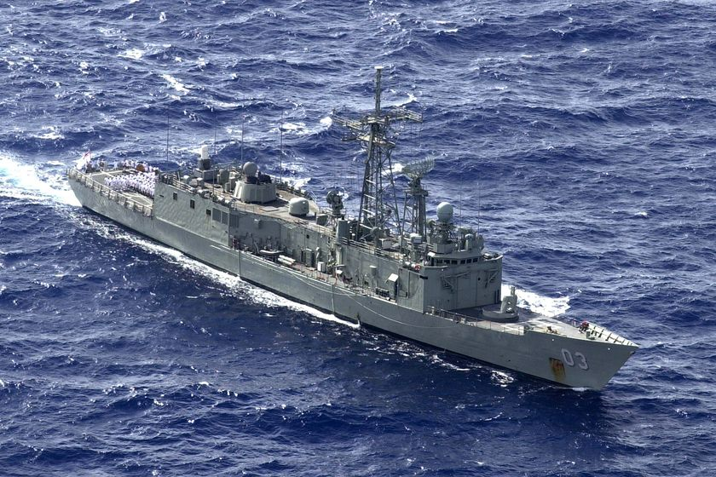
Roaring Twenties and the Great Depression
What was the Washington Naval Conference?
A meeting where world leaders agreed to limit the construction of warships.

Slide 65
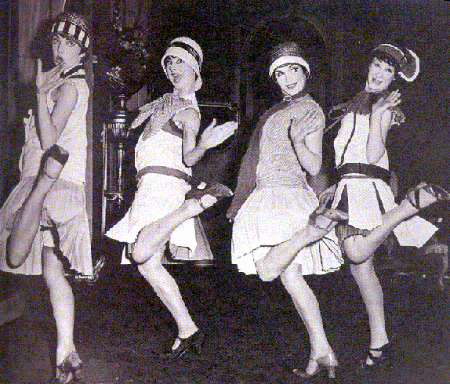
Roaring Twenties and the Great Depression
Describe 1920’s America.
Harlem Renaissance - NAACP
Prohibition- Speakeasies, Mafia
National Origins Act
Scopes Trial /
Fundamentalist movement
Rise of the 2nd Klan

Slide 66
Roaring Twenties and Great Depression
Causes of the Depression
Economic Boom
Buying on Margin / Installment Buying
Bull Market – a stock market in which stock prices were steadily increasing as result of speculation
Hawley Smoot Tariff – highest tariff in history
Stock Market Crash and bank runs

Slide 67
Roaring Twenties and the Great Depression
What was the New Deal?
Federal government (FDR’s) laws promoting recovery and providing relief to Americans.
Examples
Works Progress Administration
Expanded the role of government!

Slide 68
Roaring Twenties and the Great Depression
What was the effects of the new deal on minorities?
African Americans- Roosevelt’s “Black Cabinet” advised the president, but he did not always follow their advice- refused to support an anti-lynching law.
- Mary McLeod Bethune
Native Americans- provided economic
assistance and gave them greater control over
their own affairs.
Women- provided some women with the opportunity to increase their political influence and promote women’s rights, but did not end gender discrimination in the workplace

Slide 69
Roaring Twenties and the Great Depression
What was the effect of the New Deal on farmers?
Agricultural Adjustment Act- (AAA) paid farmers not to plant crops to combat overproduction
Rural Electrification Administration- (REA) brought electricity to rural areas
The government provided price support to farmers

Slide 70
Practice Questions
13. What did African American writers, artists and musicians hope to achieve during the Harlem Renaissance?
To display their ability as conscientious workers in the workplace
To show that the pursuit of material success can often lead to tragedy
To demonstrate that African Americans could produce great works of literature and art
To reveal that conditions for African Americans in the South were just as bad in the North

Slide 71
Practice Questions
This diagram below provides details about the Great Depression.
Which phrase completes the diagram?
War in Europe
Agricultural Drought
Overproduction of Goods
Introduction of New Technology
Speculation on the Stock Market
High Tariffs Restrict International Trade
Causes of the Great Depression
Uneven distribution of income
?

Slide 72
Practice Questions
14. How did the plans of Presidents Herbert Hoover and Franklin D. Roosevelt compare for dealing with the Great Depression?
Hoover gave emergency loans to banks and businesses while Roosevelt opposed such programs.
Both Presidents believed the federal government should provide direct payments to the unemployed.
Hoover increased federal spending on public works projects like Hoover Dam while Roosevelt opposed such projects.
Roosevelt proposed that the federal government provide direct employment to the needy while Hoover relied more on local government and private charities

Slide 73
Practice Questions
15. How did popular attitudes toward the federal government shift during the Great Depression?
Public opinion turned against new federal programs because of increased taxes.
People concluded that state governments were better at promoting economic growth.
Voters grew distrustful of the federal government because they felt it favored the wealthy.
Americans came to expect the federal government to help them solve their economic problems.

Slide 74
WWII
What was the US foreign policy from 1939-1941?
Non-Intervention
Neutrality Acts- Americans could not sail on ships flying the flag of a belligerent nation or trade arms with warring nations.
Cash-Carry- US could trade arms as long as the nations paid cash and transported their own goods
Lend-Lease-to lend, lease, sell, or barter arms to any country whose defense the President deems vital to the defense of the United States

Slide 75
WWII
What was the “date that will live in infamy”?
Dec 7, 1941
The Japanese attack on Pearl Harbor
US enters WWII!

Slide 76
WWII
What was the result of Korematsu v United States?
February 19, 1942, President Franklin Roosevelt issued Executive Order 9066, granting the U.S. military the power to ban tens of thousands of American citizens of Japanese ancestry from areas deemed critical to domestic security.
Japanese internment camps established.
Civil Rights Denied!

Slide 77
WWII
How was Palm Beach county affected during WWII?
Lights from homes and businesses on land would create silhouettes of the Allies’ supply ships, making them easy targets for German U-boats
The U.S. Government issued blackout restrictions along the East Coast, enforced by Civil Defense wardens.

Slide 78
WWII
How was the home front impacted during WWII?
Selective Service System- Draft
War Production Board- Government takes over factory production
Office of War Information- Propaganda
Rationing
Victory Gardens

Slide 79
WWII
Holocaust- the systematic slaughter of millions of Jews and other peoples.
Anti-Semitism- prejudice against Jews
Final Solution- Decision to exterminate the Jews in the concentration camps

Slide 80
WWII
US Reaction to the Holocaust
He believed that by liberating Europe from Nazi control more people could be saved.
St. Louis Jewish refugees denied entrance into the US.

Slide 81
WWII
Nuremberg Trials- over 20 Nazi officials were found guilty for “crimes against humanity”

Slide 82
WWII
Hiroshima and Nagasaki- Cities where the US dropped the atomic bomb on Japan
Atomic Weapons- developed during the Manhattan project
Robert Oppenheimer
New Mexico
Video

Slide 83
Practice Questions
16. How did methods of warfare in World War II differ from those in WWI?
Soldiers spend most of their time in trenches to avoid machine gun fire
Because of a shortage of man power, women fought overseas in combat roles
Germans submarines frequently attacked British and American shipping
Airplane, tank, and troop movements were coordinated for rapid advances.

Slide 84
Practice Question
17. Which of the following shows the correct sequence of events in WWII?
A. Pearl Harbor, Battle of Midway, D-Day, V-E Day, V-J Day
B. Pearl Harbor, Battle of Midway, V-J Day, D- Day, V-E Day
C. Battle of Midway, D-Day, V-E Day, Pearl Harbor, V-J Day
D. D-Day, V-E Day, Pearl Harbor, Battle of Midway, V-J Day

Slide 85
Practice Question
18. The posters below were created by the U.S government during WWII.
Which generalization do these posters support?
Women refused to volunteer to assist in the war effort
The government urged women to fill jobs left vacant by men
The government tried to recruit women for combat in war.
Female military officers commanded both male and female troops

Slide 86
Practice Question
19.Which Civil Rights leader helped to draft the United Nations Charter?
A. James Doolittle
B. Fred Korematsu
C. A. Philip Randolph
D. Mary McLeod Bethune

Slide 87
Cold War
What was America’s foreign policy in the 1940’s after WWII?
Confrontation and Competition b/w Russia and the US (cold war).
Containment-Stop the spread of Communism.

Slide 88
Cold War
What decisions were made at Yalta?
Discussed the creation of the UN
Germany divided into 4 occupational zones
Soviets would join the war in Asia against Japan

Slide 89
Cold War
What was the purpose of the United Nations?
To address factors which might lead to war
Peace keeping organization
Security Council- US, China, Britain, France, and Soviet
193 countries are members

Slide 90
Cold War
What was Churchill’s Iron Curtain Speech?
The term “Iron Curtain” symbolized efforts by the Soviet Union to block itself and Eastern Europe off from the West and non-Communist countries.

Slide 91
Cold War
What was Churchill’s Iron Curtain Speech?
An armed, concrete wall that separated the Soviet section of the city from the rest of Berlin.

Slide 92
Cold War
Why did the U.S. begin the Marshall Plan?
Provide economic aid to Europe after WWII.
Promote democracy in weaker nations.
$13 billion

Slide 93
Cold War
What was the purpose of the Truman Doctrine?
Contain communism in Europe by the Marshall Plan and NATO
NATO
Warsaw Pact

Slide 94
Cold War
What was McCarthyism?
Search for Communists and their sympathizers by falsely accusing people.
Loyalty Review Boards-
(HUAC) conducted investigations of govt. employees thought to be Communists.

Slide 95
Cold War
Why was there a 2nd Red Scare in America after World War II?
The Cold War between the Soviets and the US.
The Soviets developed an Atomic weapon
Fear of spies among us giving or selling secrets to our enemies
Rosenbergs sentenced to
death for spying

Slide 96
Cold War
What was the significance of the Russian launch of Sputnik I?
Soviet Union was ahead of the US in Science
Education changes – National Defense Education Act
US creates
NASA

Slide 97
Cold War
What was the Cuban Missile Crisis?
Seen as Kennedy’s greatest foreign policy success
Persuaded Cubans and Russians to back down on nuclear attack
Result: Americans and Soviets established “hot line” between each other’s leaders (red phone).

Slide 98
Cold War
What was the outcome of the Korean War?
Cease fire
Korea remained a divided nation
Domino Theory

Slide 99
Cold War
Indochina
Vietnam, Laos, Cambodia formally ruled by the French – south of China
Ho Chi Minh – leader of Northern Vietnamese Communists who fought first French then American imperialist power

Slide 100
Cold War
Gulf of Tonkin
Gave President Johnson the authority to wage war in Vietnam.
Took war powers from Congress

Slide 101
Cold War - US involvement in Vietnam
1955- Eisenhower sends advisors
1961- Kennedy sends 100 special forces
1964- Gulf of Tonkin
1966- 190,000 American troops in Vietnam
1968- Tet Offensive
1969- US bombs Cambodia
1970- Nixon begins withdrawing troops
1973- All US troops are withdrawn
1974- South Vietnam falls to Communism

Slide 102
Cold War
Vietnamization
Withdrawing American troops and replacing with South Vietnamese
Détente
Easing of tensions
Began in 1971 with Nixon
SALT I and II
Doves – antiwar supporters
Gorbechev’s glasnost – openess, free to criticize w/out fear
Gorbechev’s perestroika – free enterprise

Slide 103
Practice Questions
20. Which of these conditions was an economic cause of the Cold War in Europe?
Stalin resented the fact that western allies had delayed invasion of France during the war
Truman failed to share the secrets of the atomic bomb at the Potsdam Conference
The US had a capitalist system while the Soviets had a Communist system with central planning.
Stalin felt the Soviet Union had the right to establish a sphere of influence in Eastern Europe.

Slide 104
Practice Questions
21. Which statement best summarizes the outcome of the Korean War?
North Korea made minor gains in the South but lost territory in the North to China
A majority of Northern Koreans fled southward causing a collapse of the Northern Korean government.
North and South Korea remained divided at the 38th parallel, just as they had before the war.
Korea was reunited under the coalition government consisting of both Northerners and Southerners.

Slide 105
Practice Questions
22. Use the following:
National Aeronautics and Space Administration (NASA) was created.
National Defense Education Act was passed
Increased federal money was provided to improve schools, especially in math and science
More money was appropriated by the Congress for research and development
Which event sparked these changes?
The Soviet Union launched its satellite, Sputnik.
Mao Zedong led a successful Communist revolution in China.
North Korea crossed the 38th Parallel to invade South Korea.
Senator Joseph McCarthy announced the discovery of “Reds” in the State Department.

Slide 106
Practice Questions
23. What was an important consequence of the Cuban Missile Crisis?
The Soviet Union secretly kept nuclear missiles in Cuba pointed at Florida.
United States kept missiles in Turkey and Greece pointed at the Soviet Union.
Fidel Castro was removed from power in Cuba and all nuclear weapons were taken out of Cuba.
Soviet and American leaders established an emergency “hot line” and negotiated a partial test ban treaty.

Slide 107
Post War American Society
Huge surge in baby births between 1946-1960s
Need for more schools
Set consumer trends
Social Security problems beginning in 2011

Slide 108
Post War American Society
Suburbs / Highway System
Eisenhower signed the Federal Aid Highway Act in 1956
Shaped America into a world economic superpower and highly industrialized country
Suburbs, areas outside of cities, grow. Residential communities, single family homes.
America’s greatest
public works project!

Slide 109
Post War American Society
GI Bills
Low income mortgages
Low interest loans to start a business or farm
Tuition and living expenses
payments
Suburbs grow as a result
2.2 million veterans
took advantage of the
educational benefits!

Slide 110
Practice Questions
24. President Franklin Roosevelt signed the Servicemen’s Readjustment Act of 1944, better known as the “GI Bill”. What important benefits did this law provide to veterans returning from WWII?
Free medical care and a special retirement plan.
Low interest housing loans and a bonus payment after five years.
Low interest housing loans and payment towards high school, vocational school, or higher education.
The promise of a guaranteed jobs and payments towards high school, vocational school, and higher education.

Slide 111
Practice Questions
25. What was an important cause of American prosperity during the post- WWII period?
Most American married couples postponed having children in order to work longer.
American producers faced less competition because of destruction in Europe and Asia.
Women remained in the workforce after the war in order to increase American production.
The elimination of poverty through federal programs increased demand and stimulated production.

Slide 112
Practice Questions
26. What was an important impact of the Federal Highway Act in 1956?
State control of immigration routes had increased
Travel and trade between states became easier and faster than before.
Towns bypassed by the interstate system generally grew just as fast as those on interstate highways.
Increased traffic made it more difficult for the armed forces to move troops around the country.

Slide 113
Civil Rights / Social Movements
What were the main objectives of NOW?
Equal job opportunity
End of gender discrimination
Legalization of abortion

Slide 114
Civil Rights / Social Movements
What is Roe v. Wade
Limited the States’ abortion laws.

Slide 115
Civil Rights / Social Movements
Betty Friedan’s Feminine Mystique
Women are equal to men in their ability to do all kinds of jobs.

Slide 116
Civil Rights / Social Movements
What was President Johnson’s “Great Society”
Domestic programs to eliminate poverty and social injustice (ex. Head Start program)
Addressed education, medical care, urban problems and transportation
Under funded due to
the Vietnam War
Speech video
Similar to TR’s Square Deal in
that both attempted to address
the needs of society and
problems of cities

Slide 117
Civil Rights / Social Movements
Civil Rights Act of 1964
Outlawed discrimination
Ended segregation in the workplace
Signed by Johnson on 1964

Slide 118
Civil Rights / Social Movements
Voting Rights Act of 1965
Increased the participation of African Americans in all levels of political system.

Slide 119
Civil Rights / Social Movements
What were the Freedom Rides
Whites and African Americans rode buses to the South to bring attention to the South’s refusal to integrate.

Slide 120
Civil Rights / Social Movements
Rosa Parks
Began Montgomery, Alabama bus boycott by refusing to give up her seat on the bus.
Enter Martin Luther King, Jr. as a Civil Rights leader.

Slide 121
Civil Rights / Social Movements
Brown v. Board of Education
Overturned Plessy v Ferguson idea of separate but Equal
Little Rock Nine

Slide 122
Civil Rights / Social Movement
Black Panthers
Malcolm X
Start in CA
Protect black resident from police violence
Armed African Americans
Became face of black power movement

Slide 123
Practice Questions
27. Demonstrators attending the March on Washington are shown in this photograph. What was the main purpose of this event?
To demand an end to racial discrimination by federal contractors.
To demand that Congress pass Kennedy’s Civil Rights Bill
To demand enforcement of the Supreme Court’s decision to desegregate schools.
To demand reparations for centuries of oppression experienced by African Americans.

Slide 124
Practice Questions
2. The excerpt below comes from the opinion of the US Supreme Court in Brown vs. Board of Education of Topeka, Kansas 1954.
We conclude that in the field of public education, the doctrine of separate but equal has no place. Separate education facilities are inherently unequal.
What does this excerpt demonstrate about the power of the Supreme Court?
It can limit the actions of Congress.
It can rule state laws unconstitutional
It can dictate new laws to state legislators
It can provide funding for public education.

Slide 125
Practice Questions
- Cooperated with whites
- Ended racial segregation in schools and public places
- Relied on non-violent protests, boycotts and lawsuits
(Civil Rights Groups: CORE, NAACP, Urban League, SCLC)
- Relied on African Americans alone
- Created separated businesses for African Americans
- Willing to use violence if necessary
(Black Power Groups: Black Panthers, SNCC after 1967, Nation of Islam)
3. The diagram below compares two groups.
Which phrase best completes the diagram?
Opposed African-American participation in elections
Expressed pride in being African-American
Ignored racist attitudes in Northern cities
Proposed emigration to Africa
?

Slide 126
Modern 20th Century
What was the Watergate Scandal?
President Nixon’s attempt to cover up White House involvement in the break in at the Democratic National Committee offices.
Nixon tapes – coverup
President Ford later pardons Nixon

Slide 127
Modern 20th Century
Gideon v. Wainwright (1963)
Ensured people who could not afford and attorney would be provided one by the court to represent them.

Slide 128
Modern 20th Century
What event led the U.S to begin the war on terrorism
September 11, 2001
Memorial Video

Slide 129
Modern 20th Century
al Qaeda
Taliban
Formed by Osama bin Laden
Responsible for the 9/11 attacks
Radical Sunni Muslims
Political movement in Afghanistan
Condemned for the brutal treatment of women
Overthrown when the US invaded Afghanistan

Slide 130
Modern 20th Century
Globalization –
More countries are now participating in global trade. Telephone and internet make it easier to communicate.
World Trade Organization (WTO)
Regulates trade relations and reduces tariff and outsourcing.

