Slide 1
Hoover’s failed Policies
Unit 5 Notes (Pg. 3 – 4)

Slide 2
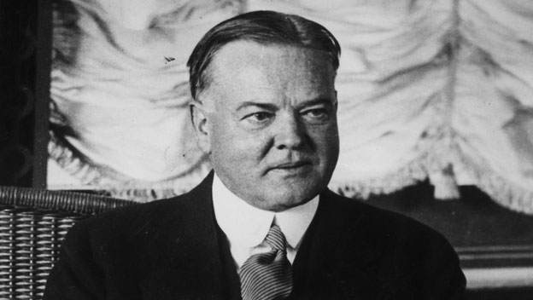
Objectives:
President Hoover’s conservative response to the Great Depression draws criticism from many Americans.
Objectives:
Why was Hoover reluctant to help people during the Depression?
What types of action did Hoover take to remedy the effects of the Depression?

Slide 3
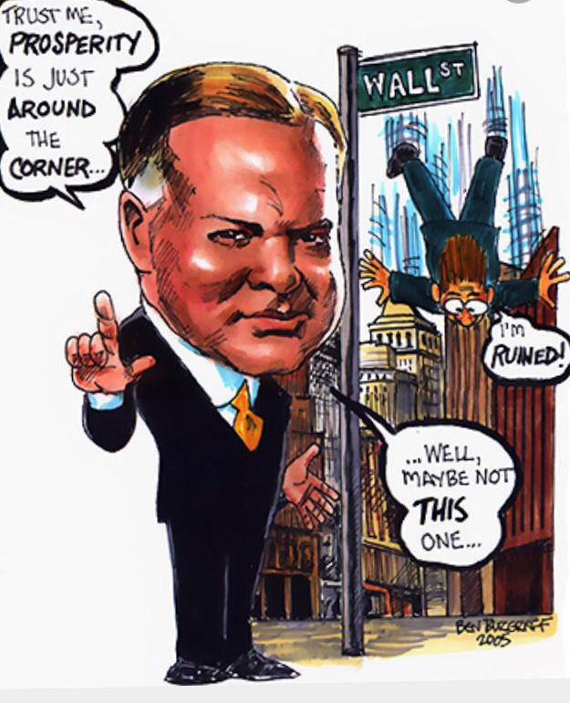
Hoover’s Philosophy
President Herbert Hoover tells Americans the economy is sound. Many experts believed that depressions are a normal part of the business cycle.
Hoover fostered this idea, but also encouraged cooperation between competing groups. If business and labor were in a conflict, for example, government should step in and help them find a solution that served their mutual interests.
Americans like Hoover valued “rugged individualism” – people should take care of their own families, not depend on the government.

Slide 4
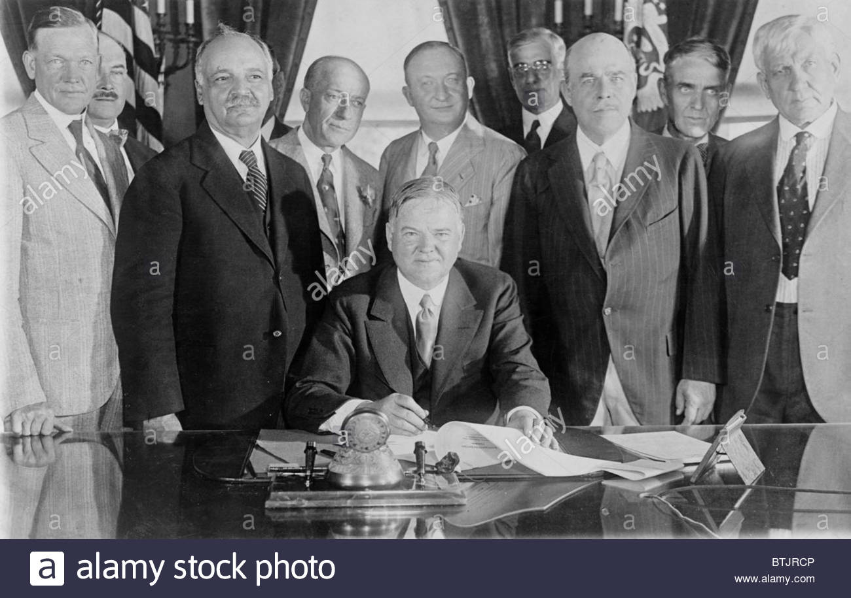
Hoover Takes Cautious Steps
Hoover calls a meeting of business, banking, and labor leaders to solve problems. He urged them to work together and not make a bad situation worse.
For example, he asked employers not to cut wages or lay off workers and he asked labor leaders not to demand higher wages or go on strike.
He created an organization to help private charities to raise money for poor.

Slide 5
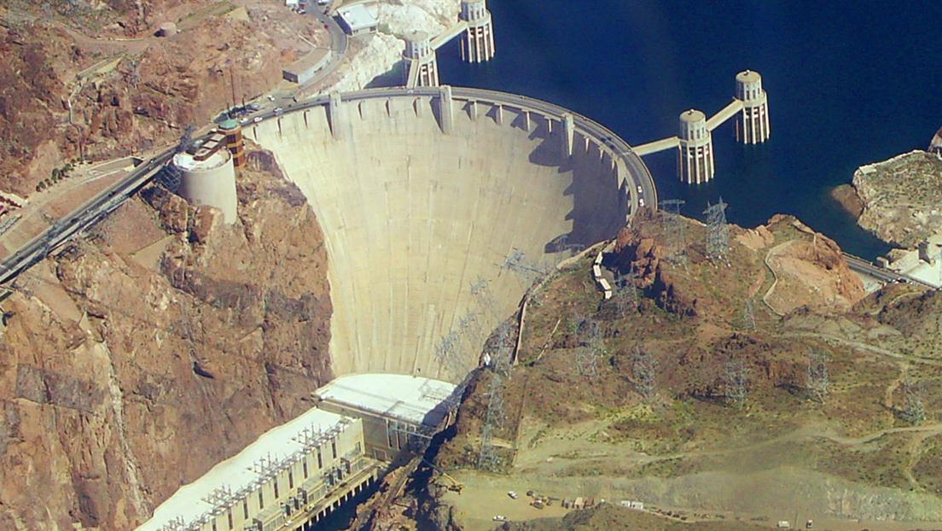
Hoover Dam
One project that Hoover approved did make a difference the Boulder Dam, later renamed the Hoover Dam.
Hoover proposed to finance the dam’s construction by using profits from sales of the electric power that the dam would generate.
It would be the world’s tallest dam and the second largest.
Provides electricity, flood control, and water supply.

Slide 6
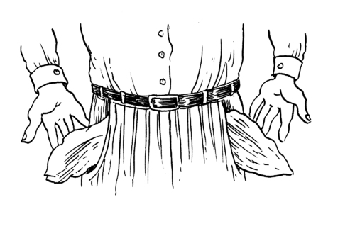
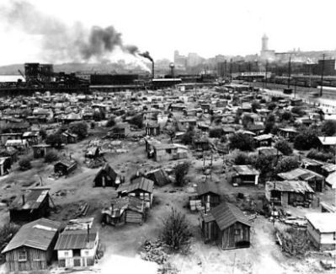
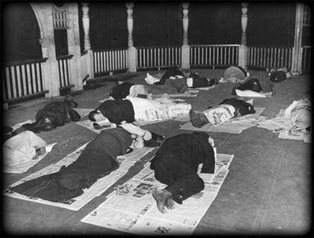
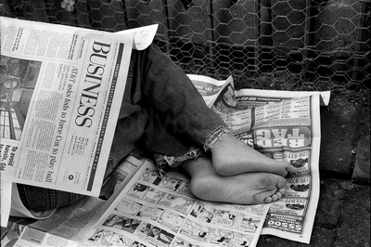
Democrats WIN in 1930 Congressional Election
As the economic problems increase, Hoover and republicans are blamed.
The Democrats won control of the House of Representatives and Republicans only had the majority in the Senate by 1 vote.
Farmers try to create food shortages to raise prices. Americans expressed their dissatisfaction with Hoover and his policies by attaching his name to various symbols of the Depression: “Hoovervilles”, “Hoover blankets”, “Hoover flags”

Slide 7
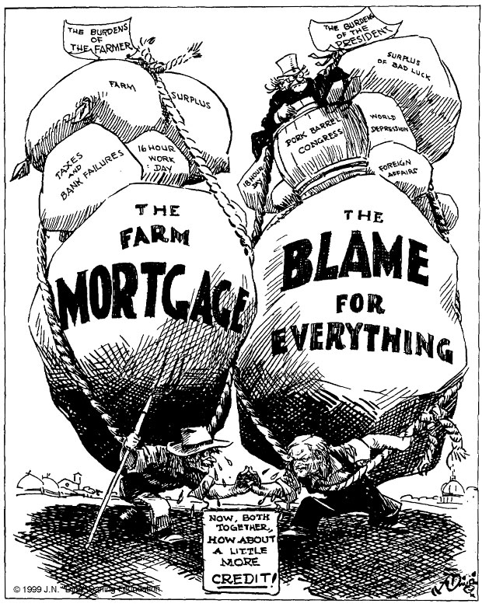
Unit 5 Notes Questions:
Carrying the Weight of the Depression
In this cartoon, both farmers and President Hoover are carrying heavy loads. The caption plays on the two different meanings of the word credit.
5. What does the farmer want from President Hoover?
6. What does Hoover want from the farmer?
7.What does the cartoonist suggest that the farmer and Hoover should do?

Slide 8
Hoover Takes action
As the Depression deepened, Hoover gradually softened his position on government intervention in the economy.
In Hoover’s view, Boulder Dam was a model of how the federal government could encourage cooperation. He negotiates agreements among private entities.
In 1932, Hoover signed into law the Federal Home Loan Bank Act, which lowered mortgage rates for homeowners and allowed farmers to refinance their farm loans ad avoid foreclosure.
The Reconstruction Finance Corporation (RFC) was Hoover’s most ambitious economic measure. It authorized emergency funds for banks, life insurance companies, railroads, and other large businesses.
Hoover believed that the money would trickle down to the average citizen through job growth and higher wages.
Unfortunately, Hoover’s measures don’t improve economy before presidential election.

Slide 9
The Bonus Army Incident
In 1932, an incident further damaged Hoover’s image and public morale. Almost 20,000 WWI veterans and their families arrived in Washington D.C. They called themselves the Bonus Army.
They came to support a bill under debate in Congress, the Patman Bill. It authorized the government to pay a bonus to WWI veterans who had not been compensated sufficiently for their wartime service.
Hoover opposes the bills and thinks the Bonus Marchers were “communists and persons with criminal records” rather than veterans. However, he provided food and supplies so that they could setup a shantytown within the Capital.
On June 17th, the Senate voted down the bill. Most veterans leave, but 2,000 stay to speak with Hoover.
Hoover feared violence and calls the U.S. Army, to disband the Bonus Army.
Infantry tear gas over 1,000 people including children.
The public is stunned and outraged.
Democratic candidate, Franklin Delano Roosevelt says to his friend Felix Frankfurter “Well Felix, this will elect me.

Slide 10
Unit 5 Notes Questions:
8. How did Americans express their dissatisfaction for the way Hoover handled the Great Depression?
They attached his name to negative symbols.
They voted for Republicans in the 1930 election.
They refused to work on the Boulder Dam project.
They demanded that the government bail them out.
9. How did Hoover try to help people keep their homes and farms during his administration?
He encouraged the formation of the Bonus Army.
He signed into law the Federal Home Loan Bank Act.
He proposed the Reconstruction Finance Corporation.
He vetoed the Patman Bill after Congress had passed it.

