Slide 1
New Deal, New Opportunities
Unit 5 Notes (Pg. 7 – 8)

Slide 2
Objectives
The Second New Deal includes new programs to extend federal aid and stimulate the nation’s economy.
Objectives:
Why was the Second New Deal so popular?
What was significant about the election results of 1936?

Slide 3
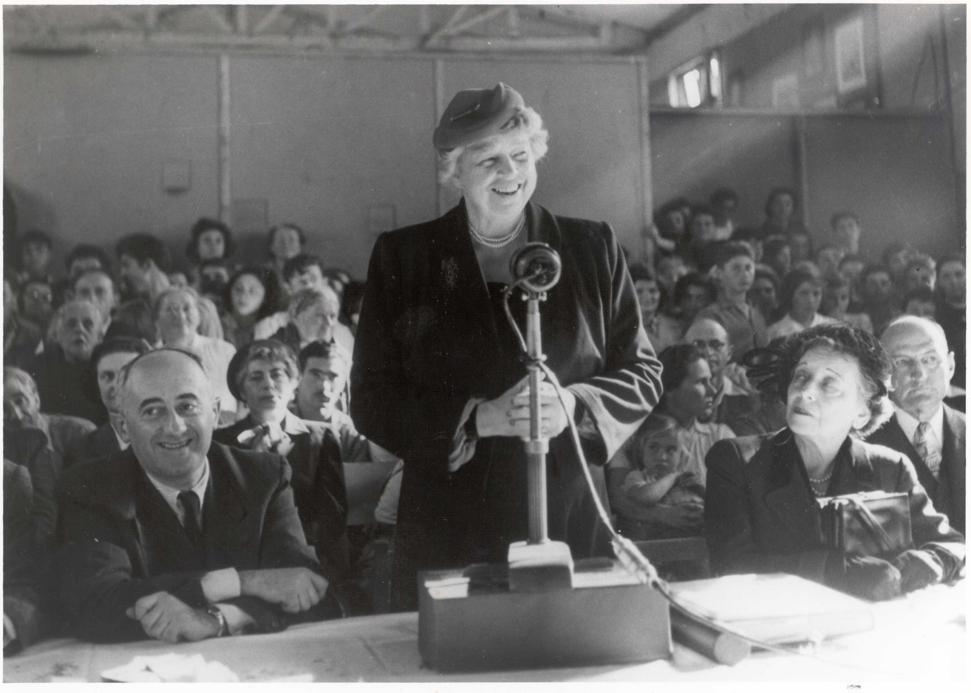
Eleanor Roosevelt
By 1935, the economic recovery was not as great as FDR had expected. Although there was improvement, the unemployment rate remained high and production still lagged behind levels of the 1920s.
FDR launches the second phase by the 1936 presidential election.
FDR’s wife Eleanor Roosevelt is also becoming a leading social reformer, and uses her position to advance more women in political office and provide more relief programs for women and men.

Slide 4
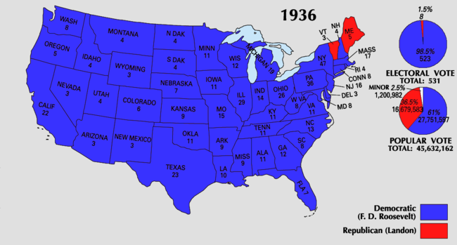
Election of 1936
In the 1936 election, Republicans nominated Alfred Landon a governor of Kansas who did not stand a chance. The Democrats re-elected FDR.
FDR won the presidency with large majorities in both houses.
This election marked the first time most African Americans voted Democratic, and the first time labor unions supported a presidential candidate.
It was a vote of confidence in FDR and the New Deal.

Slide 5
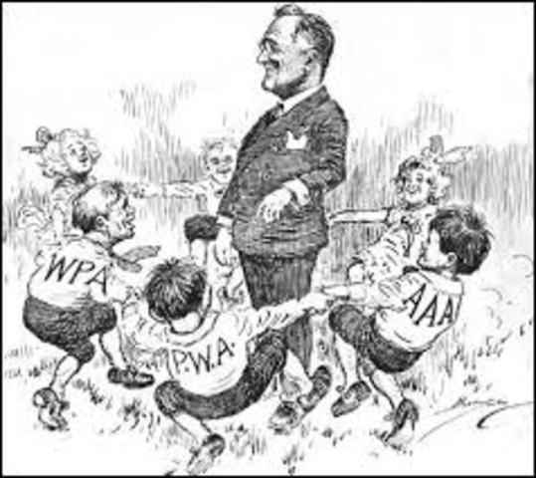
Fixing the New Deal
Since the Supreme Court ruled the AAA was unconstitutional, they replaced it with the Soil Conservation and Domestic Allotment Act.
Rewards farmers for practicing soil conservation through compensation.
New AAA is created avoiding the policies the Supreme Court denounced.
In addition to farmers, the Second New Deal assisted students, women, African Americans, and Native Americans.
Works Progress Administration (WPA) – creates as many jobs as possible as quickly as possible.
National Youth Administration (NYA) – education, jobs, counseling for young people.

Slide 6
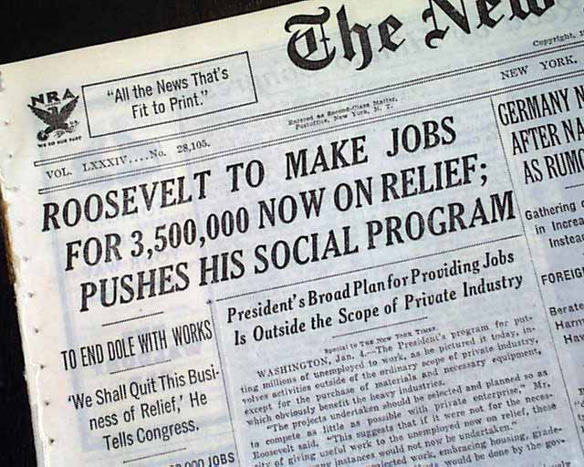
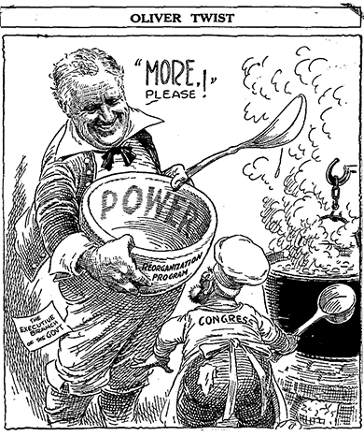
Additions to the New Deal
Wagner Act replaces the NIRA – protects employees rights to join unions; collective bargaining; prohibits unfair labor practices.
Also known as the National Labor Relations Act
The Board hears testimony about labor practices to decide if workers need representation.
Fair Labor Standards Act – sets maximum hours (55 hours per week) and minimum wages (25 cents an hour).
In 1935 the Social Security Act provides: (1) insurance for retirees 65 or older, (2) unemployment compensation (3) aid to disabled, families, and children.

Slide 7
Unit 5 Notes Questions
10. What was Elanor Roosevelt’s role in the New Deal?
She lobbied elected leaders for new banking and finance laws.
She advocated for people who were typically underrepresented.
The traveled the country encouraging people to support different policies.
She established committees to hear the grievance of different business groups.
11. How did the Second New Deal attempt to prevent another Dust Bowl through the Soil Conservation and Domestic Allotment Act?
By rewarding farmers for reaching set production targets for different crops
By rewarding farmers for good soil management with guaranteed loans
By compensating farmers for practicing good soil management and conservation
By paying farmers for cutting production and plowing under their crops

Slide 8
Helping Women
New Deal policies and actions affect various social and ethnic groups.
Frances Perkins, secretary of labor, is the first female cabinet member.
FDR appoints 2 women as diplomats and 1 as a federal judge.
Despite this success, women still faced discrimination in the work place. Male workers believed that working women took jobs away from men.
The NRA sets lower minimum wages for women.
Federal work programs hired far fewer women than men

Slide 9
Helping African Americans
FDR appoints more than 100 African Americans to government positions.
For example, Mary McLeod Bethune was a former educator who FDR put as the head of the Division of Negro Affairs of the NYA
Bethune also helped organize a “Black Cabinet” – African-American advisers to help the Roosevelt administration on racial issues.
Despite efforts to promote racial equality, Roosevelt was never committed to full civil rights for African Americans.
Afraid of upsetting with Democratic voters in the south by refusing to approve anti-lynching law and end to poll tax.
New Deal agencies discriminated by giving lower wages and favoring whites
African Americans recognized this by creating organizations like Southern Tenant Farmers Union that support black and white farmers.
However, American Americans mostly supported Roosevelt administration, generally seeing them as their best hope for the future.

Slide 10
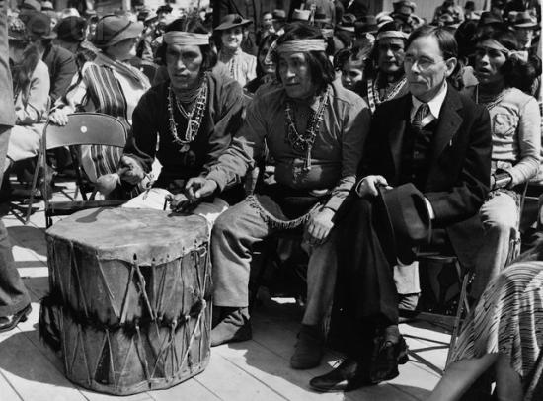
Helping Native Americans
Native Americans were another group that benefited from New Deal Programs.
1924 - Native Americans receive full citizenships
1933 – FDR appoints John Collier as commissioner of Indian affairs
Indian Reorganization Act mandates (1) land belong to entire tribe and government cannot sell unclaimed areas (2) children can attend schools on reservations (3) tribes elect tribal councils to govern reservations

Slide 11
Just helping everyone
Although New Deal policies had mixed results for minorities, these groups generally backed FDR. One of his greatest achievements was the New Deal Coalition – an alignment of diverse groups dedicated to supporting the Democratic party.
Due to things like the Wagner Act and other pro-labor legislation, union members saw Roosevelt as a “friend of labor” and donate most of the funds to FDR reelection.
New bargaining tactic of the 1930s were sit-down strikes.
Women, African Americans, Mexican Americans, Native Americans, urban workers, religious people, all walks of life supported FDR.

Slide 12
Unit 5 Notes Questions
12. Among the more than one hundred African Americans appointed by President Roosevelt, _________________________ served as the head of the Division of Negro Affairs of the NYA and she organized a group of ____________________________ to advice the president on ______________ issues.
13. Which of the following was an effect of the New Deal’s protection of worker rights?
Factories lowered wages.
Union membership increased greatly.
Farmers organized for better working conditions.
Unions supported conservative leaders in elections.

