Slide 1
America at war
Many people opposed fighting on moral grounds were conscientious objectors.
Most notorious was Alvin York, his justification was the bible states “thou shalt not kill”
Eventually, decides WWI is just and alone kills 25 Germans and helps capture 132 prisoners
He was promoted to sergeant and becomes a U.S. celebrity.
Come November of 1918, Central Powers have difficulties motivating soldiers to continue to fight.
On Nov. 3rd, Austria-Hungary surrenders; following this, German soldiers rebel and the Kaiser gives up the throne.
On the 11th hour, in the 11th month, on the 11th day, German signed the armistice, or truce, ending the war.
22 million dead; 20 million more wounded; 10 million become refugees

Slide 2
Unit 4 Notes Questions:
12. How was the U.S. government able to mobilize people to fight in WWI?
A. It paid soldiers more than most industries paid.
B. It used its large standing army to fight immediately.
C. It relied on propaganda to recruit volunteers to fight.
D. It required young men to register for military service.
13. The course of the war on the western front in France turned in favor of the Allies with the introduction of soldiers from ___________________________ in 1917.

Slide 3
Selling the War
WWI Spurs social, political, and economic change in the U.S.
The shift from producing consumer goods to producing war supplies was too complicated and important job for a private industry to handle on its own, so business and government collaborated in the effort. Ultimately expanding the power of the government.
Congress gave the president direct control of much of the economy.
War Industries Board (WIB) created to urge mass-production and standardizing products.
Head of board was Bernard M. Baruch, prosperous businessman
U.S. spends $35.5 billion on war effort: 1/3 paid through taxes and 2/3 borrowed though sale of war bonds
To popularize the war, the government set up the nation’s first propaganda, biased communication designed to influence people, agency the Committee on Public Information (CPI).
The head of CPI was former muckraking journalist George Creel.
Produces visual works, printed matter to promote war; gets volunteers to speak about war and distribute materials

Slide 4
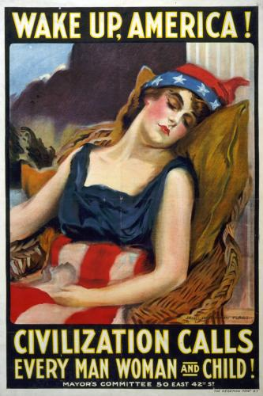
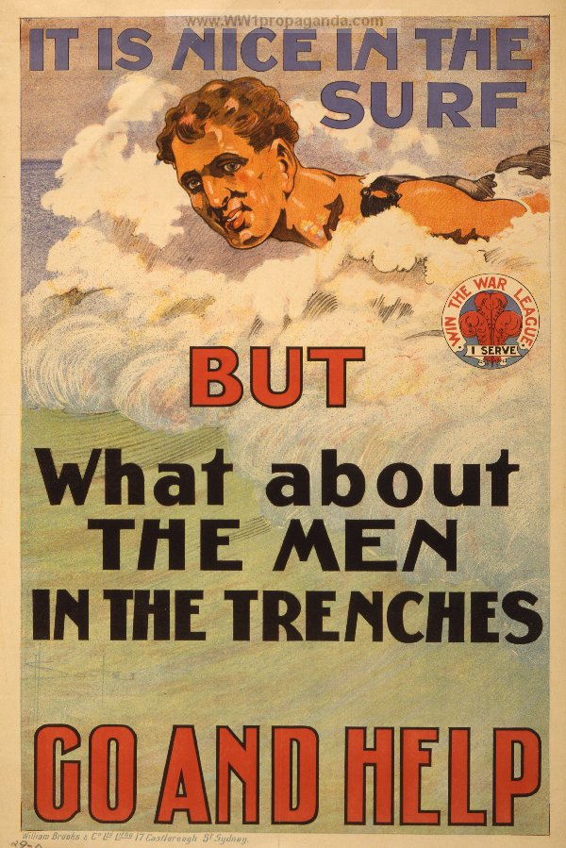
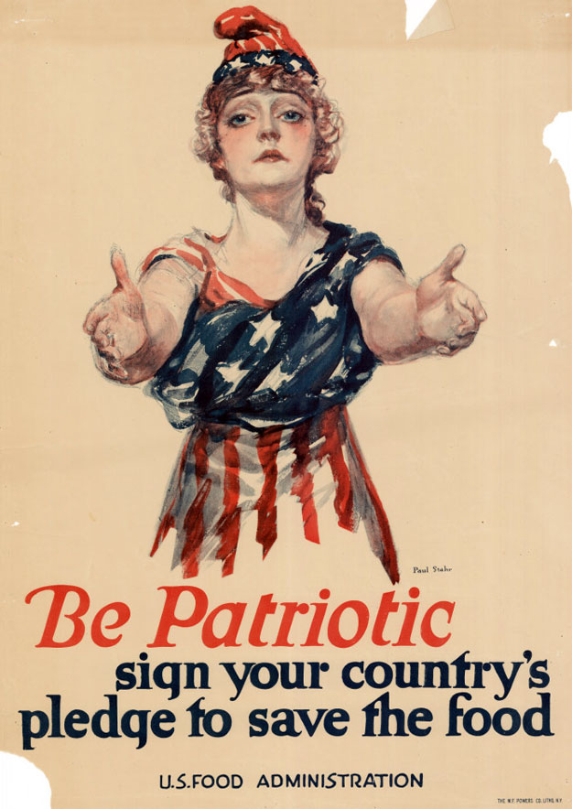
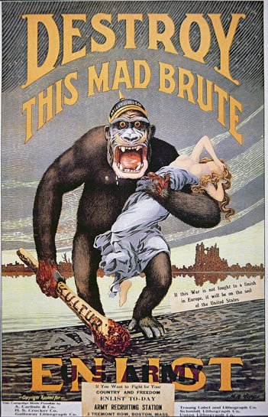
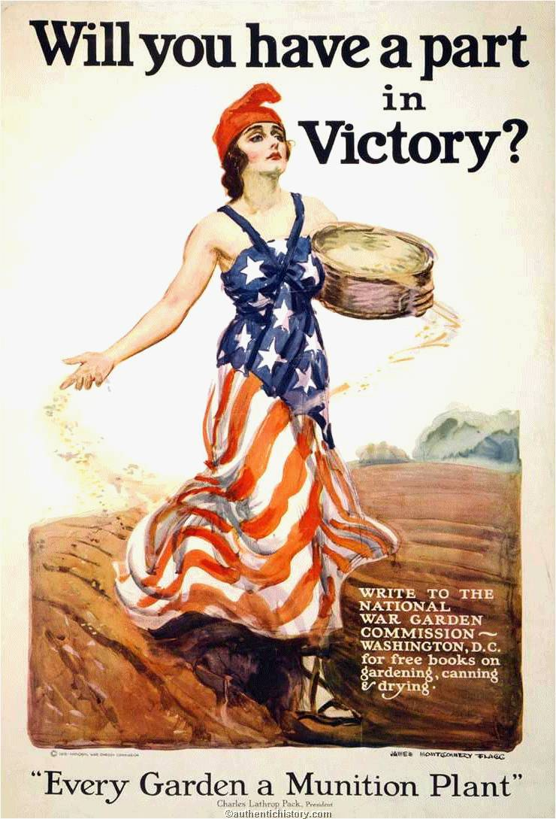
Citizens must support the war
While the government’s propaganda campaign promoted patriotism, it also inflamed hatred and violations of the civil liberties of certain ethnic groups and opponents of the war.
Attacks against immigrants especially from Germany and Austria-Hungary; suppression of their cultures
In May of 1918, the government passed the Espionage and Sedition Acts, which says a perso can be fined up to $10,000 and sentenced to 20 years in jail for interfering with the war effort or saying anything disloyal, profane, or abusive about the government or the war effort.

Slide 5
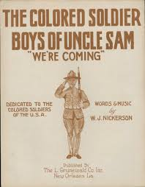
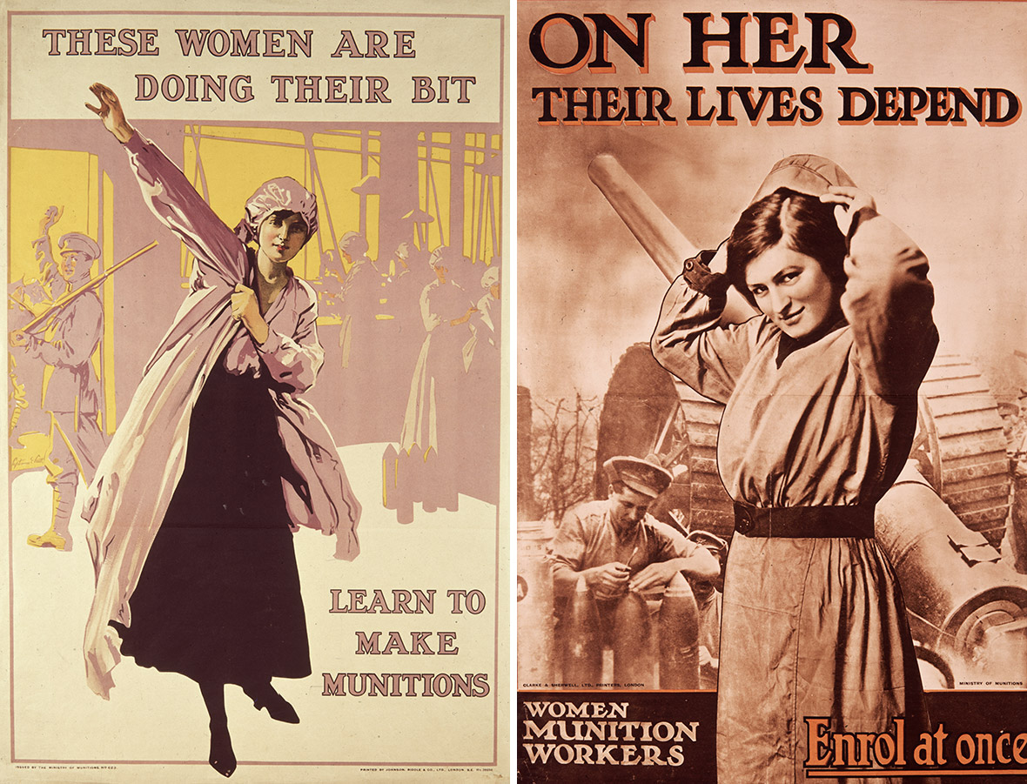
All hands on deck
Du Bois urges support for war to strengthen calls for racial justice.
Many women take jobs in heavy industry previously held by men.
In all, about 1 million women entered the work force during WWI.
Women’s effort bolsters support for suffrage and the 19th amendment is passed.
In the fall of 1918, the international flu epidemic had a devastating effect on the economy.
As many as 30 million people died worldwide.

Slide 6
Unit 4 Notes Questions
14. How did WWI affect the role of the federal government?
A. The government regulated industries less.
B. The government controlled much of the national economy.
C. The government protected workers’ rights more.
D. The government purchased more materials from different companies.

Slide 7
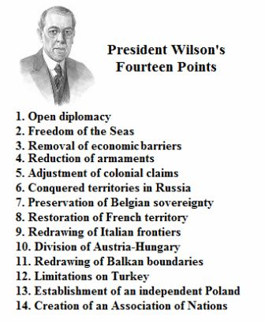
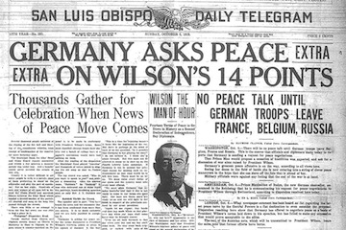
Fourteen Points
Wilson’s plan for world peace known as the Fourteen Points (pg. 349 in textbook)
Wilson believed strongly in self-determination – the right of people to choose their own political status.
Points 1 – 5 propose measures to prevent another war
Points 6 – 13 address how ethnic groups can form own nations or join others
14 calls for international organization League of Nations

Slide 8
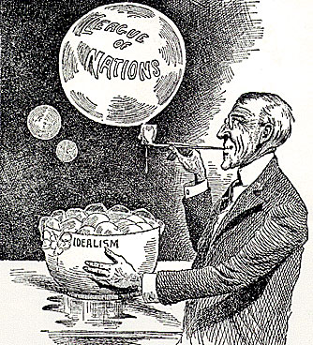
Can’t please everyone
Wilson’s plan failed to address the Allie’s hatred against Germany
France wants to prevent future German invasion
British Prime minister wants to “Make Germany Pay”
Italy wants Austrian-held territory
Treaty of Versailles creates 9 new nations and places various conditions on Germany
Germany – cannot have an army, land returned to France, pay reparations (war damages)
War-guilt clause – Germany must accept sole responsibility for war
Many American leaders disapproved of the League and the Treaty
Wilson goes on tour to convince Nation, but a stroke
Congress does not approve and the U.S. never joins the League

Slide 9
Unit 4 Notes Questions
15. Which of the following is an example of how President Wilson’s belief in self-determination was reflected in his Fourteen Points?
A League of Nations would be created to settle international disputes.
Treaties would be negotiated in public with input from ordinary citizens.
An independent Poland would be created from German and Russian territory.
Independent courtiers would have equal rights to trade and to navigate the seas.

Slide 10
Roaring 20s
(Last section of notes)

Slide 11
Objective:
Why did political, economic, and social tensions characterize the 1920s?
Identify the issues that trouble Americans in the years after World War I.
Consider the influence of popular culture, mass media, and cultural movement such as the Harlem renaissance.
Although the U.S. government was rocked by scandal during the early 1920s, a business boom fueled a rise in America’s standard of living.

Slide 12
Post-War America
The U.S. seeks postwar normality and isolation. The standard of living soars amid labor unrest, immigration quotas, and the scandals of the Harding administration.
Following President Wilson, Warren G. Harding is elected with his promise of “normalcy”
After WWI, problems surfaced relating to arms control, war debts, and the reconstruction of war-torn countries.
In 1921, Harding invited several major powers to the Washington Naval Conference to settle issues.
Russia was left out because of its Communist government.
Secretary of State Charles Evan Hughes urged that no more warships be built for ten years & that the 5 major naval powers scrap many of their battleships.
In 1928, 15 countries signed the Kellogg-Briand Pact, which renounced war as a national policy; however, the pact was futile, as it provided no means of enforcement.

Slide 13
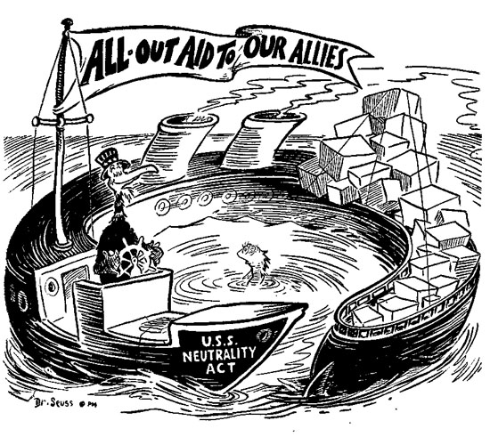
War Debts
In 1922 America adopted the Fordney-McCumber Tariff, which raised taxes on U.S. imports to 60%
Britain and France could barely repay the U.S. before, now it is out of the question
They ^ look to Germany who owes them reparations – the U.S. loans Germany money known as the Dawes plan – Germany pays Britain & France back – they pay U.S. back
Causes resentment all around

Slide 14
Scandalous
Harding’s slogan “less government in business and more business in government”; Harding was good-natured, but didn’t understand all issues facing nation
Ends up appointing corrupt friends who embarrass him known as the Ohio Gang
Corrupt friends use their positions to become wealthy through graft
Teapot Dome Scandal – the government had set aside oil-rich public lands for the Navy; Albert B. Fall manages to get reserves transferred to the Interior Department, and leases land to private companies; takes bribes
Fall became the first American to be convicted of a felony while holding a cabinet post
In August of 1923, Harding dies suddenly and his VP Calvin Coolidge assumes presidency
Coolidge favors minimal government interference in business, which allows private enterprise to flourish.

