Slide 1
Roaring 20s
Last notes of Unit 4

Slide 2
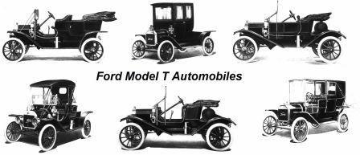
Vroom, Vroom
The auto industry and Henry Ford’s model T symbolized the success of the free enterprise system and the Coolidge era. It resulted in the urban sprawl and by the 1920s, 80% of all registered moto vehicles in the world were in the U.S.
Cars change life – paved roads gas stations, motels, shopping centers
Give mobility to rural families, women, young people

Slide 3
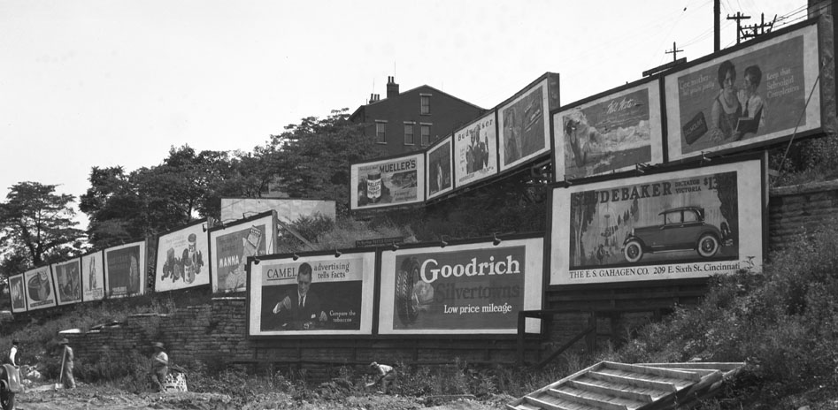
Consumerism
Consumerism, or the acquisition of goods in greater amounts, began to play a significant role in the American economy and culture.
Advertising agencies hire psychologists to learn how to appeal to the public
Make brand names familiar nationwide, push luxuries as necessities

Slide 4
Unit 4 Notes Questions
16. Which of the following was an outcome of the Washington Naval Conference?
A. The five major naval powers agreed to disarm.
B. Many countries renounced war as a national policy.
C. The U.S. raised taxes on some imports to 60%.
D. American inventors loaned Germany money to repay Britain and France.

Slide 5
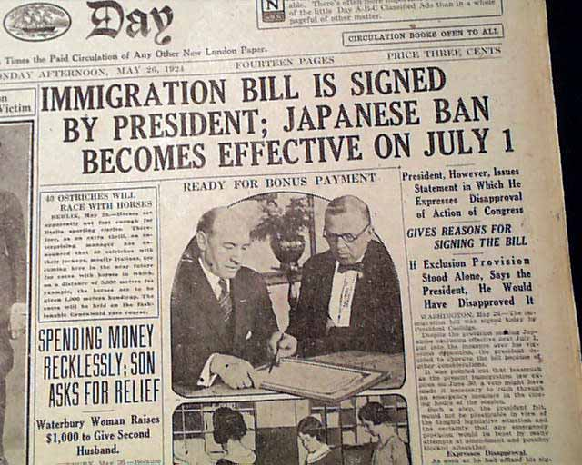
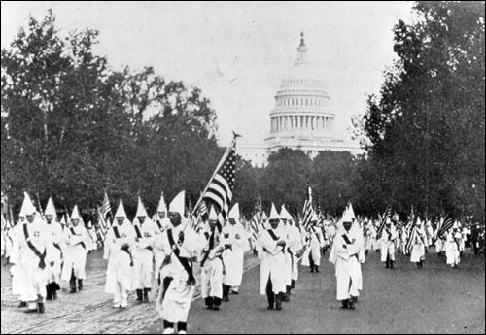
Fear of Foreigners
War leaves Americans exhausted and the debate over the League divides them.
Economy adjusting: cost of living doubles, farm, factory orders down
Soldiers take jobs from women and minorities
Many Americans responded to the stressful conditions by becoming fearful of outsiders, this fear is known as xenophobia.

Slide 6
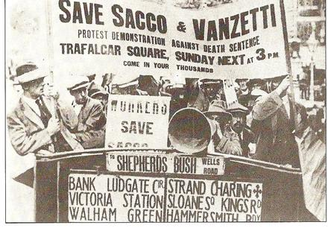
The Red Scare
One perceived threat to American life was the spread of communism, an economic and political system based on a single-party government ruled by a dictatorship.
In 1919 Vladimir Lenin forms the Bolsheviks who set up a communist state in Russia.
A communist party formed in the U.S. – the government is mailed bombs and the public grew fearful that the communists were taking over… starting the Red Scare
Red scare feeds fear of foreigners, ruins reputations
Example: Sacco and Vanzetti were Italian immigrants and anarchists arrest and charged with robbery and murder. Even though the trial did not prove guilt the jury finds them guilty and they’re executed in 1927

Slide 7
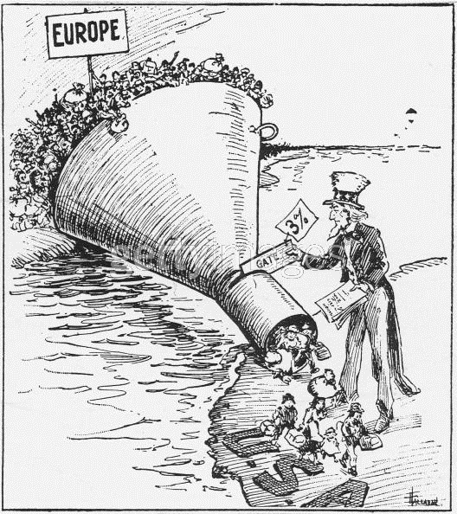
Quota System
U.S. Attorney General A Mitchell Palmer and J. Edgar Hoover begin to hunt Communists, socialist, and anarchists.
Raids trample civil rights and fail to find evidence
1919 – 1921, number of immigrants grows almost 600%
Quota System – sets maximum number can enter U.S. from each country
In 1924, European arrivals cut to 2% of number of residents
Discriminates against southern, eastern Europeans
Prohibits Japanese immigration
Does not apply to western hemisphere (Canadians / Mexicans)

Slide 8
The Roaring 20s
In the rebellious, pleasure-loving atmosphere of the twenties, many women began to assert their independence, reject the values of the 19th century, and demand the same freedoms as men.
“We have been forced to live in an atmosphere of ‘tomorrow we die’ and so naturally, we drank and were merry.” – John F. Carter
Another bitter controversy highlighted the growing rift between traditional and modern ideas. This battle raged between fundamentalist and secular thinkers.
Ex: Scopes Trial
The uprising of the flapper: liberated young woman who embraces the new fashions and urban attitudes of the day.
Casual dating became increasingly accepted. Even so, a double standard – a set of principles granting greater sexual freedom to men than to women – required women to observe stricter standards of behavior than men did.

