Slide 1
Unit 5: The Great Depression
Nation’s Sick Economy (Pg. 1 – 3)

Slide 2
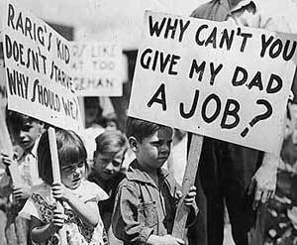
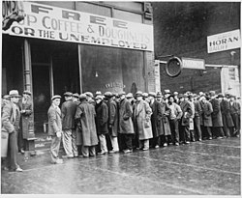
Main Idea:
As the prosperity of the 1920s ends,
severe economic problems grip the
nation. The Great Depression has had
lasting effects on how Americans view
themselves and their government.
Objectives:
How did falling incomes affect consumer behavior?
How did popular perceptions of prosperity influence the election of 1928?

Slide 3
Industries In Trouble
Many key industries began to lose business such as railroads, textiles, and steel. As these industries declined, they laid off workers or reduced their hours.
Railroads lost business to new forms of transportation – trucks, buses, and private automobiles.
Mining and lumbering expanded during war, but were no longer in high demand.
Coal especially took a hard-hit due to availability of new energy sources (i.e. electricity)
Overproduction weakened even the boom industries of the 1920s were now weak.
Housing starts to decline too.

Slide 4
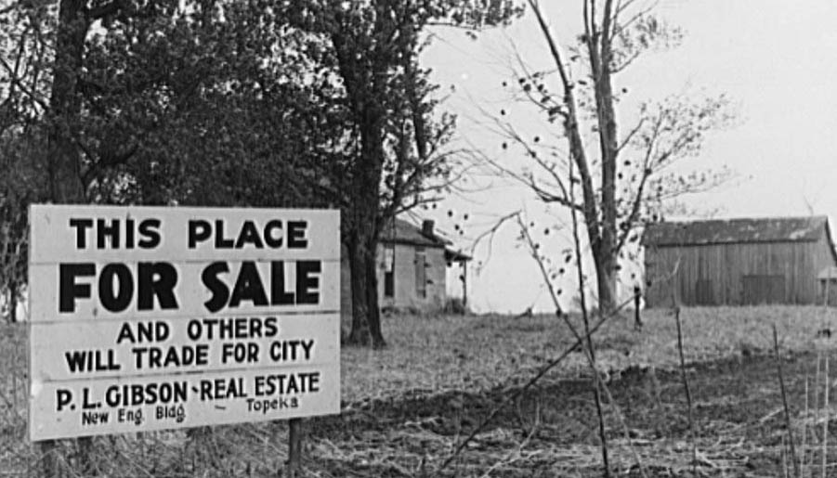
Farmers Need a Lift
During WWI, prices rose and international demand for crops such as wheat and corn soared, so the troops could be fed.
Demand fell after the war and crop prices declined by 40% or more causing deflation
Farmers increase production to sell more, but prices just drop further. Farm income declines; farmers default on loans; rural banks fail.
Government tries to help farmers with price support. The government would buy surplus crops at guaranteed prices and sell them on the world market, but President Coolidge vetoes the bill

Slide 5
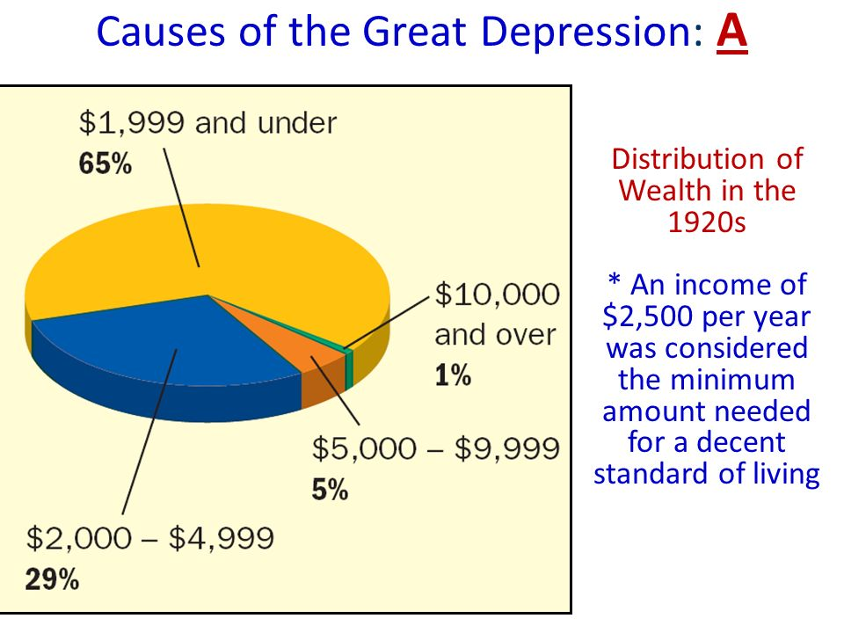
Living On Credit
Many people buy goods on credit (buy now, pay later); Business give easy credit and consumers pile up large debts. Consumers have trouble paying off debt and cut back on spending.
In the 1920s, rich get richer and the poor get poorer.
70% of families earn less than minimum ($2,500) for decent standard of living.

Slide 6
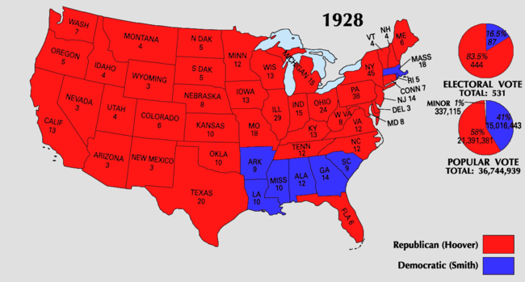
Hoover Takes the Nation
The election of 1928 was between Republican Herbert Hoover and democrat Alfred E. Smith.
Smith – career politician; served 4 terms governor in NY; personable
Hoover – Secretary of commerce under Harding and Coolidge; mining engineer
Overwhelming victory for Hoover. The message was clear: most Americans were happy with Republican leadership.

Slide 7
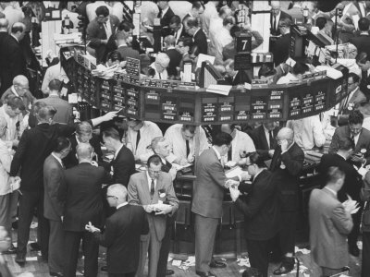
Dreams of Riches in the Stock Market
Dow Jones Industrial Average was the most widely used barometer of the stock market’s health
In the 1920s, stock prices rise steadily; people rush to buy stocks and bonds
Seeds of trouble were taking root as many engaged in speculation – they bought stocks and bonds on the chance of a quick profit, while ignoring the risks; Others began buying on margin – pay small percent of price and borrow the rest.

Slide 8
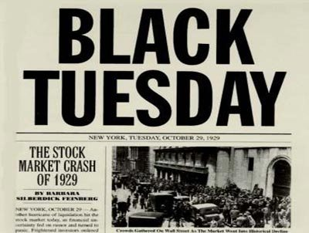
The Stock Market Crashes
In September 1929 stock prices peaked and then failed, and investors begin selling.
On October 29th, 1929 or Black Tuesday, the bottom fell out of the market and the nation’s confidence.
http://www.history.com/topics/great-depression/videos/1929-stock-market-crash
The number of shares dumped onto the market that day was a record of 16.4 million. People who had bought stocks on credit were stuck with huge debts. Others lose most of their savings.
The stock market crash signaled the beginning of the Great Depression – economy plummets and unemployment skyrockets
By 1933, 25% (1 in every 4 Americans) of workers were jobless

Slide 9
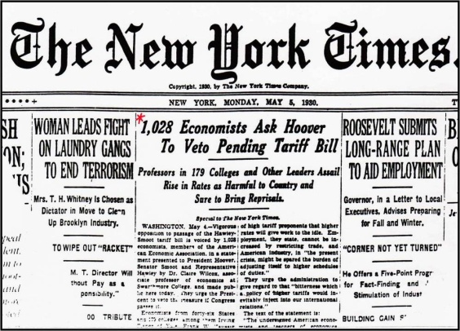
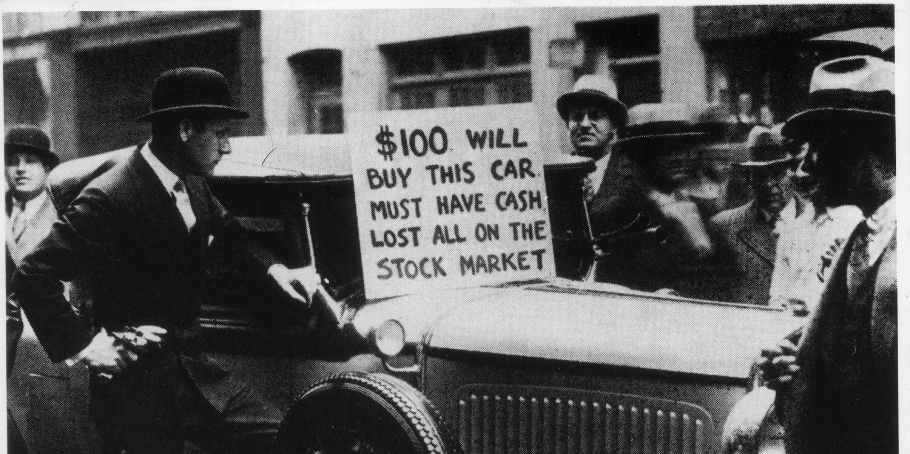
World Wide Shock Waves
Great Depression limits U.S. ability to import European goods.
Congress passed the Hawley-Smoot Tariff Act sets highest protective tariff ever in the U.S.
Other countries cannot earn American currency to buy U.S. goods and international trade drops causing unemployment to soar around the world
Factors leading to Great Depression: tariffs, war debts, farm problems, easy credit, income inequality

Slide 10
Unit 5 Notes Questions
Why was much of the prosperity of the 1920s more superficial than real?
Many people were living beyond their means.
Many people were relocating from farms to the cities.
Many people were becoming wealthier in the stock market.
Many people were benefiting from increased jobs after the war.
The rest of the world felt the impact of the stock market crash and great Depression that was going on in America because by this point many world economies were _______________________.
Independent
Rising
Interdependent
Increasing

Slide 11
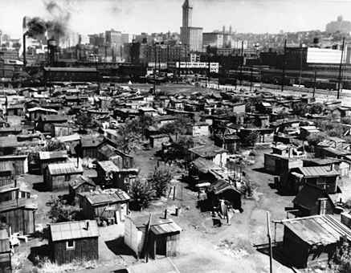
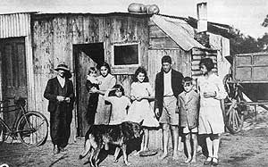
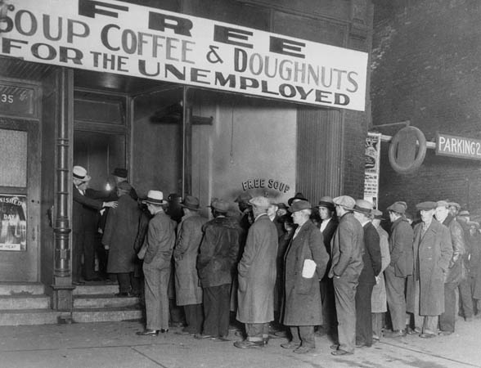
Depression Devastates People’s Lives
Statistics such as the unemployment rate tell only part of the story of the Great Depression. More important was the impact that is had on people’s lives: hardship, homelessness, and hunger to millions.
People lose their jobs and are evicted from their homes. This causes shantytowns, little towns consisting of shacks, to spring up.
Many Americans called these shantytowns “Hoovervilles” because they blamed President Hoover for the Depression.
Every day the poor dug through garbage or begged. Soup kitchens began offering free or low-cost food and breadlines, lines of people waiting to receive food provided by charitable organization or public agencies, became a common sight.

Slide 12
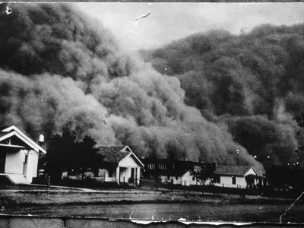
The Dust Bowl
Life in rural areas was difficult, but it had one advantage over city life: most farmers can grow food for their families.
During the 1920s, farmers had used newly affordable tractors to break up the grasslands and plant millions of acres of new farmland. Deep plowing had removed the thick protective layer of prairies grasses. Farmers had then exhausted the land through over production of crops, and the grasslands became unsuitable for farming. When the rains stopped and winds began to blow in the early 1930s, little grass and few trees were left to hold down the soil. The dust traveled for hundreds of miles.
The region that was the hardest hit, including parts of Kansas, Oklahoma, Texas, New Mexico, and Colorado, came to be known as the Dust Bowl.
http://www.history.com/topics/dust-bowl/videos/black-blizzard

Slide 13
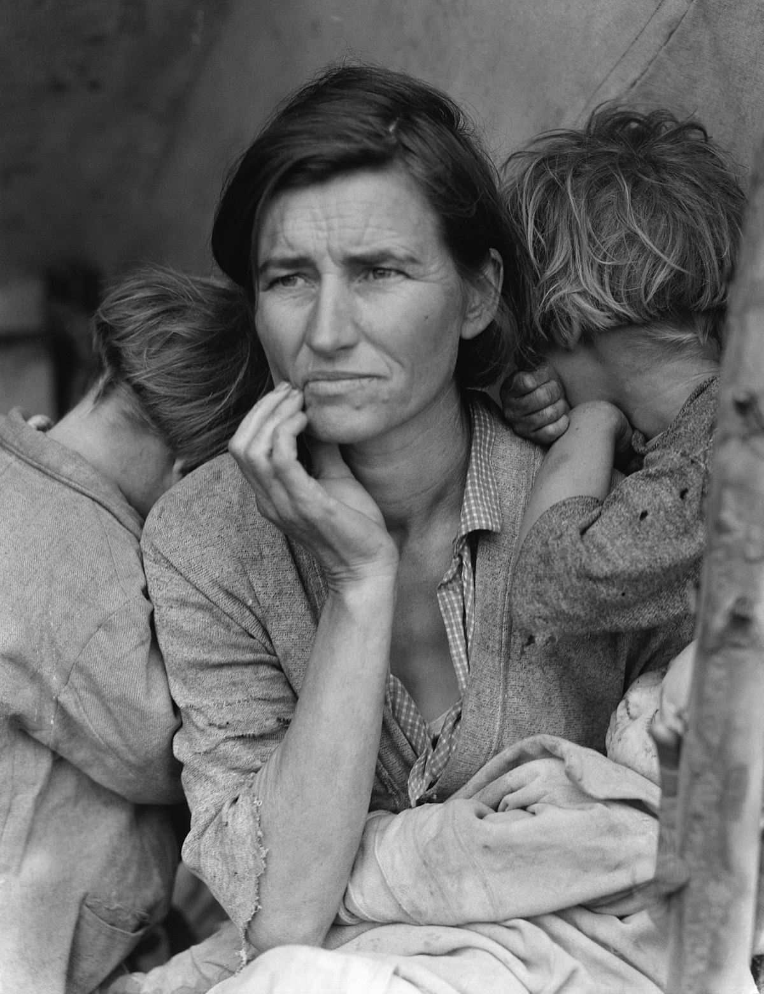
Effects on the American Family
Some people feared that hard times would undermine moral values, but most Americans believed in traditional values and emphasized the importance of family unity. Family became the source of strength.
Men used to working and supporting their families have difficulty coping and cannot find jobs.
They begin to leave their families to search for work. About 300,000 hoboes wander the country.
At this time there was no federal system of direct relief or cash / food from the government.
Women struggle to survive. Homemakers must budget carefully, can food, and sew clothes.
Women who worked were resented by unemployed men places begin not to hire
Many women suffer in silence, ashamed to stand in breadlines

Slide 14
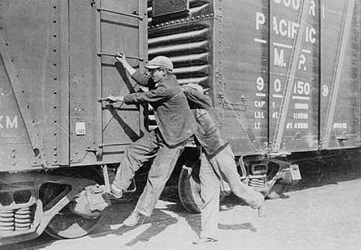
Children Suffer From Hardships
Poor diets and health care lead to serious health problems in children. Lack of tax revenue leads to shortened school year and schools closing
Teenagers began to leave home and search for work.
Others went in search of adventure and became known as Hoover tourists – would hop aboard Americas freight trains to zigzag the country, tour America for free.

Slide 15
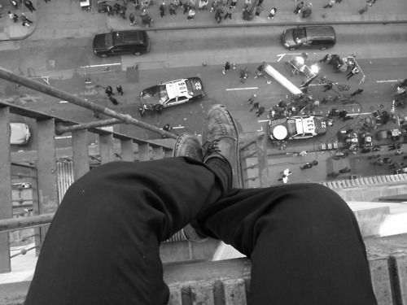
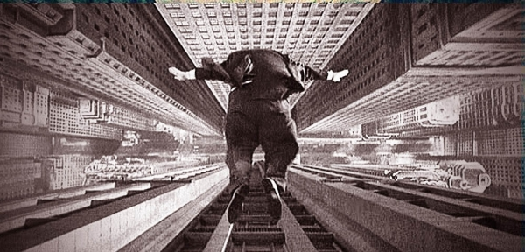
Social and Psychological Effects
Some people were so demoralized by hard times and they lost their will to survive.
1928 – 1932 suicide rates rises over 30% and three times as many people were admitted to state mental hospitals.
People give up on health care, college, put off marriage and children.
Most people’s main goal in life was financial security. Develop habit of saving.

Slide 16
Unit 5 Notes Questions:
What was one advantage that people in rural areas had during the Great Depression that people in the cities lacked?
The ability to live in shantytowns
The ability to grow food
The ability to obtain assistance at bread lines
The ability to relocated to the Pacific Coast States
4. According to the text, what was one way that women tried to help their families survive during the Great Depression?
They started businesses.
The applied for relief payments
They wrote books about thriftiness.
They canned food.

