Slide 1
UNIT 2 – THE AMERICAN WEST
Cultures Clash on the Prairies (Page 1 & Page 2)

Slide 2
Cultures Clash on the Prarie
During the late 1800s, white settlers were beginning to move westward. Many felt that it was the Americans “manifest destiny” to spread from sea (Atlantic) to shining sea (Pacific).
Most easterners (Americans) farmed and thought the west was occupied by savage people.

Slide 3
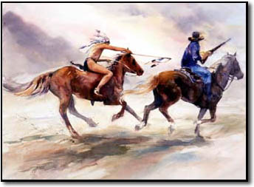
Culture of the Plain Indians
However, the Native Americans occupying the Great Plains were highly developed.
After being introduced to horses and guns from the Spanish, almost all the nations have left their farms and began to adapt a more nomadic life.
If one hunter trespassed it meant war. It was an honor to kill the enemies and by “counting coup.” (touching a live enemy with a coup stick and escaping unharmed)
Sometimes truce were called in order to trade or share news.
Native Americans tend to live in small extended family groups; young men trained to be hunters and warriors, while women helped butchered the game and prepared the hides.
Native Americans believed the land cannot be owned, but settlers believed it could and want to.
They argued that the Native Americans forfeited their rights to land because they hadn’t settled down to “improve” it.

Slide 4
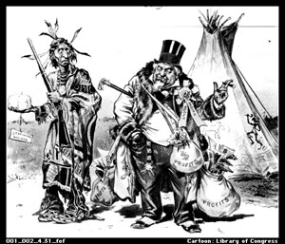
The Government Restricts Native Americans
In In 1834, the federal government passed an act that designated the Great Plains as land for Native Americans, but needing more land for railroads and the discovery of gold the U.S. changed its policies and defined specific boundaries for each tribe.
Unit 2 Notes Questions 9/18 & 9/19
Who are the two different people representing in the cartoon?
What message is this cartoon trying to convey?

Slide 5
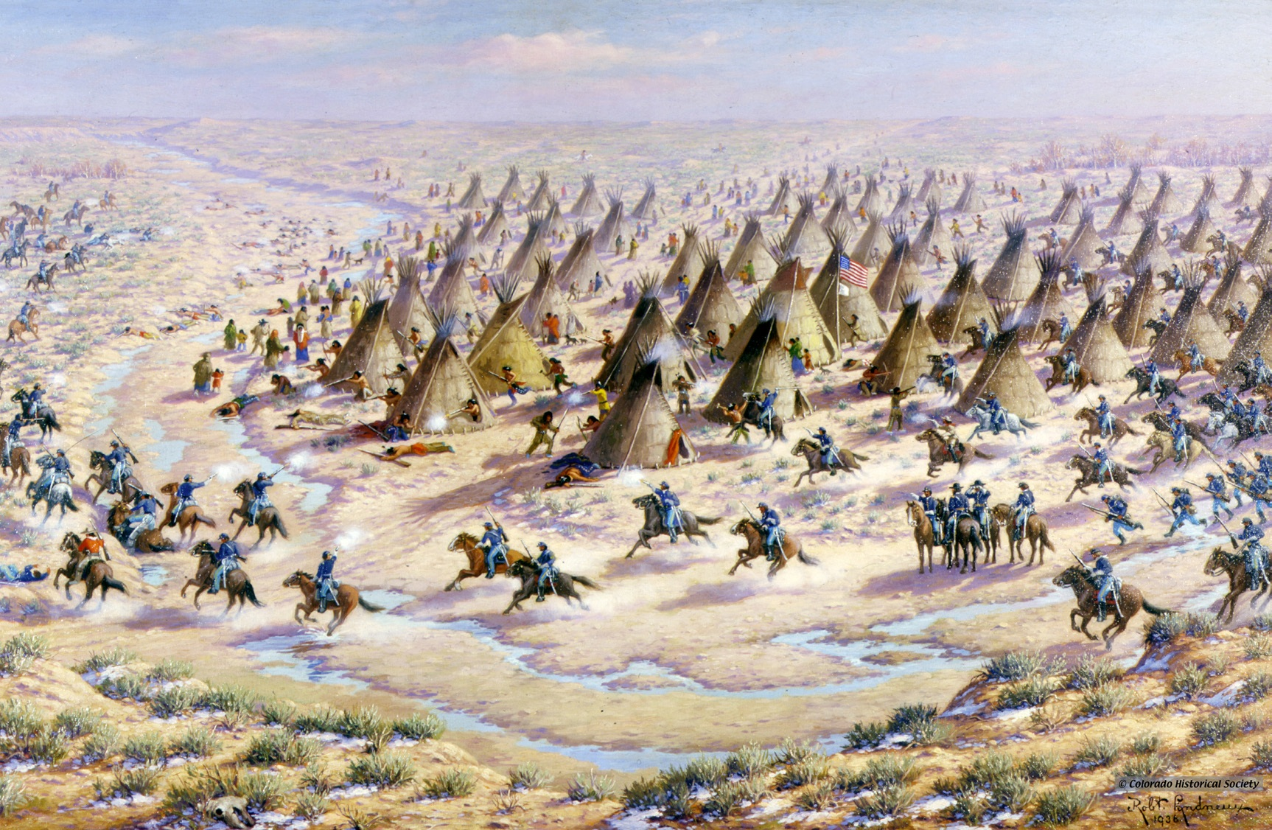
Massacre at Sand Creek
Causes are linked to control of the Great Plains. The Fort Laramie Treaty had guaranteed ownership to the Cheyenne tribe, but American miners flooded across the region.
General S. R. Curtis sent a telegram to militia colonel John Chivington that read “I want no peace till the Indians suffer more.”
Chivington moved his troops in at dawn to attack the unsuspecting Native Americans; 9 of Chivington’s men were killed while 148 of Black Kettle’s followers slaughtered (most women and children).

Slide 6
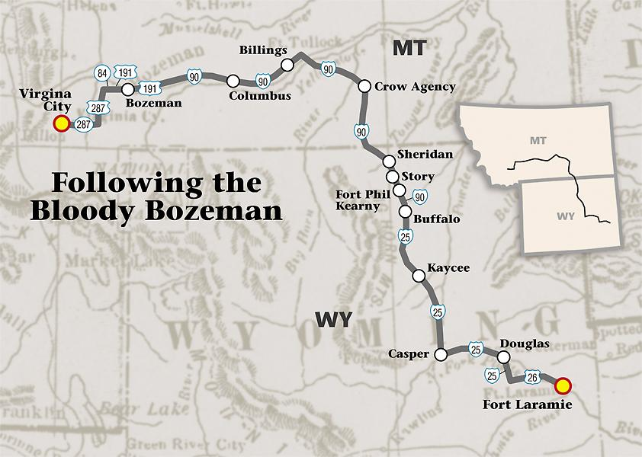
Death on the Bozeman Trail
The Bozeman trail ran through Sioux hunting grounds. A warrior Sioux named Crazy Horse ambushed Captain William J. Fetterman and his company and over 80 soldiers were killed. Attacked continued until the government agreed to close the trail and the Sioux agreed to the treaty of Fort Larmie.
Sitting Bull, leader of Sioux, never signed it and continued to use the traditional hunting grounds.

Slide 7
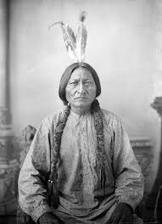
Unit 2 note questions 9/18 & 9/19
blob:http://www.history.com/89a206a1-806a-4cae-9106-285374823663
http://www.history.com/topics/native-american-history/sitting-bull
3. Why did they call him sitting Bull?
4. What treaty was broken causing all Sioux Indians to be killed?
5. Why was he killed?

Slide 8
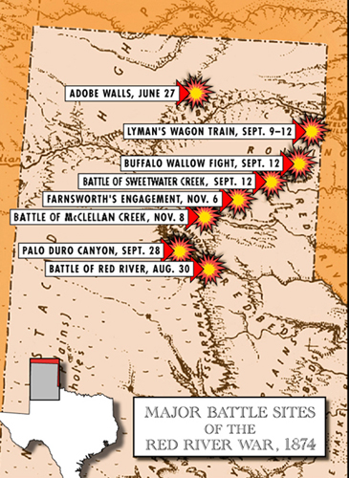
Red River War
1868 the Kiowa and Comanche engage in six years of raiding, in 1874 the U.S. Army crushes resistances and herded people onto reservations.
In 1874 the Gold Rush began when George A. Custer reported that the Black Hills had gold.

Slide 9
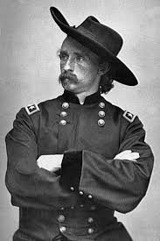
Custer’s last stand
Sitting Bull had visions during a Sundance that men of both sides were falling off their horses. When Colonel Custer and his troops reached Little Bighorn, Native Americans were ready.
Led by Sitting Bull, Crazy Horse, and Gall, the warriors crushed Custer’s troops; within an hour Custer and all his troops were dead.
By 1876 the Sioux were defeated and Sitting Bull and others took refuge in Canada… but eventually to avoid his people’s starvation, Sitting Bull was forced to surrender.

Slide 10
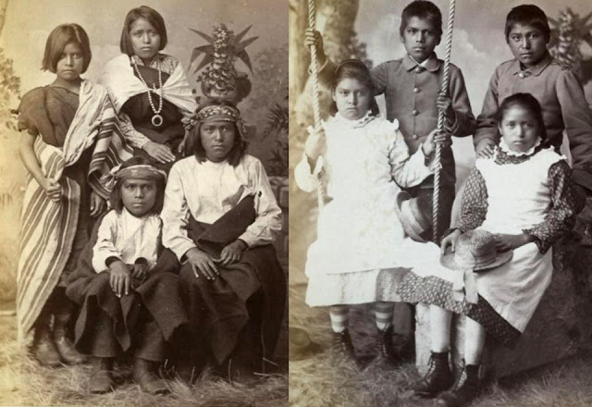
Assimilation
Unit 2 Notes Questions 9/18 & 9/19
6. What is assimilation?
Some reformers who were sympathetic to Native Americans suggested assimilation: Native Americans would give up their beliefs and way of life to become part of the white culture. The government built schools so they could be taught English and be “Americanized.”
In 1887, Congress passed the Dawes Act, which broke up reservations and gave some land to individual Native Americans to farm.
The government sold the remainder of the land to settlers.

Slide 11
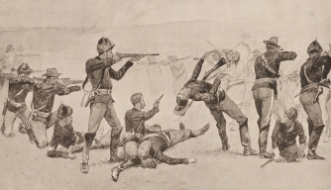
Battle of Wounded Knee
The Sioux, in desperation to get out of poverty and avoid disease, performed a Ghost Dance.
The military was alarmed and sent for the arrest of Sitting Bull. When the police came Sitting Bull’s body guard, Catch-the-Bear, shot one of them causing the police to then kill Sitting Bull.
The Seventh Cavalry (Custer’s old regiment) rounded up 350 Sioux to Wounded Knee. Ordered them hang over all their weapons; a shot fired and the soldiers opened fired and kill 300 mostly unarmed Native Americans, including children, within seconds.

