Slide 1
Farmers & the Populist Movement
Unit 2 Notes; 9/25 & 9/26; Page 3 & 4

Slide 2
Unit 2 Note Questions 9/25 & 9/26
Which of the following economic situations did American farmers face in the late 1800s? Select the two correct answers.
Increasing Debt
High Crop Prices
High Costs for Shipping
An increase in the Money Supply
A surplus of good land for farming
Why did farmers push the government to increase the money supply?
To lower crop prices
To increase the value of money
To make it easier to repay debts
To help lower transportation costs

Slide 3
Farmers Unite
Farmers unite to address their economic problems, giving rise to the Populist movement.
During the Civil War, the United States had issued $500 million in paper money, called greenbacks.
Greenbacks could not be exchanged for silver or gold money.
After the war, the government takes it out of circulation, hurting the economy.
Debtors have to pay loans in dollars’ worth more than those borrowed
Prices of crops fall dramatically
1878 – Bland-Allison Act required the government to buy and coin at least $2 million to $4 million worth of silver each month, but it wasn’t enough.

Slide 4
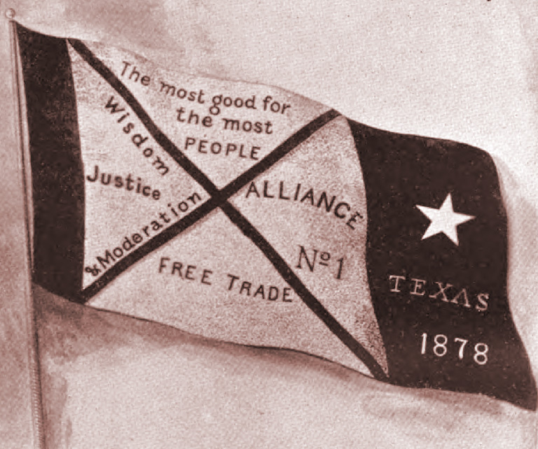
Farmers’ Alliances
Lack of competition let railroads overcharge to transport grain; Farms mortgaged to buy supplies; suppliers charge high interest
Oliver Hudson Kelley – started the Patrons of Husbandry, an organization for farmers that became known as the Grange; its original purpose was to provide a social outlet and an educational forum for isolated farm families.
Ended up spending most of the time fighting railroads
Lectures on interest rates, government control, banks

Slide 5
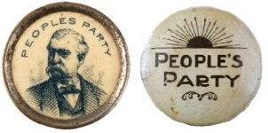
Populist Party Platform
Populism – the movement of the people, People’s party.
Wants reform; platform on economic, graduated income tax, federal loans
Concept that government is responsible for reforming social injustices
Becomes platform of future democratic party

Slide 6
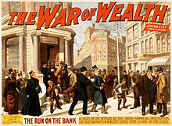
Panic of 1893
Panic of 1893 – Railroads expand faster than markets; some go bankrupt
Government’s gold supply washed-out, leads to rush on banks
Panic become depression

Slide 7
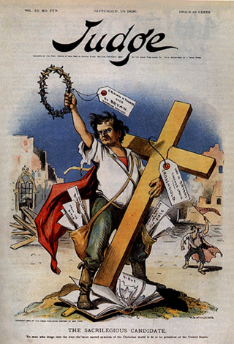
Unit 2 Note Questions 9/25 & 9/26
The point that this cartoon is trying to portray is that, Bryan is disrespecting the cross by being so against the joining of church and state. His most memorable speech was without a doubt the “Cross of Gold” speech in which Bryan calls to attention the silver and gold issue brought up by all the new silver and gold ore being mined and the decision whether or not to make a floating currency, or one based on the gold standard. What made this speech infamous was Bryan’s heavy reliance on religious symbolism. Many saw this as sacrilegious because many truly believed that politics was the trade of cheats and liars, both wholly unholy things.
3. William Jennings Bryan was the Democratic candidate for president in 1896 on a platform illustrated in the cartoon shown above. Bryan’s campaign positions on economic issues were very close to which of the following political groups of Bryan's period? A. Republican Party B. Populist Party C. Progressive Party D. Prohibitionist Party

Slide 8
Gold or Silver?
Political divisions: Republicans –Northeast business owners, bankers; Democrats: Southern, Western farmers, laborers.
Gold standard – backing dollars solely with gold – only create more stable economy if expensive currency
Bimetallism – system using both silver and gold to back currency; silverites thought this would create more money, stimulate economy
Paper money considered worthless
1896, Republicans commit to gold select William McKinley
Democrats favor bimetallism and choose William Jennings Bryan
Populists endorse
McKinley received about 7 million votes & Bryan 6.5 million.
McKinley gets the East and industrial Midwest; Bryan the South and farm
Populism ends, but sends a message that the oppressed could organize and have political impact

