Slide 1
Big Business
Unit 3 Notes (Pg. 2 – 4)

Slide 2
One American's Story
The expansion of industry results in the growth of big business and prompts laborers to form unions to better their lives.
Andrew Carnegie was one of the first industrial moguls to make his own fortune; controls almost entire steel industry
Successful because he constantly searched for ways to make better products more cheaply and use new machines, and he attracted talented staff by offering company stock and encouraged competition among his staff.
Vertical integration – buys out supplies to control materials
Horizontal Integration – merged or bought out competing companies

Slide 3
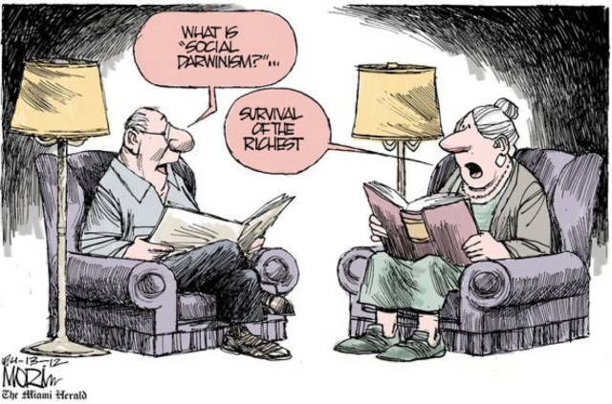
Social Darwinism
Americans understood that there were inequalities in the free enterprise system, but many thinkers believed that inequalities were part of the social order.
They embraced the philosophy of social Darwinism – basically social evolution; stronger people, businesses, and nations would prosper and weaker ones would fail.
Carnegie made his fortune building a single business; some tycoons made theirs by taking over and merging other people’s businesses.

Slide 4
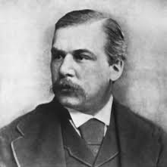
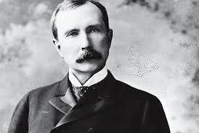
Eliminating the Competition
J.P Morgan created holding companies – corporations that did nothing but buy out the stock of other companies. He used his companies to gain control of the railroad, steel, and farm equipment industries. He merged the Carnegie Steel Company and others to form the U.S. Steel Corporation (world’s largest business at the time).
Another approach to merges was trusts, which is one John D. Rockefeller did. In a trust, competing companies put control of their businesses under a single group of trustees who run the separate companies as one large corporation.
Rockefeller founds Standard Oil Company; profits by paying low wages and underselling. When controls market, raises prices.

Slide 5
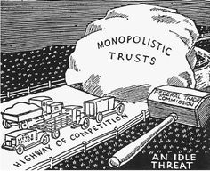
Government and Business
Critics call these industrialists robber barons. The government thinks expanding corporation stifle free competition and creates the Sherman Antitrust Act – trust is illegal if interferes with free trade, but prosecuting companies was difficult and the government stops enforcing it.

Slide 6
Labor Unions Emerge
As business leaders merged and consolidated their forces, it seemed necessary for workers to do the same. Although northern wages were generally higher than southern wages, exploitation and unsafe working conditions drew workers together across regions in a nationwide labor movement.
Most workers have 12 hour days and 6 day workweeks; perform repetitive, mind-dulling tasks; no vacation, sick leave, or injury compensation
To survive, families need all members to work, including children; sweatshops and tenant workshops often only jobs for women and children because it required few skills and pay lowest wages

Slide 7
Early Labor Organizing
NLU was the first large-scale national organization.
Gets Congress to give 8-hour day to civil servants
Local NLU chapters reject blacks and Colored National Labor Union forms
Noble Order of the Knights of Labor created and open to women, blacks, and unskilled – “An injury to one is the concern of all.”
Craft unions include skilled workers from one or more trades
AFT founded by Samuel Gompers; uses collective bargaining and strikes, which was effective.
Eugene V. Debs formed the ARU and becomes the largest union group and uses strikes.

Slide 8
Socialism?
Some labor activists turn to socialism – government control of business and property; equal distribution of wealth
IWW or Wobblies forms - organized by radical unionists and socialists; included African Americans
Most industrial unions were not too large, but they gave dignity and a sense of solidarity to unskilled workers.
Japanese, Mexicans, Chinese, and other immigrants form unions – Sugar Beet and Farm Laborers in California.
Increase both the overall strength of the labor movement and the tension between labor and management.

Slide 9
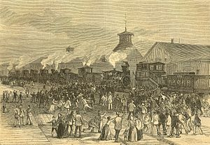
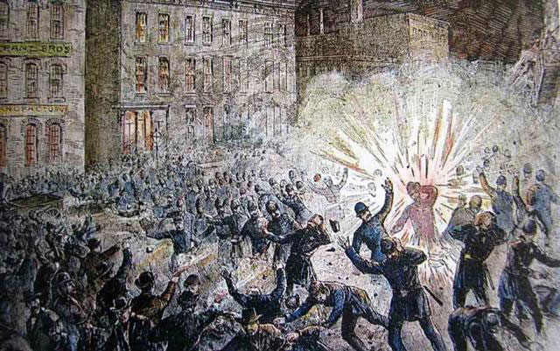
1… 2… 3 strikes your out in American business!!!!!!!!!!
The Great Strike of 1877 – Baltimore and Ohio Railroad strike to protest their second wage cut in two months.
Spreads to other lines coving over 50,000 miles and stopped trains for a week.
President Hayes had to come in and use federal troops to end the strike.
The Haymarket Affair – 3,000 gather at Chicago’s Haymarket Square to protest police brutality
Someone tossed a bomb into the police line… Police fired on the workers… Seven police officers and serval workers died in the chaos; 8 were charged with inciting riot and convicted.
This even turns public opinion against labor movement.

Slide 10
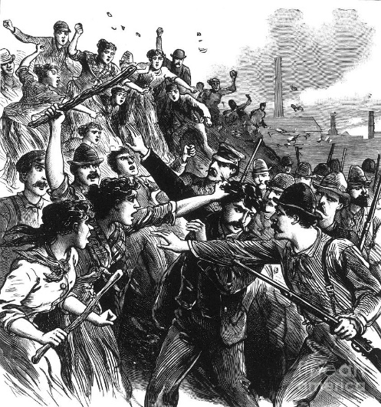
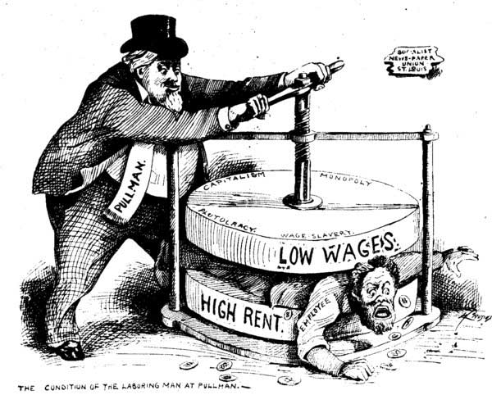
1… 2… 3 strikes your out in American business!!!!!!!!!!
The Homestead Strike – Carnegie Steel workers strike over pay cuts.
Company president hires pinkertons (strike breakers)… At least 3 detectives and nine workers died before steelworkers could hold them off until National Guard arrived.
Plant reopened, but steelworkers do not remobilize for 45 years.
The Pullman Company Strike – Pullman lays off 3,000 and cuts wages so workers strike
Eugene Debs (leader of ARU) requests negotiation, but Pullman refuses and violence occurs.
President Cleveland sent in federal troops, Debs was jailed, and most strikers were fired.

Slide 11
Women Organize
Women banded in many unions and united behind powerful leaders.
The most prominent organizer in women’s labor was Mary Harris Jones. Her nick name was “Mother Jones” because “she fights their battles with a Mother’s Love.”
She worked for United Mine Workers and led a children’s march.
Pauline Newman, at just 16 years old, was the organizer for International Ladies’ Garment Workers
1911 Triangle Shirtwaist factory – The public could no longer ignore conditions of these factories.
A fire broke out in this factory and it spread swiftly through the oil-soaked machines and piles of cloth.
As the workers, mostly immigrant women, attempted to escape, they discovered the company had locked all but one exit doors to prevent theft. That one door had fire behind it.
In total, 146 women died, but the factory owners were somehow acquitted of manslaughter.

Slide 12
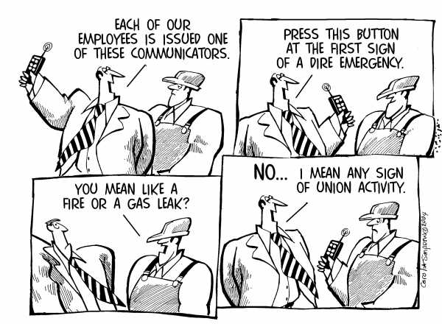
Pressure on Unions
Management of companies begin to fear unions. They forbade meetings and fired members. They required new employees to sign “yellow-dog contracts”, swearing that they would not join a union.
They turned the Sherman Antitrust Act against labor claiming striking and boycotting would hurt interstate trade.
Regardless, numbers of unions continued to rise and people continued to act.

