Slide 1
Gilded Age
Unit 3 Notes (Pg. 5 – 6)

Slide 2
Political Machine
Local and national political corruption in the 19th century leads to calls for reform.
Political Machine, an organized group that controls city political party, gives services to voters in exchange for political or financial support.
After the Civil War, machines gain control of major cities.
They’re organized like a pyramid: Precinct (local) captains, ward (electoral district), city boss.
Sometimes the city bosses served as the mayor, but if not he still: controls access to city jobs and business licenses, influences courts, and arranges building projects.
Many bosses were second generation immigrants and connected to the poor by doing favors and speaking their native tongues.
Machines use electoral fraud to win elections. Graft illegal use of political influence for personal gain.
For example, by helping a person find work on a construction project for the city, a political machine could ask the worker to bill the city for more than the actual cost. The worker then “kicked back” a portion of the earnings to the machine.

Slide 3
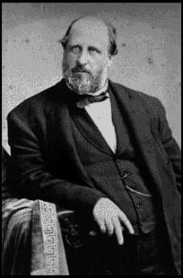
Political Corruption
William M. Tweed, known as the Boss Tweed, was one of the biggest abusers. He was indicted on 120 counts of fraud.
Another form of corruption in politics is patronage, which was the practice of giving government jobs to people how had helped a candidate get elected.
Most civil service were earned this way.
Reformers press for merit system of hiring.
Reformers made progress under presidents Hayes, Garfield, and Arthur.

Slide 4
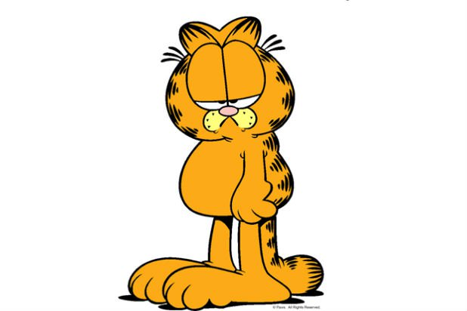
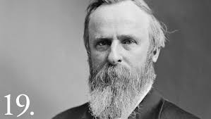
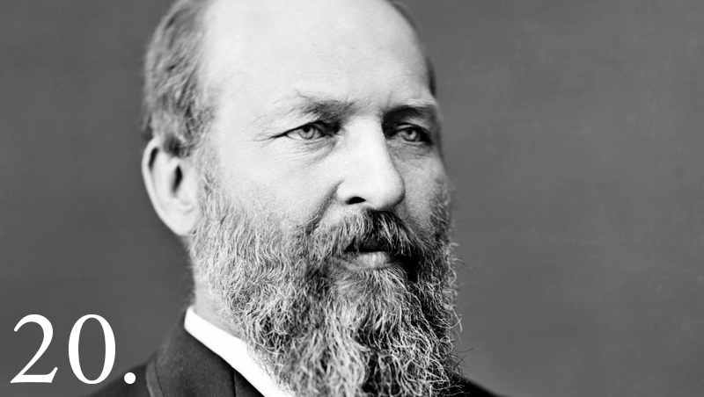
Presidents!!: Hayes, Garfield
Rutherford B. Hayes could not convince Congress, so he named independents to his cabinet and creates warrant to investigate corruption. He fired two who were in control of the Republican party and decides not run for president again.
Stalwarts (people who opposed changes) and reformers could not win a majority. They settle be electing James A. Garfield, a reformer, and his Vice President would be Chester A. Arthur, a stalwart.
July 2nd, 1881 an unbalanced lawyer (who Garfield had turned down for a job) shot the President at a train station in Washington D.C. He shouted “I did it and I will go to jail for it. I am a Stalwart and Arthur is now president.”

Slide 5
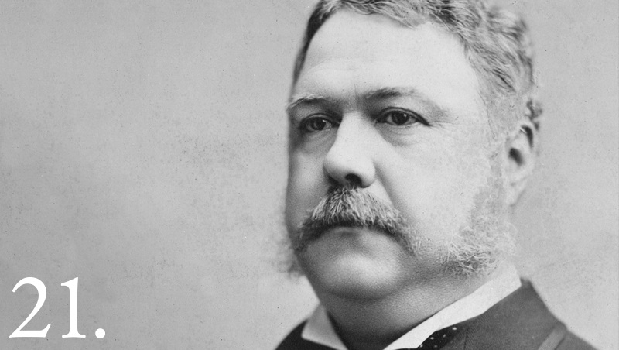
Arthur….
President Arthur turns into a reformer after this and passes Pendleton Civil Service Act – appointments for federal jobs based on exam score.
The act semi backfired. Officials could no longer pressure employees for campaign contributions and had to turn to wealthy business owners for donations.
Business wants high tariffs that protect domestic industries from foreign competition.
Democrats oppose this because that increases prices.

Slide 6
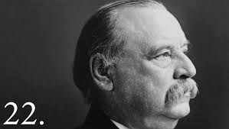
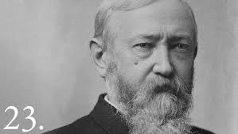
Cleveland, Harrison
In 1884 the Democratic Party won an election for the first time in 28 years with Grover Cleveland.
He tried to lower tariff, but Congress denied.
When Cleveland ran for reelection his platform was for low-tariff, and he ran against Benjamin Harrison (grandson of President William Henry Harrison) whose campaign was financed mostly by large contributions from companies that wanted even higher tariffs.
Harrison lost the popular vote, but won the electoral.
President Harrison passed the McKinley tariff, which raised tariff on manufactured goods to the highest.

Slide 7
Cleveland Again!
In 1882 Cleveland was elected again – the only president to serve two nonconsecutive terms.
By the 1900s there were 58 cities and 4 out of 10 people lived in cities.
Thanks to the invention of elevators, architects begin to build skyscrapers which is America’s greatest contribution to architecture.
Louis Sullivan designs the Wainwright Building and Daniel Burnham designs the Flatiron building.
Need for open spaces inspires people like Frederick Law Olmstead begin to plan urban parks like Central Park.
By the 1890 the U.S. literacy rate is almost 90% which causes a growing demand for newspapers, magazines, and books.

