Slide 1
Immigration
Unit 3 Notes (Pg. 4 – 5)

Slide 2
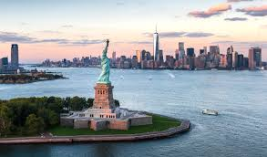
Through the “Golden Door”
Immigration from Europe, Asia, Mexico, and the Caribbean forces cities to confront overcrowding.
Some immigrants were drawn in by the promise of a better life, while others were pushed out by things such as famine, land shortages, religious and/or political persecution.
Others were known as “birds of passage,” which were people who intended to immigrant temporarily and make money to return home with.

Slide 3
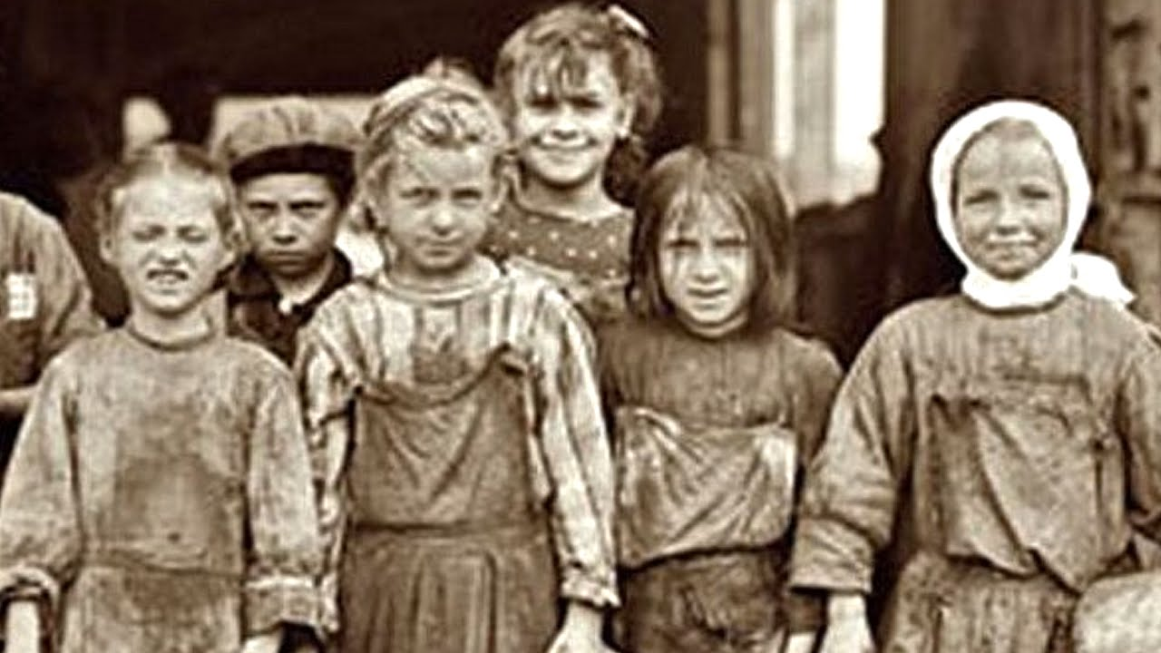
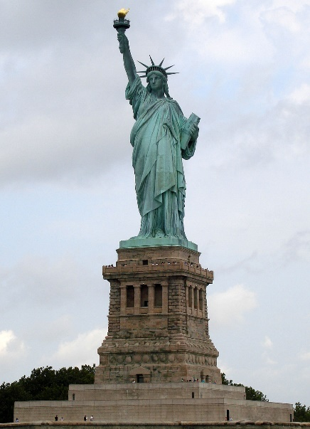
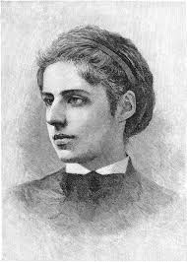
Europeans
1870 – 1920 about 20 million Europeans arrived in the U.S. on the east coast.
Jews are driven out of Russia by pogroms.
Europe was over populated and farming land was scarce.
“Keep ancient lands, your storied pomp!” cries she With silent lips. “Give me our tired, your poor,
Your huddled masses yearning to breath free, The wretched refuse of your teeming shore. Send these, the homeless, temperst-tost to me, I lift my lamp beside the golden door!”

Slide 4
Come on vamanos… Everybody Lets go (to America)
About 300,000 Chinese arrive in the late 1800s attracted by the Gold Rush.
Worked in railroads, farms, mines, domestic service
Japanese immigrants first worked on plantations in Hawaii and then migrated to the West Coast – about 200,000 by the 1920s.
About 260,000 immigrants came from West Indies (Cuba, Jamaica, Puerto Rico) to the eastern and southeastern part of the U.S. seeking industrial jobs
Mexicans flee political turmoil and in 20 years about 7% of the current population (700,000) immigrated to Southern America.
The National Reclamation Act created new farmland in western states.
Immigrants travel by steamship, most in steerage (like coach for a boat) – took a week to cross the Atlantic and three to cross the Pacific.
Conditions were harsh – rarely allowed on deck, sleep in lice infested bunks. Many died on the journey.

Slide 5
U.S. Immigration Patterns as of 1900s

Slide 6
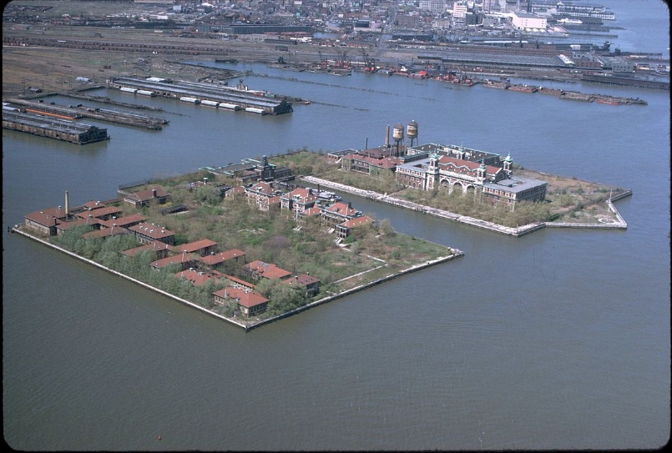
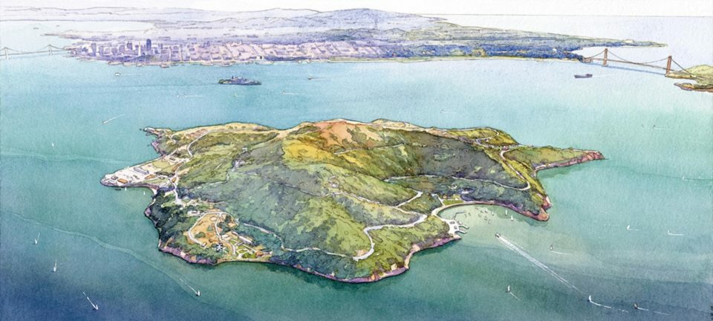
When you thought the hard part was over….
Immigrants had to pass inspection at immigration stations.
Most would be held there one day waiting inspection, but less than 2% were denied entry.
Immigrants given physical exam by doctor; seriously ill not admitted
Then they had to meet with a government inspector to prove they had never been convicted of a felony, demonstrating that they were able to work, and showing that they had some money (at least $25 in 1909).
Ellis Island – chief U.S. immigration station in New York Harbor. 1892 – 1924 17 million immigrants processed
Angel Island – station in San Francisco Bay; Immigrants endure harsh questioning, long detention for admission

Slide 7
Unit 3 Notes Questions 10/5 & 10/6
Which of the following is a pull factor that drew immigrants to settle in the U.S. during the late 1800s and early 1900s?
Famine
Land Shortages
Religious Persecution
Promise of a better life
What is the first thing that immigrants at Ellis Island encountered once the got off the ship?
Interrogation by a government investigator
Physical examination by a medical professional
Interviews for employment by local factory owners
Dark and crowded conditions with lice-infested bunks

Slide 8
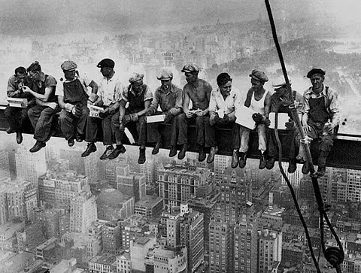
Life in the New Land
Immigrants must create a new life: find work, home, and learn new ways. Many seek people who share cultural values, religion, and language.
Ethnic communities form – immigrants can speak native tongue, some even had newspapers.
Friction between Americans and immigrants develops “hyphenated” Americans.
The U.S. becomes a melting pot – people blend by abandoning native culture and adapting new ones.

Slide 9
The Rise of Nativism
A negative reaction to immigration was nativism – favoritism towards native-born Americans; began to create Anti-immigrant groups.
They believed Anglo-Saxons superior to other ethnic groups; people from the “right” countries (British, German, Scandinavian)
Many reject immigrants’ religion (Catholicism and Judaism) because they think it will contradict democracy.
In 1897, Congress passed literacy bill for immigrants. Although President Grover Cleveland vetoes, it a powerful statement of public feeling.
Despite President Woodrow Wilson’s veto in 1917, a similar bill passes.
Nativism finds foothold in labor movements, especially in the West. People feared that the limited amount of jobs available would go to Chinese immigrants because they will work for less.
In 1882 the first significant law restricting immigration was past – the Chinese Exclusion Act.
The statue suspended Chinese immigration for ten years… and then ultimately they remained ineligible until 1943.

Slide 10
Gentlemen’s agreement
These fears were extended on to the Japanese as well.
In August of 1900, Japan agreed to deny passports to laborers, but couldn’t control their alternative methods.
As more Japanese immigrants came, racial antagonism intensified and on Oct. 11th, 1906 San Franciso school board arranged for all Asian children to be placed in a segregated school.
This upset the Japanese who were trying to comply with America’s request. President Roosevelt did not want to ruin relations with Japan as a county to Russian expansion in the Far East.
On February 24, the Gentlemen’s Agreement with Japan was concluded that the Japanese note agreeing to deny passports to laborers intending to enter the U.S. and recognizing the U.S. right to exclude Japanese immigrants holding passports originally issued for other countries. This was followed by the formal withdrawal of the San Francisco school board order on March 13, 1907.

Slide 11
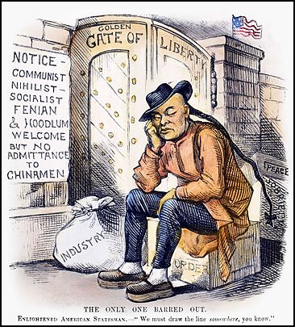
Unit 3 Notes Questions 10/5 & 10/6
~Cartoon made in response to the Exclusion Act~
3. What group was denied entry? Why?
4. What group or groups were welcome? Why?
5. What country is located on the other side of the “Golden Gate of Liberty”

Slide 12
Urban Opportunities
Most immigrants settle in cities because industrialization leads to urbanization.
New farm technology decreases need for laborers so people move to cities.
Many African Americans lose their livelihoods: the escape the south just to find slightly less segregation and discrimination in the North
Working-class families live in either houses on outskirts of town and face transportation problems or live in boarding houses.
Immigrants tended to take over row houses, 2 – 3 families per house or tenements
Social stratification, or organization of people into social classes by wealth, was clearly on display in NYC.

Slide 13
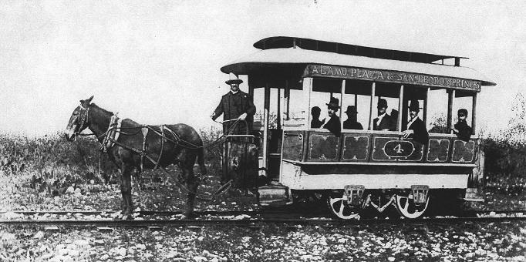
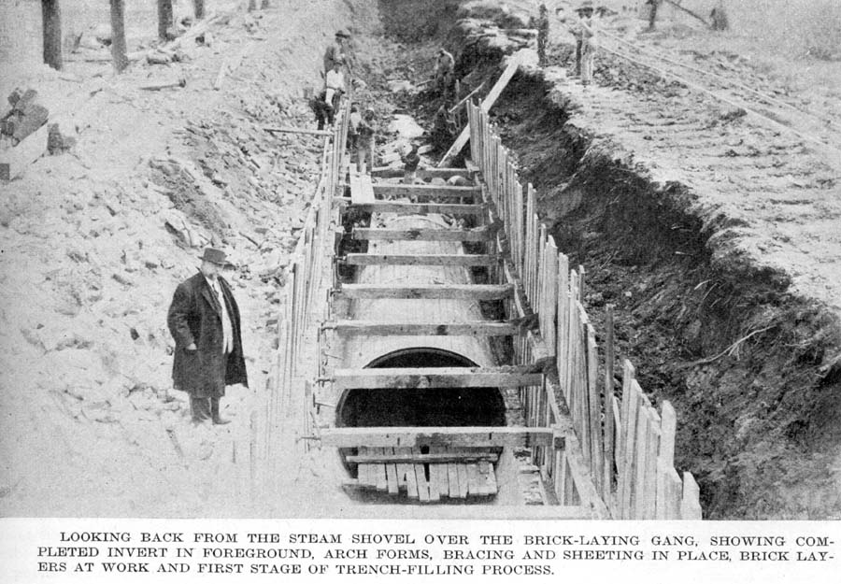
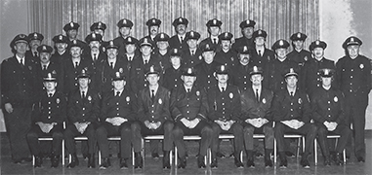
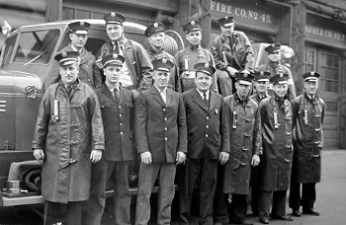
Some Important “first”
Mass transit, like streetcars, were introduced to move large numbers of people along fixed routes.
In response to poor sanitation (manure, open gutters, factor smoke, etc.) cities develop sewer lines and create sanitation departments.
As population grows, thieves flourish. In 1844 NYC organized the first full-time salaried police force.
In 1853 Cincinnati, Ohio established the nation’s first paid fire department in response to major fire hazards from limited water, wood houses, candles, and kerosene heaters.

Slide 14
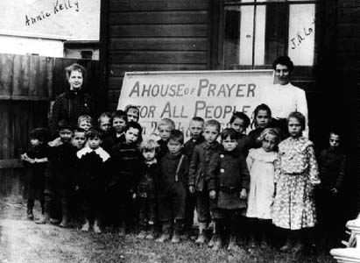
Reformers Mobilize
Social reformers begin to work to relieve urban poverty and begin the Social Gospel movement. Preaches salvation through service to poor.
Members of the movement believed the church had a moral duty to help.
Settlement houses are built – community centers in slums to help immigrants. They’re run mostly by college-educated women and provide educational, cultural, and social services, send visiting nurses to the sick and help with personal, job and financial problems.

