Slide 1
Progressivism
Unit 3 Notes (pg. 7 – 8)

Slide 2
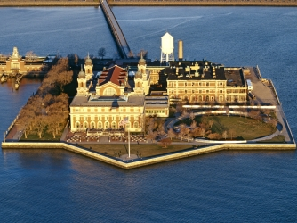
Unit 3 Notes Questions 10/11 & 10/12
Select true or false for the following statements about Ellis Island.
Single women could be deported if they didn’t have a male relative to vouch for them.
Prior to Ellis island, immigrants on the East Coast were processed at Angel Island.
More people immigrated to the West Coast than the East Coast.
All immigrants had a pass a medical examination before they were admitted to the country.

Slide 3
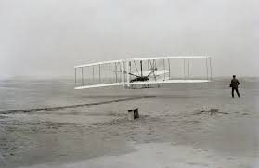
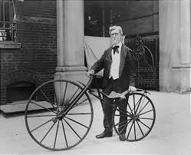
Some more firsts…
Orville and Wilbur Wright use engines to fly “heavier-than-air” craft on Dec. 1903 in Kitty Hawk, North Carolina.
By 1920 the first transcontinental air mail is established.
As Americans have more time for leisure activities, a modern mass culture emerges.
Amusement parks begin to be built on outskirts with picnic grounds, rides.
The first bicycle is dangerous and is only for males. As it becomes safer it becomes more popular.

Slide 4
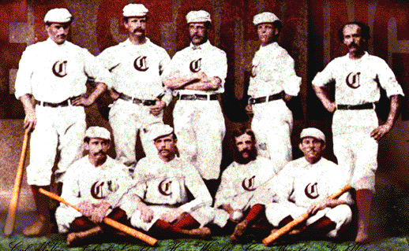
Take me out to the ball game…
Americans become fans of spectator sports like boxing and baseball.
In 1845 an amateur player, Alexander J. Cartwright organized an official club and set down rules.
In five years there were 50 baseball clubs.
In 1869 a professional team, Cincinnati Red Stockings, tours the nation.
By 1876 the National League is formed and the American League in the 1900.
Discrimination leads to Negro National, Negro American Leagues.

Slide 5
Sin, sex, and sensation
Newspapers use sensational headlines and stories to capture readers.
Joseph Pulitzer buys New York World and emphasized “sin, sex, and sensation” and his competitor William Randolph Hearst who published exaggerated stories.
Libraries begin to pop up and most people like dime novels that glorified adventure tales of the West.
Mark Twain rejects high culture yet writes American classics.
Shopping centers open and Marshall Field opens the first department store in Chicago.

Slide 6
Progressivism
Political, economic, and social change in late 19th century America leads to broad progressive reforms and the progressive movement.
Reformers aim to restore economic opportunity and correct injustice by protesting social welfare, promoting moral improvement, creating economic reform, and fostering efficiency.
The Social Gospel movement and settlement houses are the start of softening the harsh conditions of industrialization.
Florence Kelley was a political activist who helped pass the Illinois Factory Act which prohibited child labor and limited women’s working hours.
Other reformers felt that morality, not the workplace, held the key to improving the lives of poor people.
Prohibition, the banning of alcohol, was one way to encourage poor city dwellers to uplift themselves.
WCTU spearheaded the crusade for prohibition.

Slide 7
Reforming works??
Reformers try to make government more efficient and responsive to voters; some cities adopt government by commission.
Governors push states to pass laws to regulate large businesses.
One success was Robert M. La Follette; 3-term governor then senator in Wisconsin
Set up a program where the government received help from professors at the University of Wisconsin in writing laws and providing expert advice.
Based on the theory that government should be controlled by voters rather than business leaders.
Efforts to limit working hours:
Muller v. Oregon – Court upholds limiting women to 10-hour workday
Bunting v. Oregon – upholds 10-hour workday for men
Reformers also succeed in getting workers’ compensations for families of injured or killed
Oregon adopts secret ballot, initiative, referendum, and recall.
Seventeenth Amendment permits popular election of senators.

Slide 8
Unit 3 Notes Questions 10/11 & 10/12
5. Which of the following correctly describes a commission form of city government?
A political boss buys votes and favors with brides.
A city council is elected by the people to make laws.
An experienced person is appointed to run all of the city’s departments.
A group of experts is appointed with each expert heading one city department
6. What effect did the statewide primary system have on politics?
It enabled voters to remove public officials from elected positions.
It allowed voters to choose candidates for office.
It made it easier for political bosses to manipulate elections.
It gave citizens the power to create new laws.

Slide 9
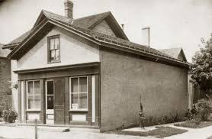
Reform Education
Reforms in public education lead to a rise in national literacy and the promotion of public education.
During the late 1800s, states pass laws requiring schools attendance for children.
Kindergartens originally designed for childcare for working women, but as it became more popular it became a requirement.
By 1880, 62% of white children and 34% of black children are in elementary school.

Slide 10
It is where you guys are!
The industrial economy demands technical and managerial skills. By 1900, more than half a million students are in high school.
Less than 1% of black teenagers attend high school and 2/3 of that number wen to private school.
For example, Mary McLeod Bethune stated one in Daytona Beach, Florida. With less than $20 in her budget, she rented a house and built desks. Through her work in education and civil rights, she attracted help from wealthy donors such as Rockefeller and Eleanor Roosevelt.
Immigrants were encouraged to attend school and be Americanized.
Some resent the suppression of their native languages.
Many public schools read from the bible.

Slide 11
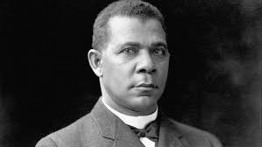
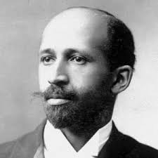
Higher Education for African Americans
By the turn of the century, 2.3% of youth attend college and research universities emerge.
African Americans excluded from most universities.
Brooker T. Washington believed that racism would end once blacks acquired useful labor skills and proved their economic value to society.
Washington was born enslaved, graduated from Virginia’s Hampton Institute and headed the Tuskegee Normal and Industrial Institute, now called Tuskegee University in Alabama.
W.E.B. Du Bois was the first African American to get Harvard doctorate and disagrees with Washington. He founds the Niagara Movement to encourage liberal arts study and believes well-educated future leaders needed.

