Slide 1
Teddy, Taft, and Wilson
Unit 3 Notes (Pg. 9 & 10) LAST NOTES

Slide 2
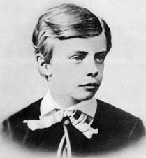
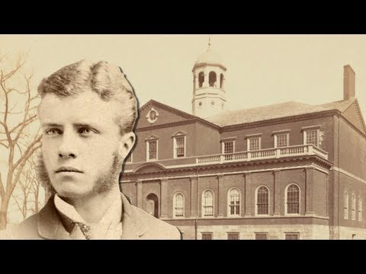
Young Theodore Roosevelt
As president, Theodore Roosevelt works to give citizens a Square Deal through progressive reforms.
As a child, Roosevelt suffered from severe asthma and a respiratory disease. Due to this, he was forced to be home schooled. He was determined to overcome being ill and at age 12 mastered marksmanship and horseback riding.
Roosevelt went to Harvard College where he boxed, wrestled, and began to develop his political career.
3 term state assembly; NYC police commissioner; Rough Riders; Governor; VP
Roosevelt was William McKinley’s president for only 6 months till McKinley was assassinated by an anarchist.

Slide 3
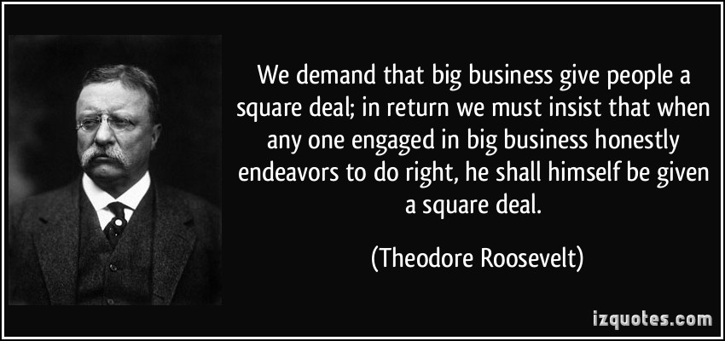
Square deal by Theodore Roosevelt
Roosevelt saw the presidency as a “bully pulpit” from which he could influence the news media and shape legislation.
When the states did not solve problems, he supported using the federal government to fix things. This came known as Square Deal, which is the term used to describe the various progressive reforms sponsored by his administration.

Slide 4
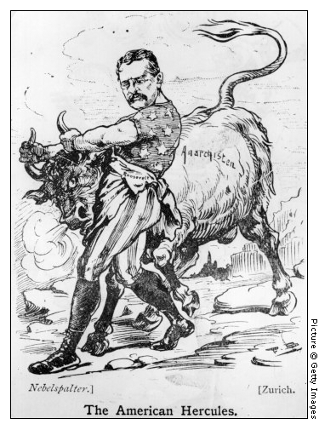
Roosevelt Fixes Problems
In 1902, 140,000 coal miners went on strike. The mine operated refused to bargain. Five months into the strike, coal reserves ran low and threatens public life. Roosevelt was irked by the “Extraordinary stupidity and bad temper” he later confessed that the dignity of the presidency was the only thing that kept him from taking own owner “by the seat of the breeches” and toss him out the window.
A third-party commission was formed and progress for miners was made.
Most importantly, sets principle of federal intervention when strikes threatens public.
Roosevelt continues to push for federal regulations to control abuses – passes Elkins Act, which stops sudden rate changes in railroad and the Hepburn Act which forces ICC to set maximum rates.

Slide 5
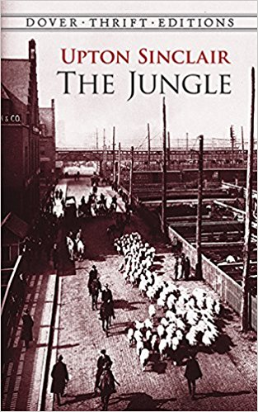
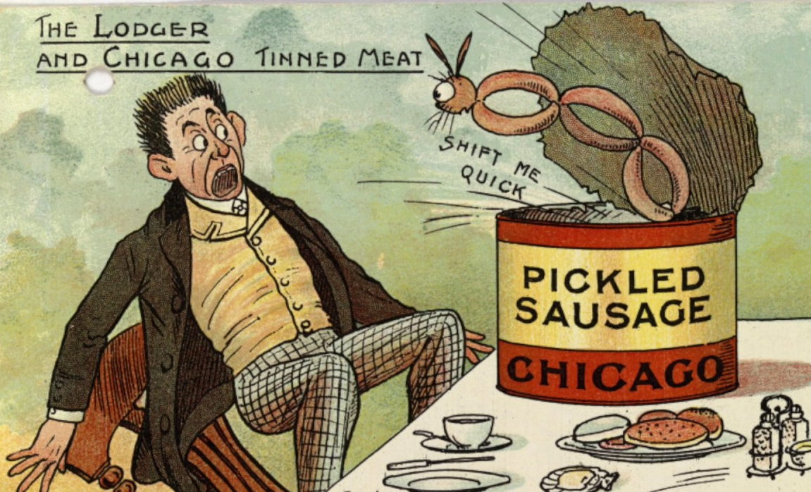
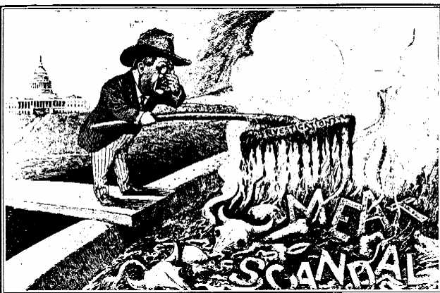
YUM FOOD
After reading Upton Sinclair’s novel The Jungle, Roosevelt demands investigation of meatpacking industry.
Pushes for Meat Inspection Act, which dictates sanitary requirements and creates federal meat inspection program.
Also passes the Pure Food and Drug Act which stops advertisements from making false claims and the sale of contaminated food, medicine requires truth in labeling.

Slide 6
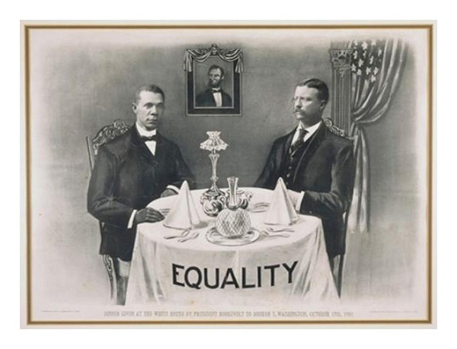
Makes Progress, but not everywhere
Roosevelt is also partial to the environment and establishes the U.S. Forest Bureau and sets aside forest reserves, sanctuaries, and national parks.
Roosevelt’s concern for the land and its inhabitants was not matched in the area of civil rights. He failed to support civil rights for African Americans, but he did support a few individuals.
He invited Booker T. Washington to the White House. (FIRST AFRICAN AMERICAN)

Slide 7
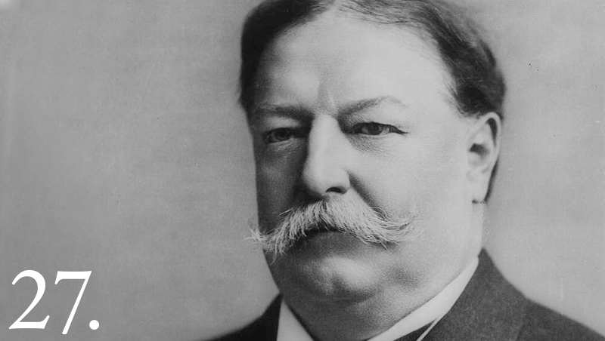
“BIG WILL”
In 1908, Republican William Howard Taft wins with Roosevelt’s support.
Cautiously progressive agenda and receives little credit for successes.
He angers Progressives by not being as aggressive and accomplishing as much as Roosevelt.
He signs the Payne-Aldrich Tariff which only moderated the high rates.
He named Richard A. Ballinger the interior secretary and Ballinger removed 1 million acres of forest land form reserved list.
One man, Gifford Pinchot, speaks out against Ballinger and is fired.

Slide 8
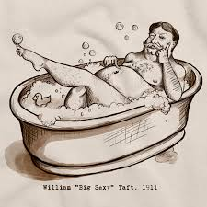
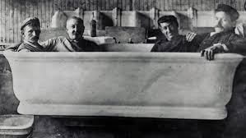
ANNNNNNNNNNNNND He’s gone….
Republicans split over Taft’s support of House Speaker Joseph Cannon and the Democrats get control of House in the 1910 midterm elections.
For the 1912 election, Progressives form the Bull Moose Party and nominate Teddy Roosevelt for he is “as strong as a moose.” Their platform was more voter participation in government, women suffrage, and labor legislation.
With Republicans split between Roosevelt and Taft, Woodrow Wilson wins the election.

Slide 9
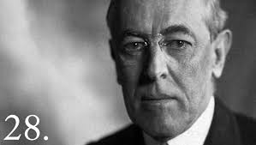
Coiner of Weasel Words
Wilson endorses platform called the New Freedom and wants strong antitrust laws, banking reform, and lower tariffs.
Wilson was a lawyer, professor, president of Princeton, and NJ governor.
Passes the Clayton Antitrust Act which stops companies buying stock to form monopoly.
Creates the Federal Trade Commission – new “watchdog” agency to investigate regulatory violations and end unfair business practices.
The Sixteenth Amendment legalizes graduated federal income tax.
Federal Reserve System is created – private banking system under federal control.

Slide 10
ProgRess… Progress… WAR.
College-educated women spread suffrage message to working-class
“Women begin all voters into the world – Let Women vote”
Carrie Chapman Catt, head of NAWSA, stresses organization and lobbying.
1920 the Nineteenth Amendment grants women right to vote
As a candidate, Wilson wins support of NAACP by speaking out about civil rights.
As President, similar to Taft and Roosevelt, opposes anti-lynching legislation for the federal government.
NAACP feels betrayed, but with the outbreak of World War I, all Americans are distracted and reform efforts stall.

