Slide 1
Imperialism
Unit 4 Notes (Pg. 1)

Slide 2
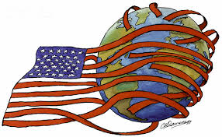
Objectives:
What is the policy of imperialism?
What were the major factors that contributed to the growth of American imperialism?

Slide 3
Early Encounters
Beginning in 1867 and continuing through the century, global competition causes the United States to expand.
Imperialism – policy in which stronger nations extend their economic, political, or military control over weaker territories
As the US expanded west in the mid-19th century, new port cities on the Pacific coast gave the nation the opportunity to expand its global trade network as well.
Feelings of nationalism, or national pride in the US grew; Americans believed in the superiority of America’s political and cultural ideas. Three factors fueled American imperialism.
Desire for military strength
Thirst for new markets
Belief in cultural superiority

Slide 4
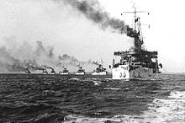
Global Competition
European nations had been establishing colonies for centuries. In the late 19th century, Africa had emerged as a prime target of European expansionism.
Only Ethiopia and Liberia were the only African countries that remained independent.
Imperialists also competed for Asia. Japan joins the race against the U.S. for China.
Japan was isolated and it didn’t agree to trade until the U.S. sent warships into Tokyo Bay.
1. Admiral Alfred T. Mahan urges U.S. to build up navy to compete.
The U.S. builds modern battleships such as the Maine and the Oregon and becomes the third largest naval power.

Slide 5
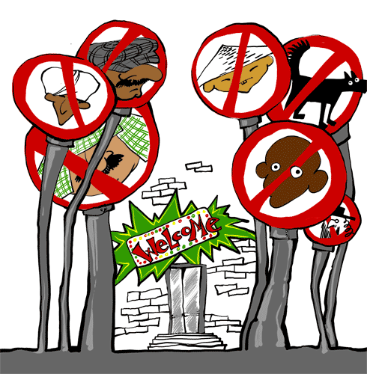
American Expansionism
2. Advances in technology enabled American farms and factories to produce far more than American citizens could consume.
U.S. needs new markets for goods and the solution is foreign trade to solve overproduction, unemployment, and depression.
3. The same xenophobia that helped pass the Chinese Exclusion Act in 1882 fueled imperialist ideas about foreign nations.
Some combine Social Darwinism with the belief in superiority of Anglo-Saxons.
Argued the U.S. had a responsibility to spread Christianity and democracy to “civilize” the world’s “inferior peoples.”

Slide 6
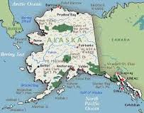
Early Expansion
William Seward served as Secretary of State under Presidents Lincoln and Johnson.
1867 arranged purchase of Alaska from Russia for $7.2 million.
He had trouble convincing the House to fund purchase – called it “Seward’s Icebox”
They were proven wrong in 1959 when Alaska became a state and it was rich in timber, minerals, and oil.

Slide 7
Where American business goes… American military follows
Since the 1790s, U.S. merchants stop in Hawaii on their way to places like China, India
By the mid 1800s, American-owned sugar plantations are 75% of islands’ wealth
In 1887, U.S. pressures Hawaii to allow naval base at Pearl Harbor and it becomes a refueling station.
1890 the McKinley Tariff eliminates duty-free (no taxes on imports) status on Hawaiian sugar; causes planters to encourage annex islands so will not have to pay duty
In 1887 business men force King Kalakaua to limit vote to landowners… when he died, his sister, Queen Liliukalani tries to remove landowning requirement “Hawaii for Hawaiians”
With help of marines, business groups overthrow queen and set up government headed by Sanford B. Dole
President Cleveland cannot make Dole surrender and Congress proclaims Hawaii as U.S. territory.

Slide 8
U.S. unit 4 note Questions – 10/30 & 10/31
The United States tried many strategies to get Japan to negotiate trade agreement with them. However, the Japanese leaders were not interested in discussing trade. So, as a final effort, the United States gave the impression that they would use military force when they sent _____________________ on July 8th, 1853.
William Seward was an American leader who supported the idea of American expansionism. Because he felt this way, he arranged for the ________________.
In the late 1800s, most of the Americans living in Hawaii were wealthy sugar plantation owners. They didn’t want to pay duties on sugar that they sent to the United States. One way to stop paying those fees was to __________________.

