Slide 1
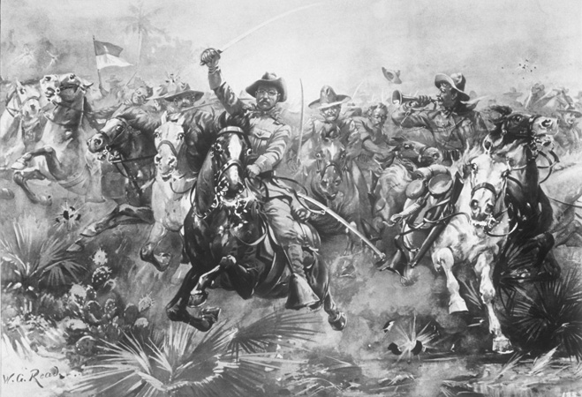
Treaty of Paris
The U.S. then set up a blockade of the Spanish fleet in Santiago de Cuba harbor.
Unlike the navy, the U.S. had army made up of many volunteers who were ill-prepared and ill-supplied.
Leonard Wood and Theodore Roosevelt lead a volunteer cavalry known as the Rough Riders.
Roosevelt was declared a hero of attack on strategic San Juan Hill.
Treaty of Paris: Spain and the U.S. sign an armistice August of 1898 in Paris; Spain frees Cuba, hands over Guam & Puerto Rico, sells Philippines.

Slide 2
Unit 3 Note Questions
1.After _________________________ , the American public demanded that the United States take action against Spain and go to war.
2. Theodore Roosevelt joined the Rough Riders and led an infantry attack. Newspapers declared him the hero of __________________________.

Slide 3
U.S. as a World Power
Unit 4 Notes (pg. 2 – 3)

Slide 4
Post Spanish-American War
Puerto Rico was a strategic post in the Caribbean for protection of future canal.
Congress passed the Foraker Act sets up civil government and takes away military control. President appoints governor. In 1917, Puerto Ricans are made U.S. citizens.
The U.S. recognizes Cuban independence from Spain and passes the Teller Amendment which says U.S. has no intention of taking over Cuba.
The American military helps rebuild the country.
U.S. makes Cuba add the Platt Amendment to is new constitution; no treaties that led foreign power control land, U.S. has right to intervene, U.S. can buy, lease land for navy.
Cuba became U.S. protectorate, a country whose affairs are partially controlled by a stronger power.

Slide 5
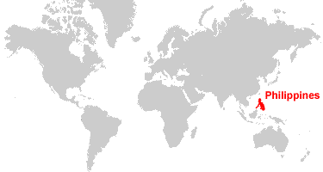
Aftermath in the Philippines
Filipinos outraged at Treaty of Paris and demand annexation. Emilio Aguinaldo leads fight.
U.S. forces Filipinos to live in designated zones in poor conditions; white U.S. soldiers see Filipinos as inferior; black troops troubled a spreading prejudice
20,000 Filipinos die in fight for independence
U.S. President appoints governor and they’re not independent until July 4th, 1946.

Slide 6
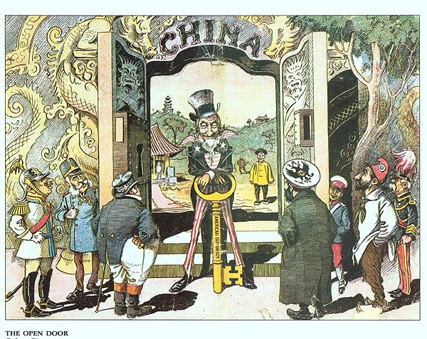
Foreign Influence in China
U.S. sees China as vast potential market and investment opportunity. Fearing that other imperialist nations (France, Britain, Japan, Russia) might get power first, U.S. Secretary of State John Hay issues Open Door Notes. Notes ask nations to share trading rights with U.S. so no one country forms a monopoly.
Europeans dominate most large Chinese cities; out of rebellion, Chinese form secret societies like the Boxers
Boxer Rebellion – kill hundreds of foreigners, but international forces shut it down killing thousands
Hay feared Europe would use this rebellion to take more control of China and made amendments to the Open-Door policy: the U.S. would “safeguard for the world the principle of equal and impartial trade with all parts of the Chinese Empire.”

Slide 7
Imperialist vs. Anti-Imperialists
McKinley’s reelection confirms most Americans favor imperialism regardless of the formation of the Anti-Imperialist League.
For various reasons, they agreed it was wrong to rule others without consent.

Slide 8
Unit 4 Notes Questions
6. Why did the people of Puerto Rico probably dislike the Foraker Act?
It forbade Puerto Ricans from traveling outside their country.
It allowed the U.S. Supreme Court to try Puerto Rican citizens
It required that Puerto Ricans buy goods only from American merchants.
It let the president of the United States to choose the top Puerto Rican leaders.
7. What are two reasons the U.S. imperalists were interested in China?
China was open to new religious points of view.
China was seen as a vast market for foreign products.
China had a struggling government that was about to collapse.
China had forbidden the formation of uniosn and secret societies.
China had large geographic areas that would eventually need railroad construction

Slide 9
Teddy Roosevelt & The World
The Russo-Japanese War, the Panama Canal, and the Mexican Revolution add to America’s military and economic power.
Russia and Japan were fighting for control of territories in East Asia. Roosevelt negotiates the Treaty of Portsmouth to avoid country control the world.
Japan gets Manchuria and Korea
Roosevelt won Nobel Peace Prize
U.S. builds the Panama Canal to cut travel time of commercial and military ships.
Buys French company’s route through Panama
U.S. signs treaty; U.S. pays $10 million for Canal Zone
Connects Atlantic to Pacific

Slide 10
Teddy Roosevelt and the World
Many Latin American countries borrowed money from European banks to industrialize; Roosevelt feared Europeans would intervene in these nations.
Reminded them of the Monroe Doctrine and then creates the Roosevelt Corollary – U.S. force to protect economic interest
The U.S. exercises its police power and issues dollar diplomacy – U.S. guarantees foreign loans by U.S. business.

Slide 11
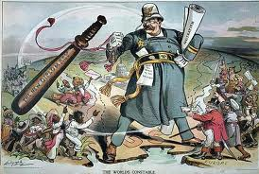
“The World’s Constable”
This cartoon, drawn by Louis Dalrymple in 1905, shows Teddy Roosevelt implementing his new world diplomacy. The cartoon implies that Roosevelt has the right to execute police power to keep the countries of Europe (shown on the right) out of the affairs of Latin American countries (shown on the left)
How does the cartoonist portray President Roosevelt ?

Slide 12
Woodrow Wilson Missionary Diplomacy
Under dictator Porfiro Diaz many U.S. investors held land in Mexico.
In 1911, peasants and workers led by Francisco Madero overthrew Diaz.
With Diaz dead, General Victoriano Huerta takes over the government; then Madero was murdered
President Wilson refuses to recognize Huerta’s government
Wilson adopted a plan of “watchful waiting” and had soldiers off the coast of Tampico
Huerta officers arrested U.S. sailors
Wilson orders Marines to occupy Veracruz, an important Mexican port.
Wilson refused to leave or recognize a government that had come to power because of violence and Huerta regime falls
Nationalist Venustiano Carranza is the new president and Wilson recognizes him.

Slide 13
Woodrow Wilson Missionary Diplomacy
Francisco “Pancho” Villa and Emiliano Zapata oppose Carranza
They threat reprisals and kill Americans
Wilson sends General John J. Pershing lead force to capture Pancho
Carranza demands withdrawal of U.S. troops – Wilson refuses and leads to war
Eventually, since U.S. was facing a war in Europe, wanted peace on southern border; Wilson orders Pershing home.
Mexico adopts a new constitution: government controls oil and minerals, which restricts foreign investors
In 1920 Alvaro Obregon becomes new president and ends Mexican civil war.

