Slide 1
Allied Victory
Complete your battle chart.
Notes at 8:10

Slide 2
Liberation
The Battle of the Bulge left Germany severely weakened – Allied troops pressed into their heartland.
Soviet troops were the first to come upon the Nazi death camps.
SS guards scrambled to bury and burn all evidence of their hideous crime, but time was not their friend.
When the Soviets entered Majdanek, they found a thousand starving prisoners barely alive and the world’s largest crematorium. Soviet Soldier “This is not a concentration camp. It is a gigantic murder plant.” Pg. 556
Germany tried to escape the Allied forced by stationing in The Rhine and burning all bridges to it, but the Americans reached the railroad bridge before they could.

Slide 3
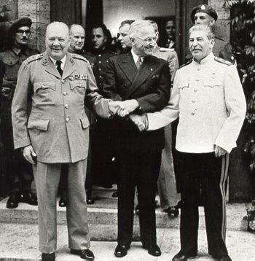
Yalta Conference
In February 1945, Churchill and FDR traveled to Yalta to meet with Stalin to discuss the expected defeat of Germany.
Germany would be divided into four occupation zones controlled by the Americans, British, Soviets, and the French.
Stalin agreed to join the war against Japan, which was struggle that was expected to continue for another year.

Slide 4
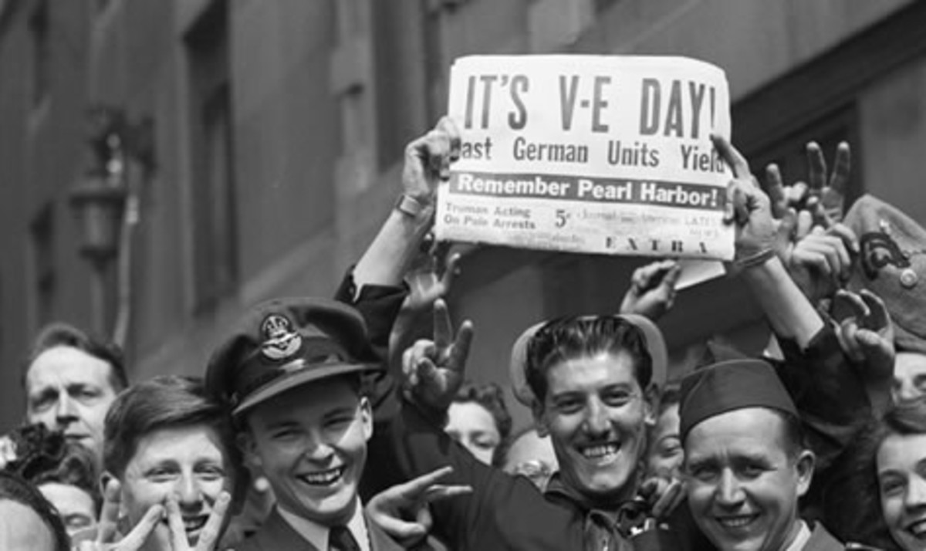
V-E Day
By April 25th of 1945, the Soviet army had stormed Berlin. Hordes of soldiers stationed in berlin deserted and were shot on the spot or hung from the nearest tree with cards on their chests reading ‘we betrayed the fuhrer’
On April 29th, Hitler married his longtime companion, Eva Braun. The same day he wrote out his last address to the German people. He blamed the Jews for starting the war and his generals for losing it. The next day, Hitler shot himself while his new wife swallowed poison.
A week later, General Eisenhower accepted the unconditional surrender of the Third Reich and on May 8th, 1945, the Allies proclaimed V-E Day – Victory in Europe Day.

Slide 5
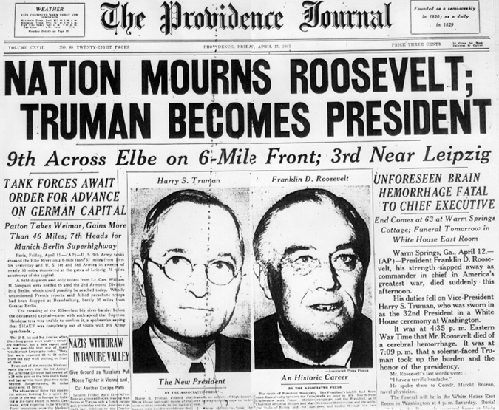
FDR -> Truman
Sadly, President Roosevelt did not live to see V-E Day. On April 12th, 1945, while posing for a portrait in Warm Springs, Georgia, the present had a stroke and died. Served as president for 13 years!
Vice President Harry S. Truman became the nation’s 33rd president that same night.

Slide 6
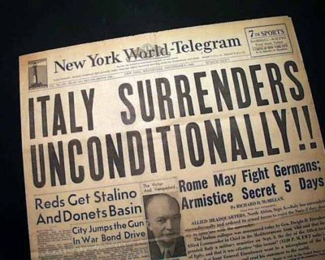
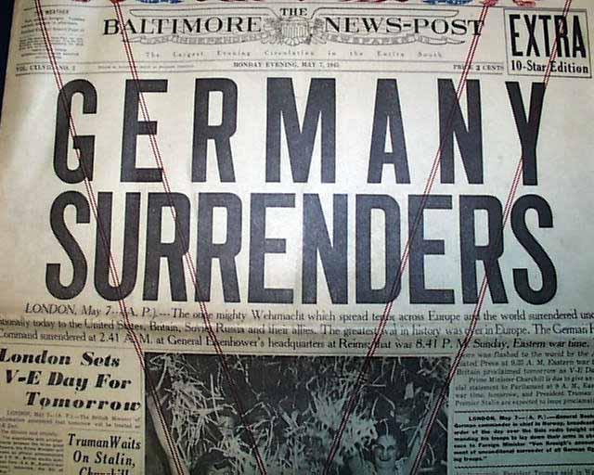
Two down, one more to go
With the fall of Italy and the surrender from Germany, all focus turned to Japan.
The taking of Iwo Jima and Okinawa open the way for an invasion of the Japanese homeland, but they still had a huge, destructive army that the Allies knew would be tough to defeat.

Slide 7
Pros & Cons of Atomic Bomb
President Truman saw the only way to avoid an invasion and achieve victory was to use the atomic bomb.
The Manhattan Project had been in progress for years. It cost more than $2 billion and involved over 600,000 Americans.
Many scientists believed the bomb should be used to end the war and save American lives.
Many political advisors believed the bomb should be used to prevent Soviets from entering the Pacific war and give the U.S. an advantage.
Many scientists and advisors argued however that the bomb was immoral and unnecessary because Japan must be on the verge of surrender.

Slide 8
The war is over
Ultimately, Truman decided that the bomb was the way to achieve the goal of total victory with the lowest cost of American lives.
A day after Truman’s order to the military, the U.S. and the other Allies warned Japan that it faced “prompt and utter destruction” unless it surrendered at once. Japan refused.
On August 6th, 1945, at atomic bomb, code-named Little Boy was released over Hiroshima, an important Japanese military center. 43 seconds later, almost every building in the city collapsed into dust from the force of the blast.
STILL, Japanese leaders hesitated to surrender.
Three days later, a second bomb, code-named Fat Man was dropped on Nagasaki, a major Japanese military port and shipping base.
By the end of the year, an estimated 200,000 people had died due to injuries and radiation poisoning caused by the atomic blasts.
Finally, Hirohito expressed he could not watch the innocent people of his empire suffer any longer and drew up papers for a formal surrender.
Now the Allies are tasked with rebuilding war-torn nations in a changed world.

