Slide 1
- Take out your packets - Do your vocabulary

Slide 2
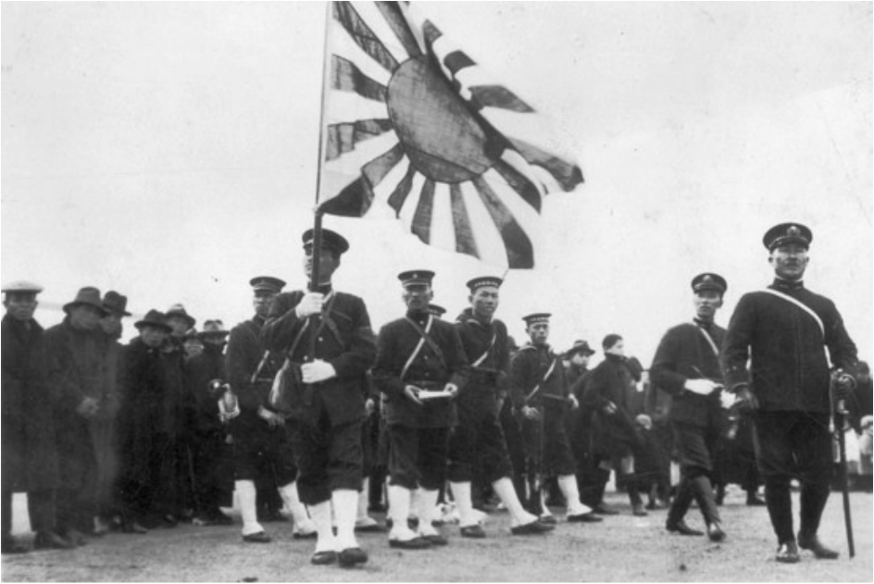
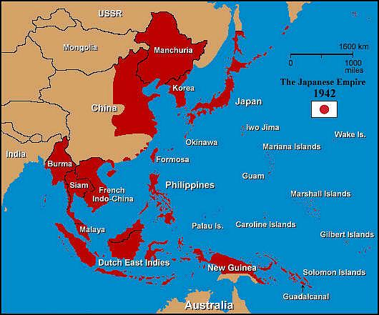
Japan
In 1931 the militarists in control of Japan’s government launched a surprise attack and seized control of the Chinese province of Manchuria. This action was a significant test of the power of the League of Nations. The League condemned Japan, who in turn simply quit.

Slide 3
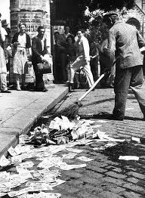
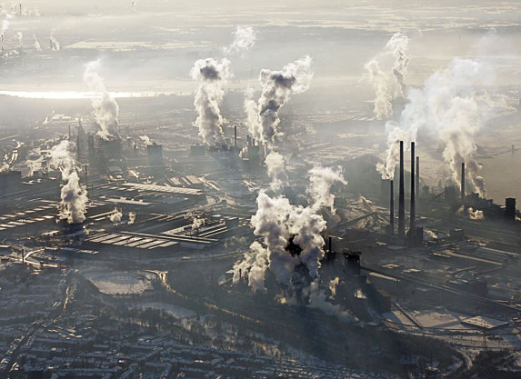
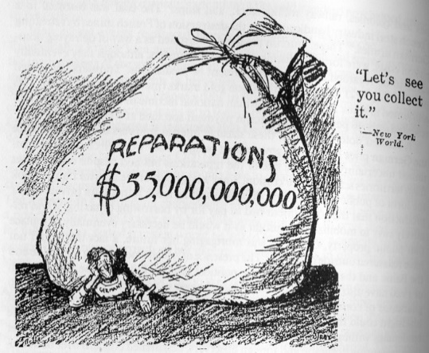
Ruhr Valley
1933 Hitler pulled Germany out of the League of Nations and began a military buildup in violation of the Treaty of Versailles.
A year later he sent troops into the Rhineland, a German region bordering France and Belgium that was demilitarized. The League did nothing to stop Hitler.

Slide 4
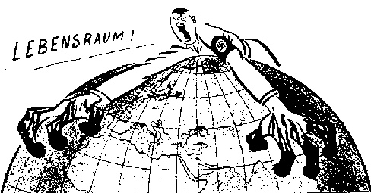
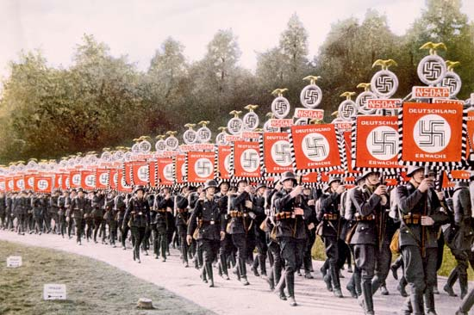
Rise of the Nazi Party
Pursing the Nazi idea of lebensraum, Hitler advocated for absorbing Austria and Czechoslovakia into the Third Reich

Slide 5
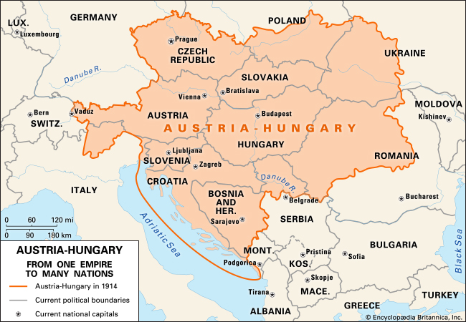
Anschluss
Austria was Hitler’s first target. The Paris Peace Conference following WWI had created the nation of Austria out of what was left of the Austria-Hungary Empire. The majority of Austria’s 6 million people were German descent who favored unification with Germany.
On March 12, 1938, German troops marched into Austria unopposed. A day later Germany announced that its Anschluss, or “union,” with Austria was complete.

Slide 6
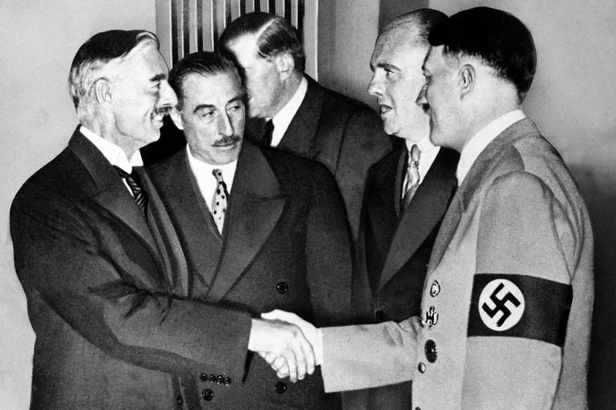
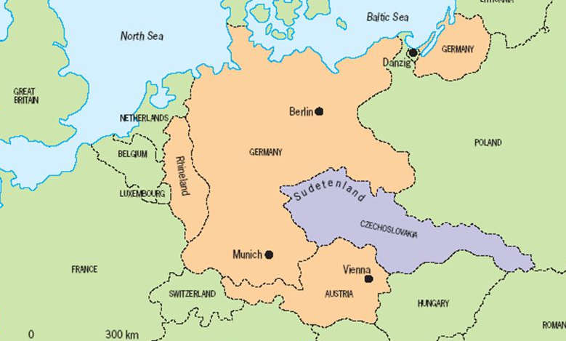
Munich Agreement
Hitler then turned to Czechoslovakia. About 3 million German-speaking people lived in the western border regions of Czechoslovakia which were called the Sudetenland.
The Czechs were not as easy to convince and were promised to be protected by France and Great Britain. Since war seemed inevitable, Hitler invited the French and British leaders to meet with him in Munich. When they arrived, he declared that the annexation of the Sudetenland would be his “last territorial demand.”
In their eagerness to avoid war, Daladier and Chamberlain chose to believe him. On September 30, 1938, they signed the Munich Agreement, which turned the Sudetenland over to Germany without a single shot being fired.

Slide 7
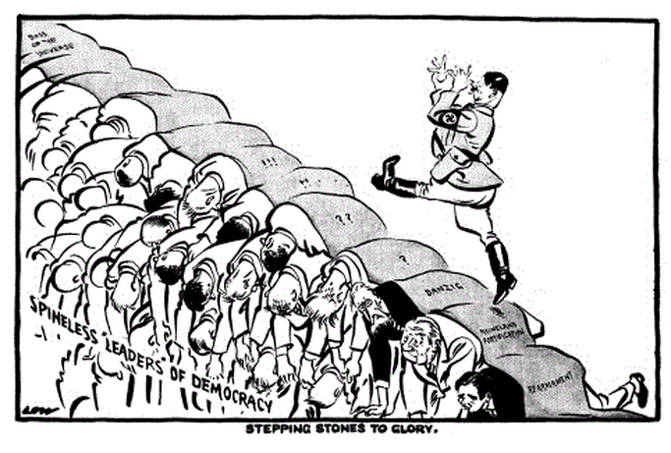
Appeasement
Chamberlain’s satisfaction was not shared by Winston Churchill, his political rival in Great Britain.
Churchill’s view, by signing the Munich Agreement, Daladier and Chamberlain had adopted a shameful policy of appeasement—or giving up principles to pacify an aggressor.

Slide 8
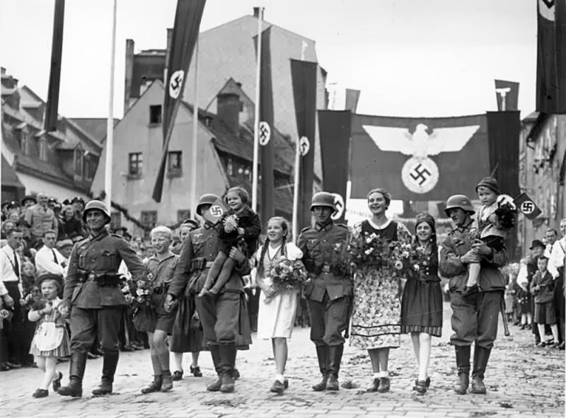
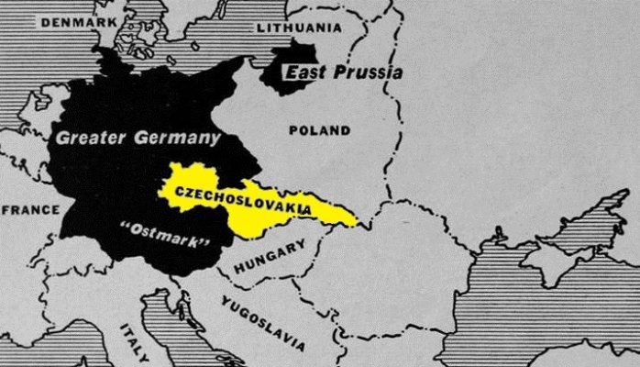
More space!
As Churchill had warned, Hitler was not finished expanding the Third Reich. As dawn broke on March 15, 1939, THREE DAYS LATER German troops poured into what remained of Czechoslovakia. The German dictator turned his land-hungry gaze toward Germany’s eastern neighbor, Poland.

Slide 9
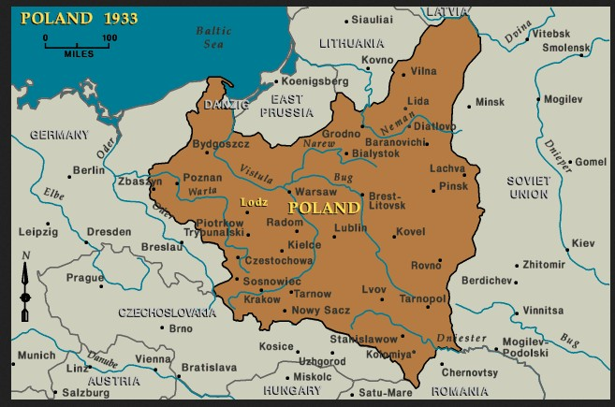
Not this again
Most believed that Hitler was bluffing and would not go through attacking Poland.
This attack would lead to a conflict with the Soviet Union, Poland’s eastern neighbor and would provoke a declaration of war from France and Britain
Fighting on two fronts had exhausted Germany in WWI, Hitler would not be foolish enough to repeat the mistake

Slide 10
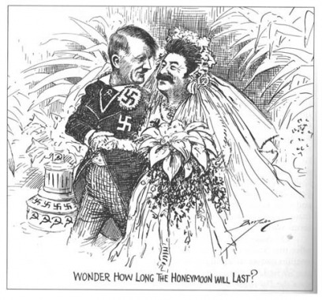
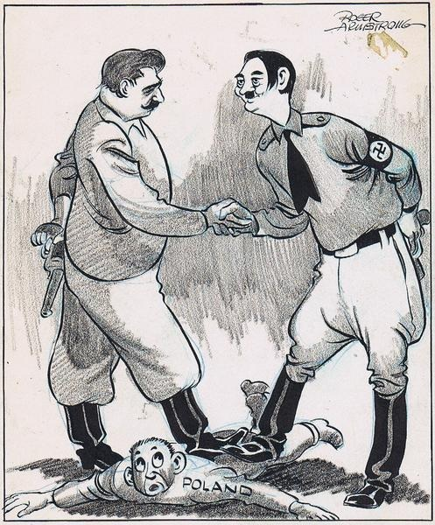
Nonaggression Pact (not cool Stalin)
As tensions rose over Poland, Stalin surprised everyone when he signed a nonaggression pact with Hitler. On August 23, 1939, fascist Germany and Communist Russia now committed never to attack each other. Germany and the Soviet Union also signed a second, secret pact, agreeing to divide Poland between them.

Slide 11
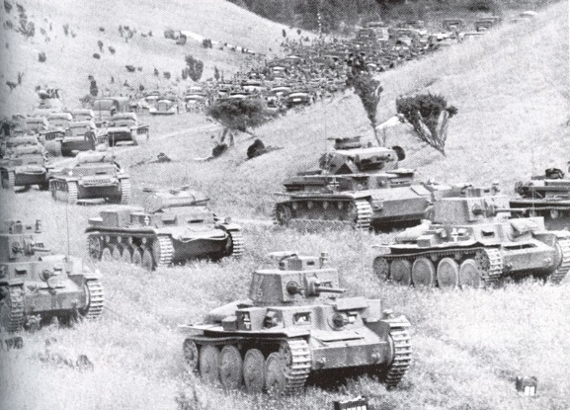
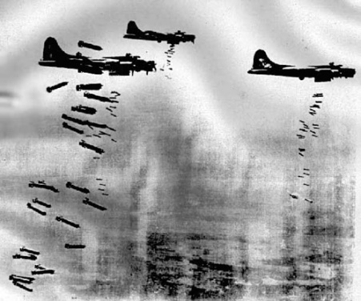
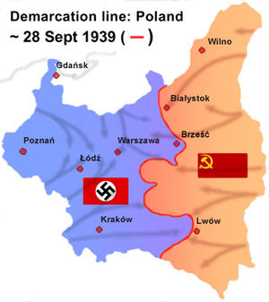
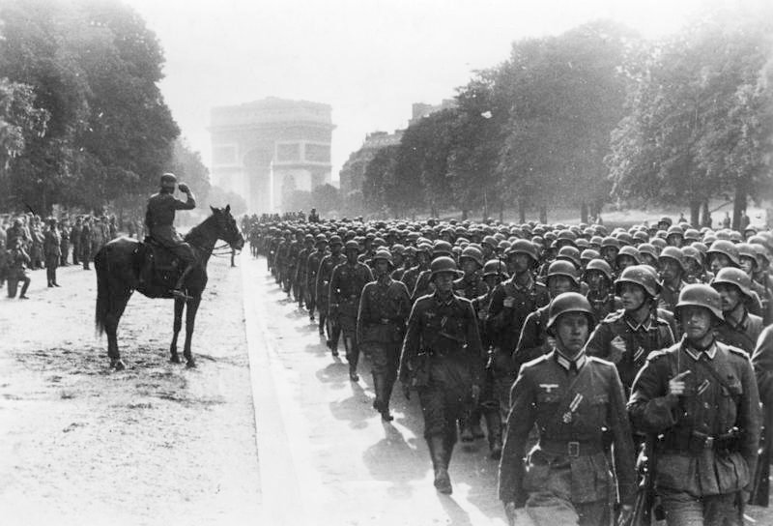
Bye Poland
September 1, 1939, Germany issued its newest military strategy, blitzkrieg, or lightning war – To take the enemy by surprise and then quickly crush all opposition with overwhelming force.
The main element of blitzkrieg was surprise, and it worked perfectly. With the Soviet Union taking parts of Poland in the east, Poland ceased to exist just like Czechoslovakia and Austria.
On September 3, two days following the terror in Poland, Britain and France declared war on Germany and WWII had officially begun.

Slide 12
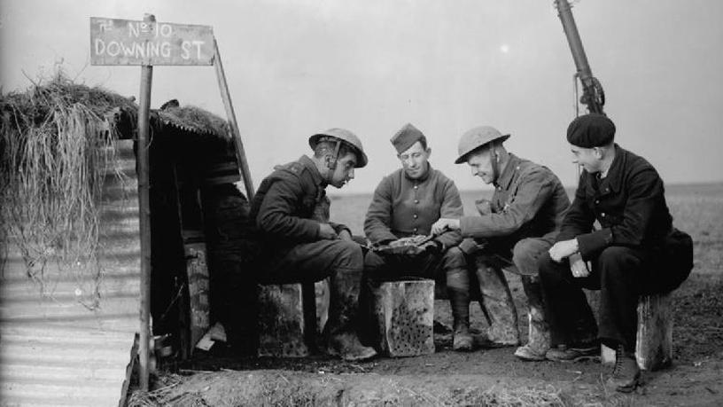
Your move, boss
For several months after the fall of Poland, the war was at a stand-still. Germans called it “sitzkrieg” (sitting war). It is known as the Phony War. Hitler and Stalin danced around Europe unmatched
French and British troops on the Maginot Line waiting and German troops on the Siegfried Line.

Slide 13
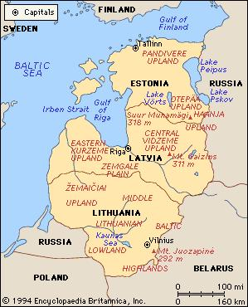
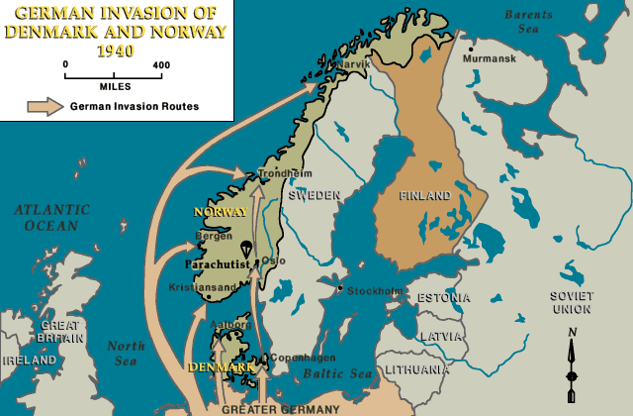
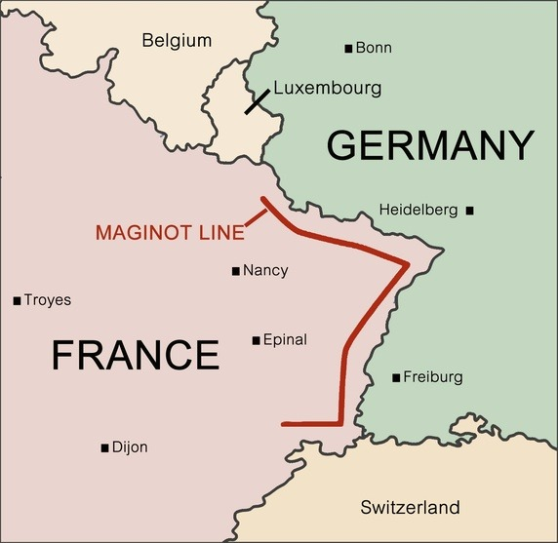
You snooze, you lose
After occupying eastern Poland, Stalin began annexing Baltic states (Estonia, Latvia, and Lithuania) and Finland.
Suddenly, Hitler launched an invasion on Denmark and Norway. He wanted to build bases along the coasts to strike at Great Britain. Then he attacked the Netherlands, Belgium, and Luxembourg. This ended the Phony War.
The Maginot Line proved to be ineffective and could have easily been bypassed, but Hitler sent tanks through the Ardennes instead trapped almost 400,000 British and French soldiers and troops fled.

Slide 14
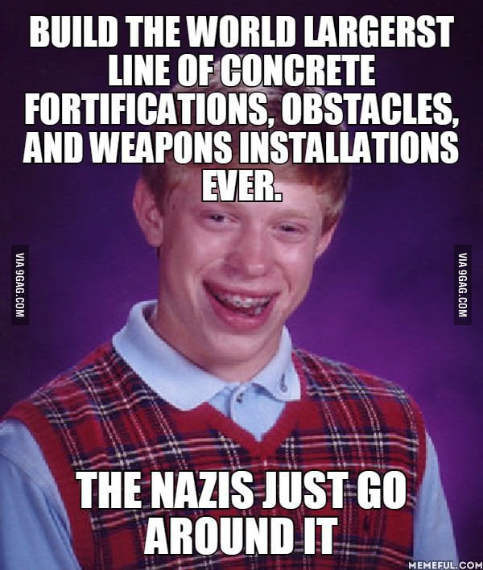
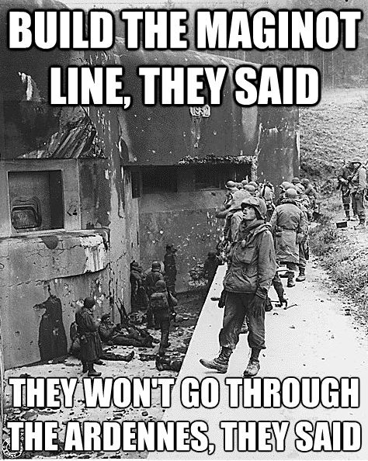
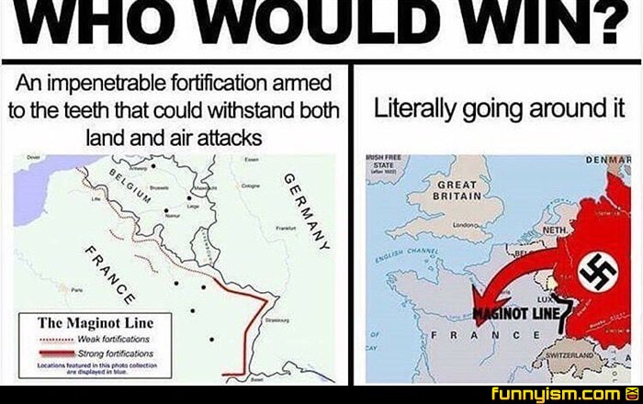
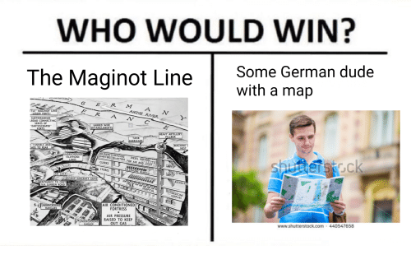

Slide 15
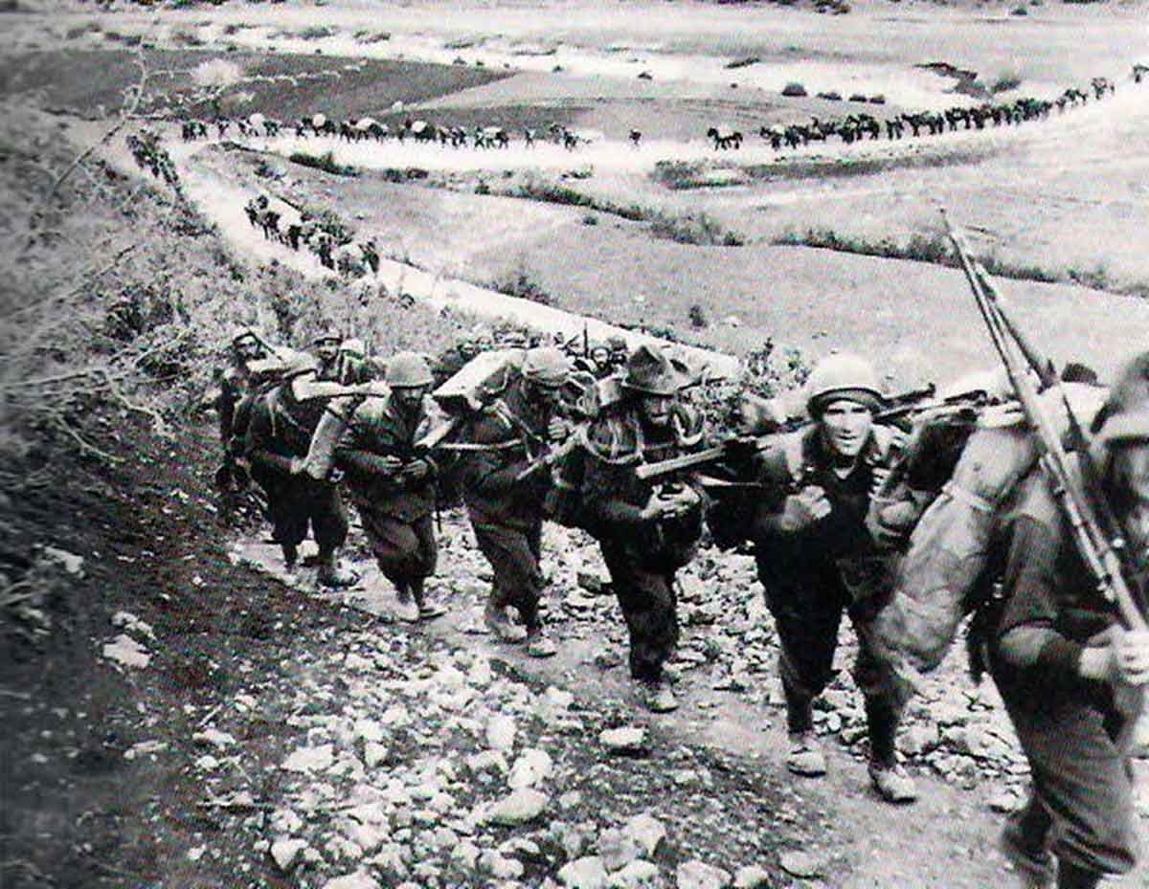
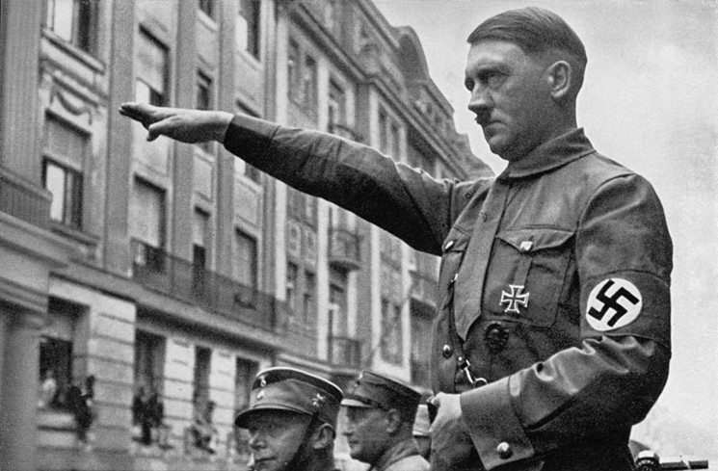
Another one bites the dust
A few days later, Italy joined the war as Germany’s ally and invaded France from the South as Germany closed on Paris from the north.
On June 22nd, 1940, France was forced to surrender. Germany would occupy France and set up a Nazi-controlled puppet government.
Charles de Gaulle fled to England and set up a government-in-exile. “France has lost a battle, but France has not lost the war.”
Over the next five years (1939-1944) the nations of Europe would be fighting for their right to exist.

