Slide 1
Holocaust
Notes:
All of them wanted to take control of their respective nations. They generally wanted to make their nations more powerful or gain more territory or resources to benefit their nations but at the expense of others.

Slide 2
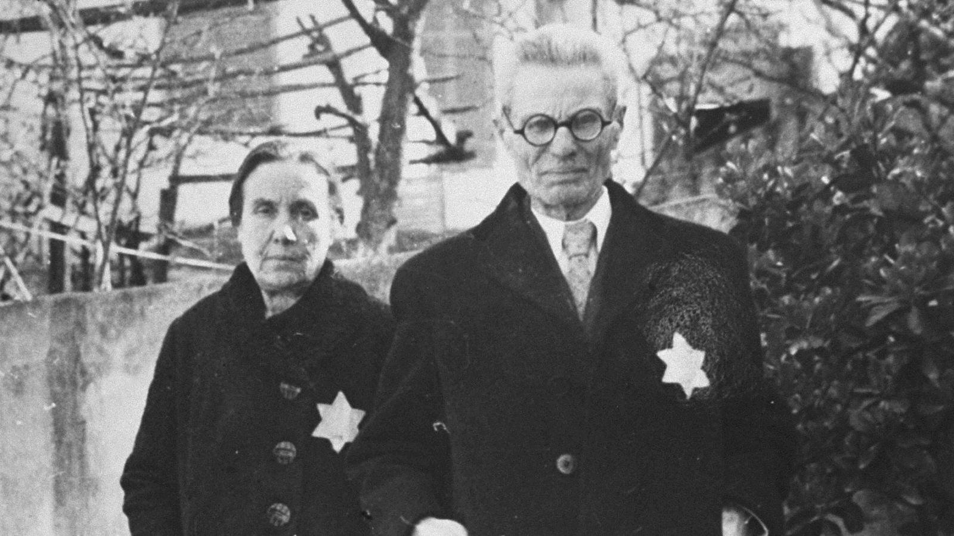
Racial Purification
As Hitler rose to power, he found that the majority of Germans were willing to support his belief that Jews were responsible for Germany’s economic problems and defeat in WWI.
On April 7, 1933 ordered all “non-Aryans” to be removed from Government jobs.
In 1935 Nuremberg laws stripped Jews of their Germany citizenship, jobs, and property and Jews had to wear a bright yellow Star of David attached to their clothing.

Slide 3
Night of Broken Glass
November 9 – 10, 1938 became known as Kristallnacht or “Night of Broken Glass.” Nazi storm troopers attacked Jewish homes, businesses, and synagogues across all Germany, Austria, and Sudetenland. Nazi’s claimed the attacks was a response to the assassination of a Nazi official by a Jewish teenager.
Around 100 Jews were killed, more injured, and 30,000 arrested – then they were blamed and fined.
Kristallnacht was a clear message for Jews to flee. Over 100,000 manage to leave, but they had nowhere to go. Nazi laws left many Jews without money or property and most countries were unwilling to take in poor immigrants.
Countries worried about fueling anti-Semitism, but France had already taken in 40,000 and Britain 80,000 plus allowed 30,000 to settle in Palestine Mandate U.S. only accepted “persons of exceptional merit” i.e. Albert Einstein

Slide 4
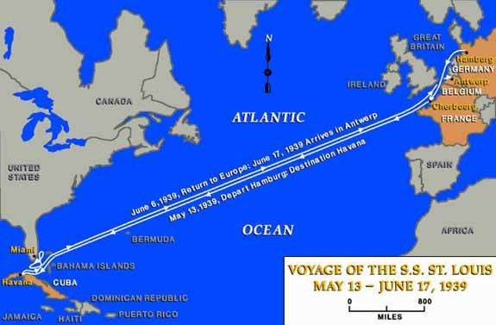
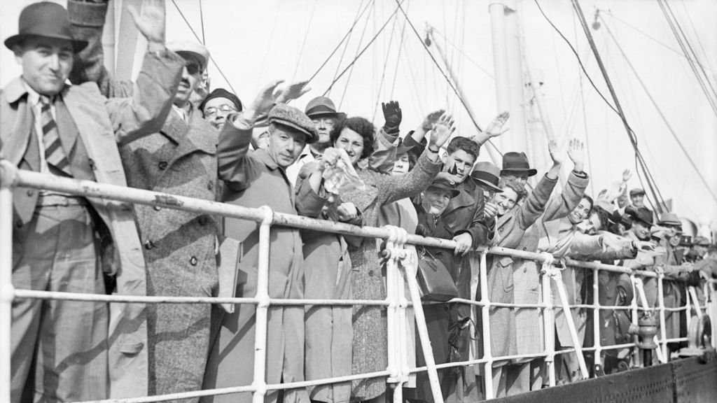
St. Louis
Indifference to the situation of Germany’s Jews was clear in the case of the ship St. Louis. This German ship had over 740 passengers with U.S. immigration papers, but the Coast Guard followed the ship to prevent anyone from getting off in America forcing it to turn back. New York Times “cries of high heaven of man’s inhumanity to man” More than half of the passengers were later killed in the Holocaust.

Slide 5
“Final Solution
By 1939 only about a quarter million Jews remained in Germany, but other nations that Hitler occupied had millions more. Obsessed with a desire to rid Europe of Jews, Hitler imposed the “Final Solution” a policy of genocide, the deliberate and systematic killing of an entire population.
To accomplish this, the Nazis condemned the Jews, communists, socialists, liberals, gypsies (wanders), freemasons (supporters of the “Jewish conspiracy”) and Jehovah’s Witnesses (refused to join the army or salute Hitler) to slavery or death.
Nazi’s even targeted other Germans unfit to be part of the “master race” such as: homosexuals, mentally deficient, mentally ill, physically disable, and incurably ill.
He began implementing his Final Solution with elite Nazi “security squadrons” (SS) who rounded up Jewish men, women, children, and babies, and shot them on the spot

Slide 6
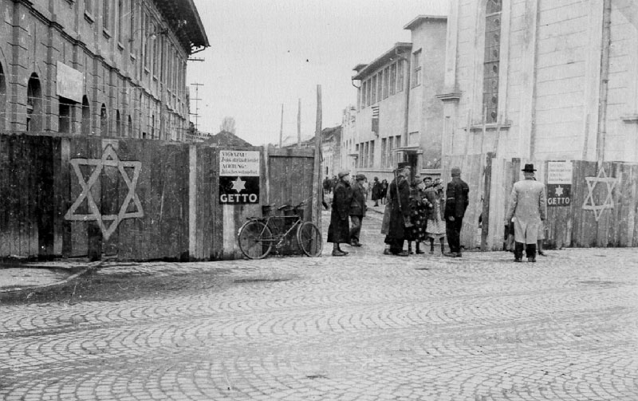
Jewish Ghettos
Jews were also ordered into ghettos, segregated Jewish areas. They were sealed off with barbed wire and stone walls. Jews who tried to leave, were shot.
Jews who were not reached by the SS were dragged from their homes and herded onto trains or trucks for shipment to concentration camps.
Nazi concentration camps were originally set up to imprison political opponents and protesters.
Camps were turned over to the SS and used as a warehouse for “undesirables”

Slide 7
Concentration Camps
The Final Solution reached its final stage in early 1942. Hitler called his officials to a meeting and they agreed a new phase of mass murder of Jews. Nazis already were using slaughter and starvation, and now they would add poison gas.
The Germans built six concentration camps. Each had several huge gas chambers that could kill as many as 12,000 a day. When prisoners arrived, they had to walk past SS doctors and be separated by those strong enough to work and those would die that day.
The first, Chelmno, began operating in 1941.
The largest, Auschwitz.

Slide 8
The Holocaust
An estimated six million Jews died in death camps and in the Nazi massacres.
But some miraculously escape, many of whom received help just from ordinary people who were appalled by the Nazis’ treatment of Jews.

