Slide 1
The War Abroad
Work on your vocab!
Take out your notes

Slide 2
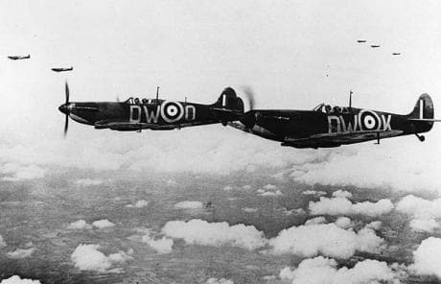
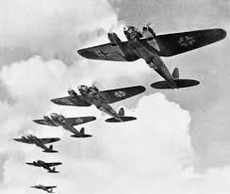
Battle of Britain
Battle of Britain – The Luftwaffe (German aerial warfare) began bombing over Britain every night for two solid months. Its goal was to gain total control of the skies by destroying Britain’s Royal Air Force (RAF).
RAF began to use radar and could plot the flight paths of German places even in darkness and on Sept. 15th RAF shot down 185 German planes, while only losing 26.
Hitler finally called off the invasion.

Slide 3
Rape of Nanking
FDR found it impossible to remain neutral. When Japan attacked China again in 1937, Roosevelt found a loophole in the Neutrality Acts.
In late 1937, over a period of six weeks, the Japanese brutally murdered hundreds of thousands of people–including both soldiers and civilians–in the Chinese city of Nanking. The horrific events are known as the Rape of Nanking, as between 20,000 and 80,000 women were sexually assaulted. Nanking, then the capital of Nationalist China, was left in ruins, and it would take decades for the city and its citizens to recover from the savage attacks

Slide 4
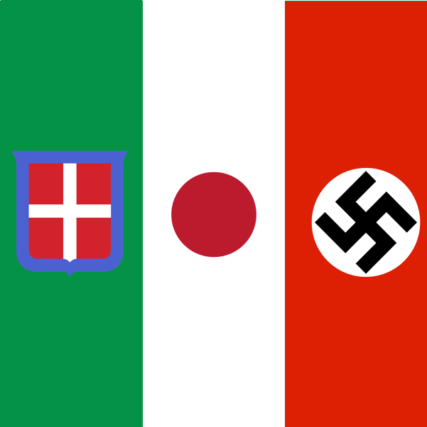
Axis Powers
On September 27th, 1939, Germany, Italy, and Japan signed a mutual defense treaty and became known as the Axis Powers. Agreed to defend each other in case of attack – motivating countries, particularly the U.S. to stay away

Slide 5
Atlantic Charter
To prevent the supplies from reaching the Allies, Germany issued the wolf pack attack. At night groups of up to 40 submarines would stink supplies ship. They sunk over 350,000 tons of shipments in a single month.
In June of 1941, FDR granted the navy permission to attack German U-boats in self-defense
In August 1941, FDR and Churchill met secretly and formed the Atlantic Charter. Both pledged collective security, disarmament, self-determination, economic cooperation, and freedom of seas. More than protection of the seas; set forth the war aims of the Allies
After the Germans attacked several of U.S. U-boats, submarines, and merchant ships, the senate lifted the ban to retaliate. The U.S. was involved in an undeclared naval war with Hitler, but Japan would ultimately bring the U.S. into war.

Slide 6
U.S. & Japan
As Japan invaded more territories (Indochina Vietnam, Cambodia, Laos, and Manchuria) the U.S. protested the aggression by halting trade with Japan. One trade item they desperately needed was oil. The Leaders of Japan knew they must either persuade the US to end its oil embargo or capture the oil fields in the East Indies
When Hideki Tojo became the prime minster of Japan he ordered the navy to prepare an attack on the U.S.
U.S. military had broken Japan’s secret communication codes but didn’t know where the attack would happen. FDR sent a “war warning” to military commanders in Hawaii, Guam, and the Philippines.
U.S. Secretary of State and Japan’s Military leaders had many meetings, but Japan would not pull out of China or accept any peace offerings.

Slide 7
Pearl Harbor
On December 7th, 1941 for an hour and a half, the Japanese planes attacked Pearl Harbor, the largest U.S. naval base in the Pacific. Their goal was to keep the Americans from preventing Japanese expansion in the Pacific, and they were successful. Japan had prepared 1year for this attack
In less than two hours, the Japanese caused more damage to the U.S. than they had suffered in all of WWI. 2403 dead, 1178 wounded, 21 ships, 8 battle ships, 300 aircraft
The next day Congress approved a declaration of war against Japan, and three days later both Germany and Italy declared war on the U.S.
Shortly after FDR joined the international conflict, Prime Minister Churchill arrived at the White house for them to develop a plan.
Their strategy was called Germany First. Churchill convinced FDR that they posed a greater threat than Japan.

Slide 8
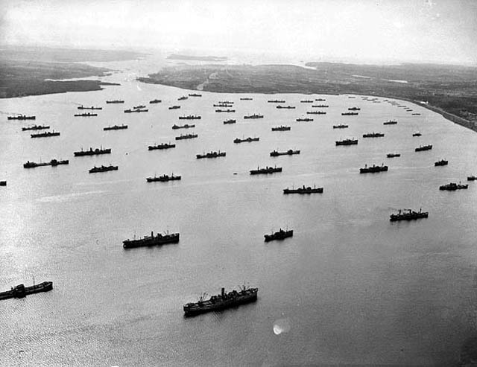
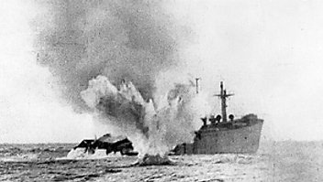
Battle of the Atlantic
After the attack on Pearl Harbor, Hitler ordered submarine raids against ships along America’s east coast.
The goal was to prevent food and war materials from reaching Great Britain and the Soviet Union.
The U.S. tried to implement the convoy strategy used in WWI, a group of ships travel together for mutual protection. For four months it was ineffective, and Germany sank 87 ships.
With improved tracking and production, the Allies were able to find and destroy German U-boats faster than the Germans could build them.
By June 1943 the tides had turned, and Churchill reported “was the best month at sea from every point of view we have ever known in the whole 46 months of war.

Slide 9
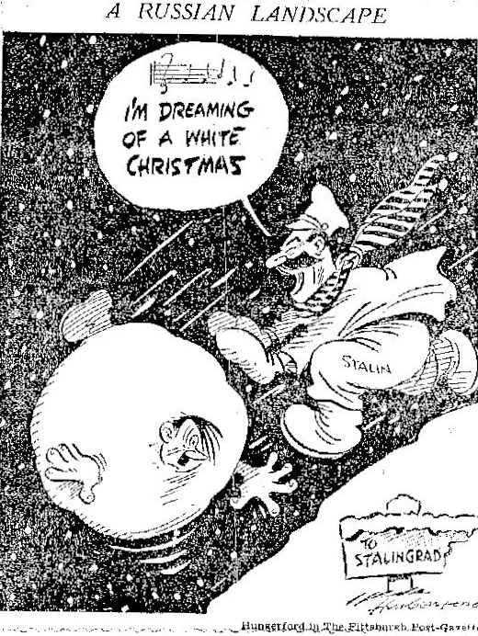
Battle of Stalingrad
The Battle of Stalingrad was the first land turning point for the Allies. Germany attempted to overtake Russia breaking the non-aggression pact. Germany was successful at first, conquering house by house, but what they could not conquer was the winter. The cold forced them to surrender, but there were over 2 million military and civilian casualties.
While Hitler was entertained by the Battle of Stalingrad, Stalin encouraged the allies to open a “second front.” Knowing that they could not win an invasion on European soil, they launched Operation Torch an invasion of Axis-controlled North Africa commanded by American General Dwight D. Eisenhower.
After months of heavy fighting, the enemy resistance ceased, and the Allies control the North African shores.

Slide 10
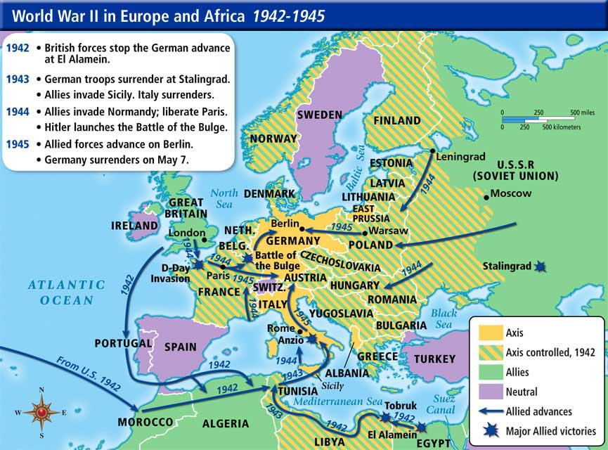
The North-African Front
The summer of 1943, the Allied troops ventured to capture Sicily. The Italian army quickly collapsed. Stunned, King Emmanuel III and the government forced dictator Benito Mussolini to resign and had him arrested. The king told Mussolini “At this moment, you are the most hated man in Italy.”
Sadly, this battle did not free Italy. Hitler was determined to stop the lies in Italy rather than fight on German soil. Italy was not freed until Germany itself was close to collapse in 1945.
Notes:
Neutral Countries – Ireland, Spain, Portugal, Saudi Arabia, Turkey, Sweden, Switzerland;

Slide 11
D-Day
Early in 1944, The Allies gathered forced nearly 3 million British, American, and Canadian troops. It was time to execute D-Day, code name Operation Overlord.
To keep it a secret, the Allies set up a huge phantom army. They sent out radio messages they knew the Germans could read with commands to send orders to attack the French port of Calais.
It worked, and Hitler ordered his generals to this make-believe invasion.
On June 6th, 1944, shortly after midnight, two airborne divisions attacked Normandy beach and a few hours later they were followed by thousands upon thousands of seaborne soldiers. This was the largest land-sea-air operation in army history. Land fighting, tanks, tons of soldiers
By Aug. 23rd the American troops liberated the French Capital.

Slide 12
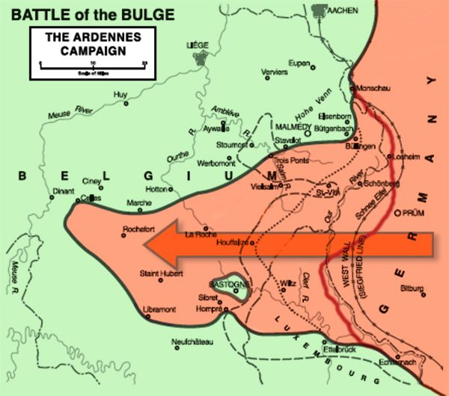
Battle of the Bulge
Hitler responded to the Allies with a desperate last-gasp offensive. His objective was to split the Allied armies by means of blitzkrieg.
On Dec. 16th the German army launched the deadliest battle. As the German armies drove deeper into the Ardennes, the line defining the Allied front took on the appearance of large protrusion or bulge.
The frozen forests of the Ardennes proved fatal to Hitler’s ambition causing a draw.

Slide 13
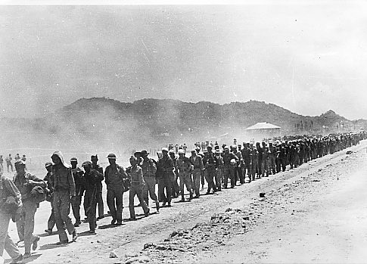
A Slow Start for the Allies
Only six months after Pearl Harbor, the Japanese had a devastating lead over the Allies. Their fighter aircrafts were better, and their ships and torpedoes were high quality.
These factors led to the overtake of many nations including the Philippines. The worst part was not the battle, but the Bataan Death March that followed. For five days and nights, the Japanese forced the captured soldiers to march to the death camps. The prisoners were given little food or water, and those who dropped out of line were beaten or shot.

Slide 14
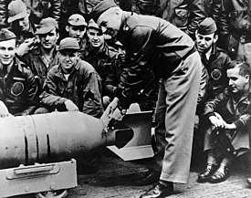
Fortunes Shift in the Pacific
A few months after the surrender in Bataan, things started to turn around for the Allies.
On April 18th, 1942 American Army Lieutenant Colonel James Doolittle led 16 bombers in a daring raid on Tokyo. Headlines read “Tokyo Bombed! Doolittle Do’od It!”
More morale enhancement came from the Battle of the Coral Sea. The fighting was done by aircraft carriers only. Both sides suffered losses, and both claimed victory. The U.S. considered a positive battle because a Japanese invasion had been prevented.
Upset with these “victories”, the Japanese devised a plan to destroy the U.S. naval force at Midway Island. But the U.S. was able to break the Japanese code and surprise attack the Japanese ships before they arrived. The Battle of Midway “avenged Pearl Harbor.”

Slide 15
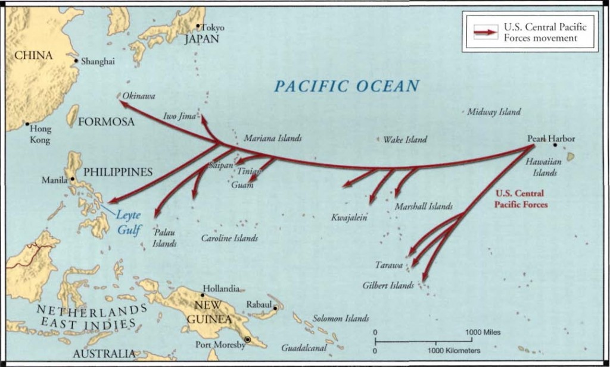
Island Hopping
The Allies developed the strategy of “island hopping.” It was a combination of land, sea, and air forces capturing and securing islands while avoiding the heaviest concentrations of enemy forces. AKA took over little islands at a time, building up to take on larger forces.
The first land win for the Allies was Guadalcanal.
Battle of Leyte Gulf – reduced Japanese navy to minor role.
Iwo Jima: Capturing this critical base for heavy bombers put the Allies a step closer to reaching Japan
Okinawa: An attack on Japan itself.

