Slide 1
The Medieval Church
Unit 2 notes; Pg. 2 – 3

Slide 2
Medieval Church
During the Middle Ages, most Western Europeans were devout Christians (thanks to the Romans) and took pilgrimages to see holy places.
Before Europe became a Christian civilization, the Church spent centuries converting its diverse people from other religions i.e. Polytheism, Judaism, Muslim, etc.
Churches were often the largest public buildings in a village (castles were owned by Kings and Nobles; therefore, not public).
Church doctrine taught that men and women were equal before God, but women were viewed as weak and easily led to sin.

Slide 3
Medieval Church
Some men and women left their worldly life & joined monasteries. They devoted their entire lives to spiritual goals & became monks & nuns.
The Feudal system basically determined a person’s way of life, but the church provided an opportunity for advancement.
Traveling monks known as friars, who did not live in monasteries, moved from town to town & preached humility, love of God, & helping the poor.
Canon law, developed by the church, was used to govern all aspects of life according to Christian teachings.

Slide 4
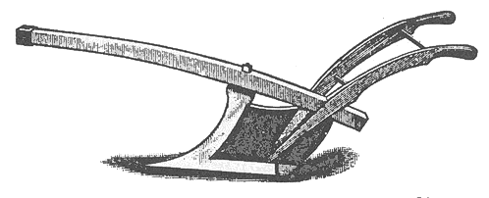
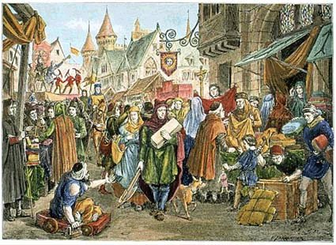
Economic Recovery
The invention of iron plows, used by peasants to plow into soil, allowed farmers to expand their farms & income.
With more food available, Europe’s population began to grow (the population TRIPLED from 1000-1300 A.D.)
Traders began doing business at local trade fairs.
Peasants: purchased food and animals
Nobles / Merchants: bought fine art, weaponry, and silk
Jesters: would entertain

Slide 5
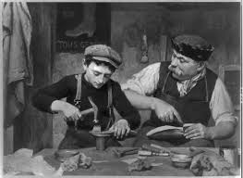
Economic Recovery
With a boom in population & safer kingdoms, people began to travel farther (across Europe & into the Middle East).
Banking houses were created, offering loans for merchants (who were now joined in business “partnerships”). This led to the beginning of modern business.
Merchants, artisans, & traders formed a new middle class. Each group had their own guild (similar to a union).

