Slide 1
Rise of Europe
Unit 2; Pages 1 - 2

Slide 2
Fall of the Roman Empire
The Roman Empire included most of Western Europe. Rome unified this region by spreading the Latin language and Christianity.
Rome fell to Germanic tribes. The theory of Rome’s collapse is tied to a sting of military loses.

Slide 3
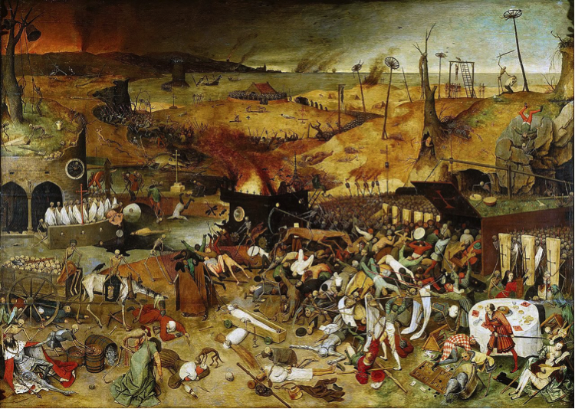
Dark Ages
Western Europe earned the title the Dark Ages due to this fallen empire.
Western Europe became politically divided, rural, and largely cut off from advanced civilizations. Trade slowed and towns emptied.
Germanic tribes that overtook the Roman Empire included: Goths, Vandals, Saxons, and Franks.
These tribes were mostly farmers and herders and were governed by unwritten laws.
Warriors swore loyalty in exchange for weapons and plunder.

Slide 4
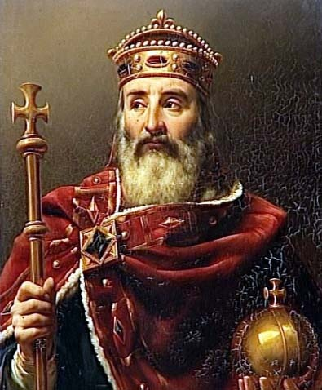
The Franks
Franks gained ultimate control of Western Europe after winning the Battle of Tours under the rule of Charles Martel, who became known as Charlemagne.
Helping Pope Leo keep rebels out of Rome, Charlemagne became the new Emperor of Rome.
He used this power to unify Western Europe. He spread Christianity and encouraged education.
Despite the victory of Tours, after Charlemagne’s death, Muslim forces still posed a threat to Christian Europe.

Slide 5
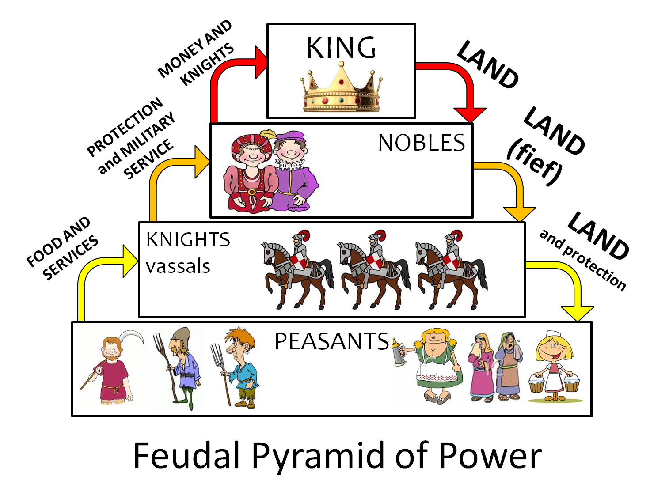
Feudalism
People seeking protection from invaders (the Magyars, Vikings, & Muslims) now looked to their local lords.
A new system of social order called feudalism developed.
The power structure was as follows: royal family (king/queen, prince/princess), nobles (landowners & knights), vassals (small landowners / merchants), & peasants (worked in exchange for protection).

Slide 6
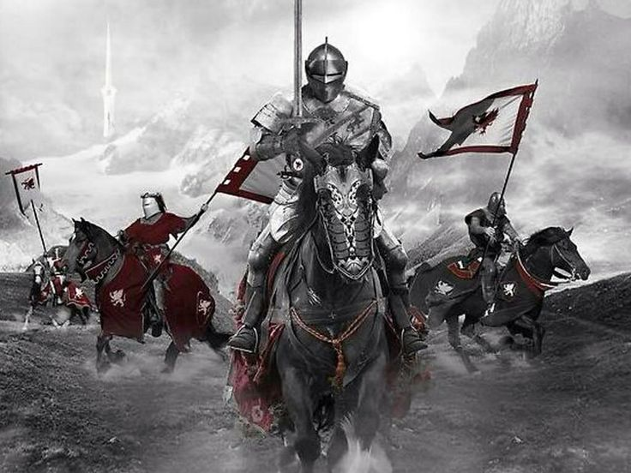
Knights
Rival monarchs battled for power and land. This gave rise to a class of warriors, known as Knights and to the development of castles.
Trained from boyhood, Knights were the primary warriors of medieval society. They used a wide range of weaponry (swords, shields, daggers, spears, bow & arrow, etc.)
Knights abided by a code of conduct called chivalry. They were required to be brave, loyal, & true.
Most nobles owned stone castles, which served as both homes & fortresses (in case of an attack).

Slide 7
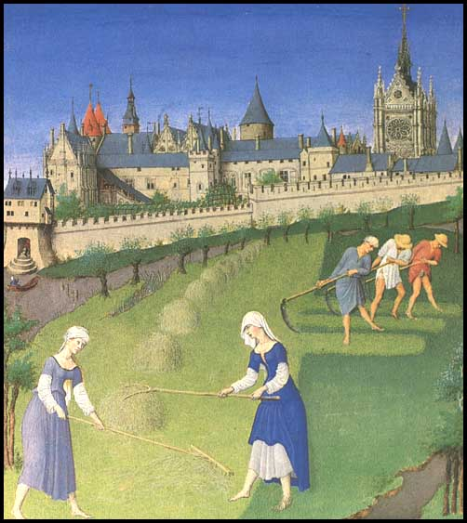
Peasants
The peasant life was the harshest among members of the Feudal System. A typical day included: farming, tending animals, planting, harvesting, all from sunup until sundown.
Manor (houses / estates) system: peasants were granted land in return for their labor. This peasant labor was either as farmers or artisans.

