Slide 1
The Byzantine Empire
Unit 3 Notes (Pg. 1 – 2)

Slide 2
“New Rome”
As Germanic invaders continued to attack, communications between the eastern and the troubled western parts of the empire grew. It was time for them to separate.
Roman Emperor Constantine took his followers to the east and created the Byzantine Empire along the Mediterranean.
In 330 A.D., Constantine made “New Rome” and named the capital Constantinople after himself.

Slide 3
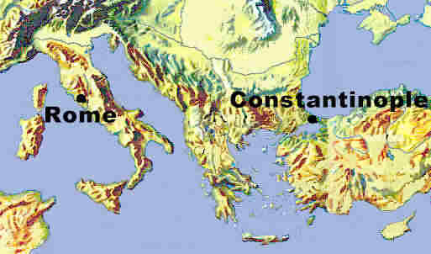
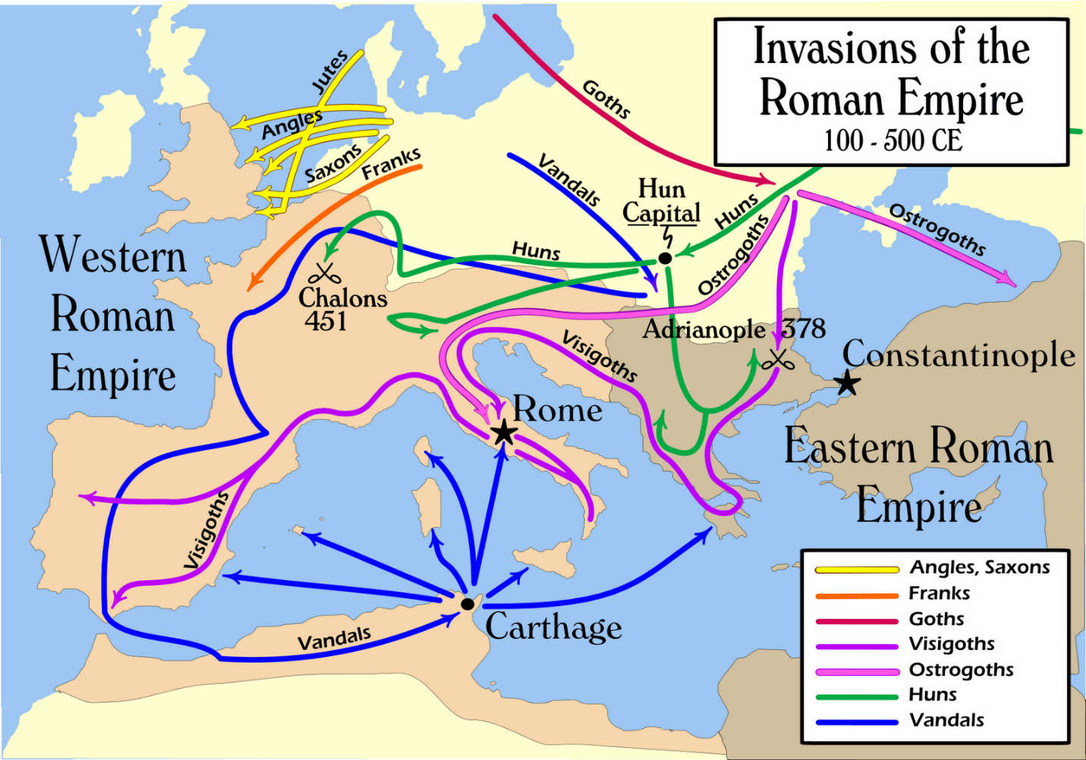

Slide 4
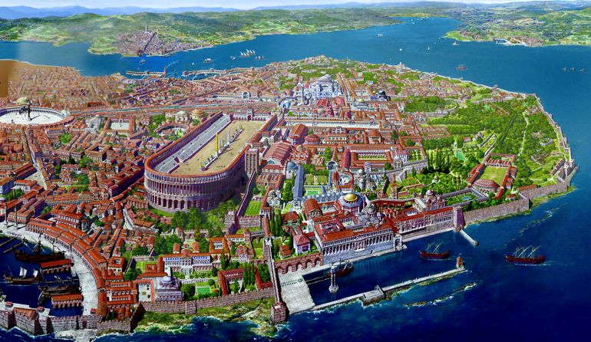
Constantinople
Emperors after Constantine built an elaborate system of land and sea walls to boost its defenses and commanded key trade routes linking Europe and Asia.
The city’s favorable location made it Europe’s busiest marketplace.
For nearly a thousand years after the collapse of the Western Empire, Byzantium and its flourishing capital would carry on the glory of Rome.

Slide 5
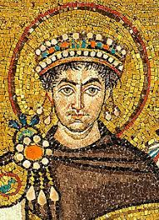
Justinian I
Justinian is noted as the Byzantine’s greatest Emperor because he helped Rome rise from the ashes and became the new Caesar.
Like the last of the old Caesars, the Byzantine emperors ruled with absolute power and headed not just the state, but the church as well.
Justinian conquered the Mediterranean: After numerous campaigns, Justinian’s armies won nearly all of Italy and parts of Spain, ruling all the territory that Rome had never ruled.

Slide 6
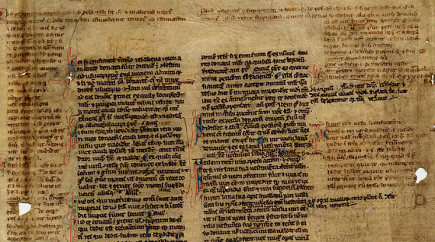
Justinian’s Code
Justinian restored Roman Law: Created Justinian’s code, which collected, revised, and organized all the laws of ancient Rome; Justinian used the law to unify the empire.
Justinian ruled as an autocrat; “The emperor is equal to all men in the nature of his body, but in the authority of his rank he is similar to God, who rules all.”
His control was aided by his wife Theodora.

Slide 7
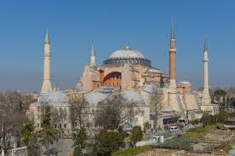
The Great Schism
Justinian built the Hagia Sophia: launched the most ambitious public building program ever seen.
Justinian viewed churches as the most visible sign of the close connection between church and state in his empire.
Hagia Sophia was the new Church of “Holy Wisdom”
When the Roman Empire split, so did the church. Those living in the eastern Roman Empire joined the Eastern Orthodox Church. This split was known as the Great Schism.
Even the patriarch, Saint John Chrystom, bowed to the Emperor.

Slide 8
Fall of the Byzantines… ☹
In the later years of Justinian’s reign, a disease similar to the Bubonic Plague broke out in Constantinople probably from rat-infested ships from India. Historians estimate that in 542, the worst year of the plague, 10,000 people were dying every day.
The Byzantines had enemies in the East and West. They called the foreign invaders from the west “barbarians.” The faced Muslim Turks in the east.
After the Crusades (1095-1291), the Byzantine economy collapsed, leading to a poorly supplied army. They were eventually attacked & defeated by the Ottomans.

