Slide 1
Feudal China & Japan
Unit 3 Notes (Last notes)

Slide 2
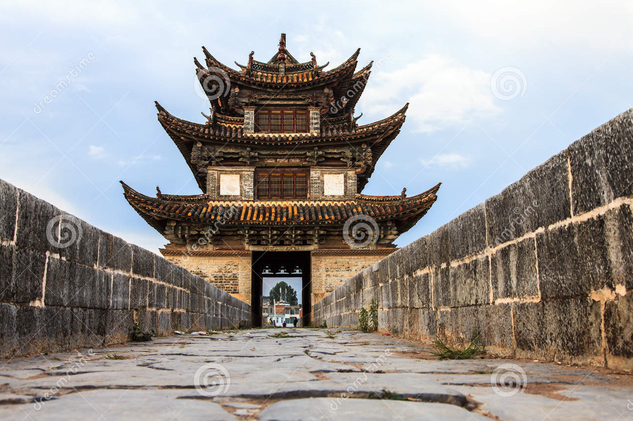
Medieval China
Similar to Islamic & African empires, China thrived while Europe fell into the Dark Ages (500-1300 AD).
With the emergence of the Tang dynasty in 618 A.D., China was able to restore its glory (of the ancient empire).
Tang rulers unified Chinese government, expanded civil service, spread Confucianism (ethics & humanism), lowered taxes, and gave away property to peasants.

Slide 3
Mongols Attack!!
Centuries later (outside of China’s borders), bands of nomadic warriors known as the Mongols were uniting under military chieftain Genghis Kahn.
Kahn led a furious assault on China’s border cities. By 1270 A.D., China had been toppled.

Slide 4
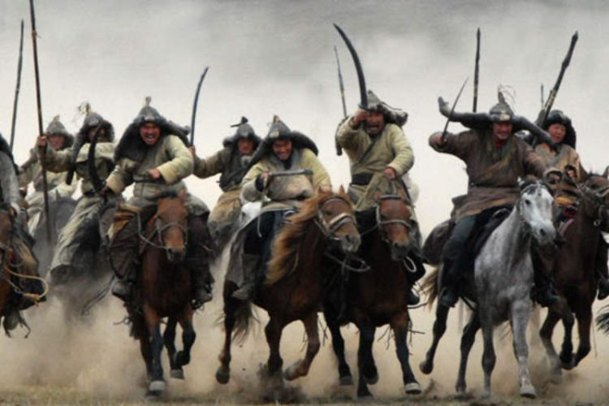
Mongols
Surprisingly, the Mongols were not oppressive rulers. They only required that homage be paid.
Kahn’s legacy is one of ruthlessness & determination. He is still known as history’s greatest conqueror (his army wiped out nearly 1/8 of the world’s population).

Slide 5
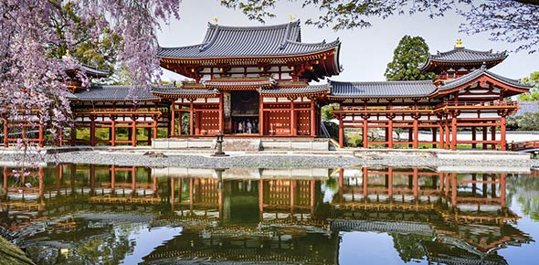
Rise of Japan
During the Middle Ages, Japan took notice of China’s resurgence and began sending nobles there to study.
After a one year visit, the nobles returned to Japan eager to share Chinese philosophy (Confucianism), religion (Buddhism), & government (totalitarianism).
Around 710 AD, Japanese rulers adopted the title “Heavenly Emperor” & claimed absolute power.

Slide 6
Feudal Japan
In the centuries that followed, Japan’s nobles (both men & women) began shaping their own unique culture through literature, performing arts, & warfare.
Japanese warriors known as Samurai (meaning “those who serve”) dedicated their lives to protecting the emperor.
Similar to European chivalry, the Samurai followed “bushido”. It emphasized honor, bravery, & loyalty.
Zen Buddhism shaped Japanese culture during & after the middle ages. It emphasized self-reliance (be responsible) & stressed devotion to duty (do your job!!).

Slide 7
Answer these questions about Japan:
What was a “heavenly super person” ?
What religion was spread across Japan?
What country did Japan try to learn government strategies from?
What were samurais used for?
What happened when Japan was isolated?
https://youtu.be/Mh5LY4Mz15o

