Slide 1
Ottoman Empire
Unit 3 Notes (3 – 4)

Slide 2
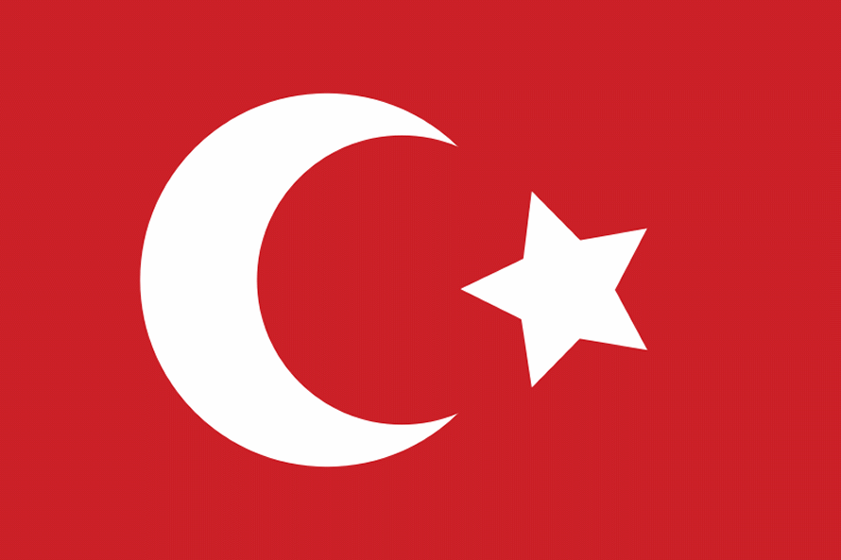
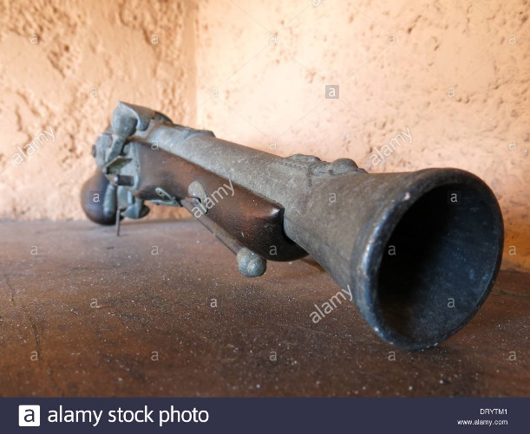
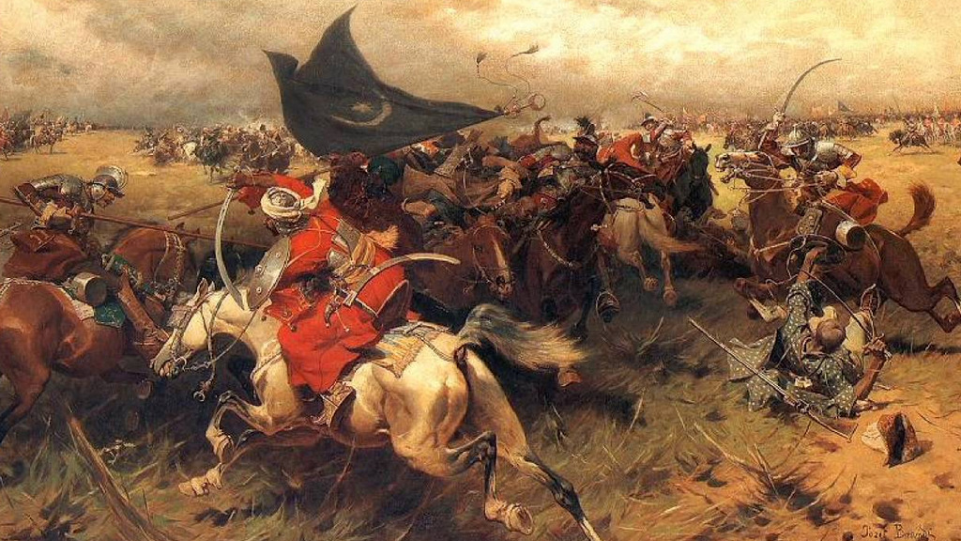
Being strong counts! (In the middle ages)
The Ottoman Empire, which was created by the Turks, was one of the world’s most powerful states during the 15th & 16th centuries.
The Turks saw themselves as ghazis, and formed military societies and followed a strict Islamic code of conduct.
The Ottoman Empire began with Osman who built a small Muslim state in Anatolia.
The Ottomans owe much of their success to new weapons (i.e. muskets) that changed warfare.
Much of their military success was due to gun powder.

Slide 3
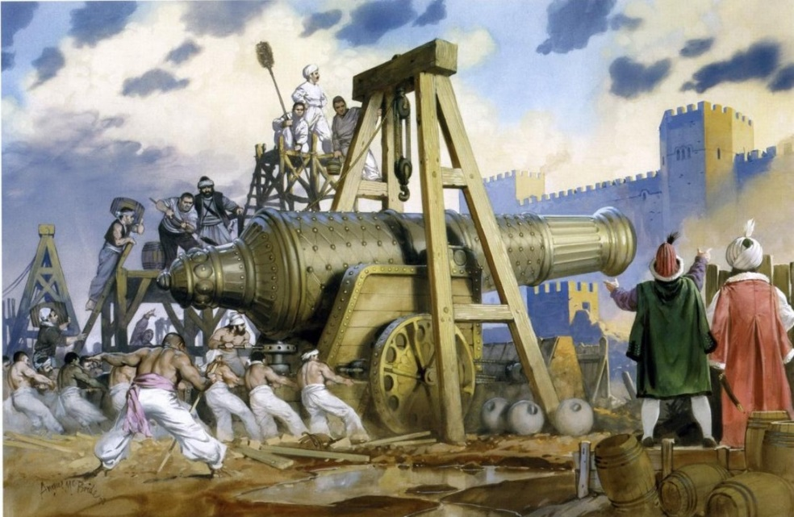
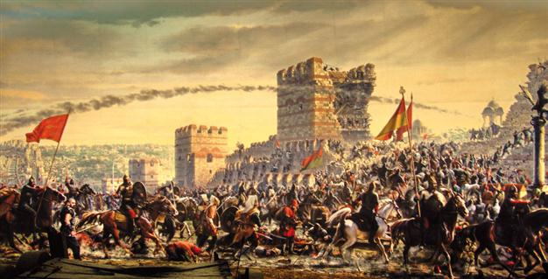
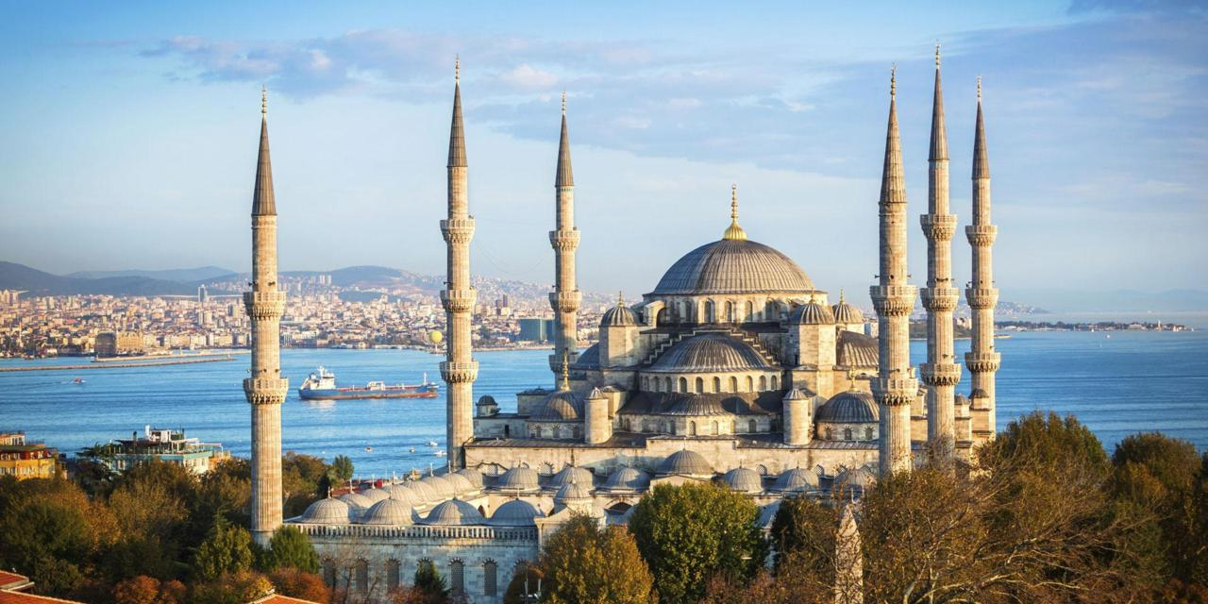
Istanbul (Not Constantinople)
The first Ottoman leader to call himself “Sultan” was Osman’s son, Orkhan I.
Generations later when Mehmed II or Mehmed the Conqueror was Sultan he led a siege to capture Constantinople.
After nearly a two-month siege, Ottoman cannons finally blasted gaps in the great defensive walls.
The Ottomans renamed Constantinople “Istanbul”.

Slide 4
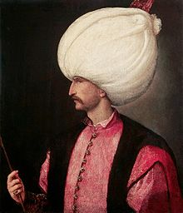
Successful Sultan Suleyman
Early Ottoman leaders were Muslim warriors who fought against the Christian Byzantine Empire. Their main goal was territorial expansion.
The empire reached its apex (or “peak”) under Suleyman the Magnificent.
His people called him “the Lawgiver”.
Suleyman modernized the army and conquered the land from Hungary to Arabia and Mesopotamia, and across North Africa. (pg. 67 of your book)

Slide 5
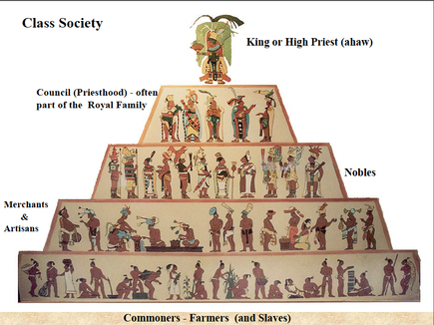
Suleyman’s Social Structure
Suleyman’s crowning achievement was his social structure. The Ottoman society was divided into classes, each with its appointed role.
“Men of the sword” - Soldiers who guarded the sultan and defended the state
“Men of the pen” – scientists, lawyers, judges, and poets
“Men of negotiation” – merchants, artisans; carried out trade and production
“Men of husbandry” – farmers & herders who produced food for the community

Slide 6
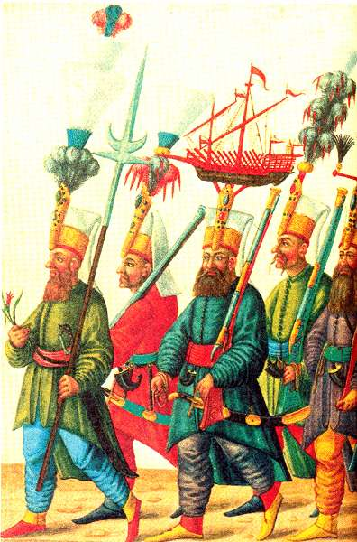
Suleyman’s Social Structure
The people were organized into millets, or religious communities.
The men of the sword & pen were almost all Muslim; other classes included non-Muslims.
These included: Greek Christians, Armenian Christians, and Jews.
The Jewish millets included many Jews who had been expelled from Spain in 1492 during the Reconquista.
The sultan’s 20,000 personal slaves staffed the palace bureaucracy. The slaves were acquired as part of a policy called devshirme.
He also had his janissaries.

Slide 7
Ottoman Social Structure

Slide 8
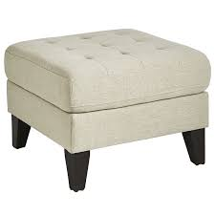
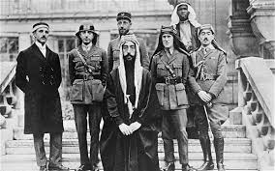
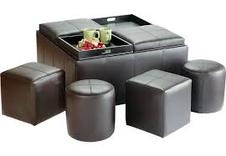
DID YOU KNOW??
The empire stood for over 600 years. It wasn’t until World War I that they were defeated (& renamed “Turkey”).
The Ottoman Empire is known for being one of history’s largest & most powerful Muslim empires.

