Slide 1
The Rise of Islam
Unit 3 Notes (Pg. 2 – 3)

Slide 2
Where does it come from?
The religion of Islam, whose followers are called Muslims, emerged in the Arabian Peninsula;
The Arabian Peninsula is a crossroads of three continents – Africa, Europe, and Asia.
Before the development of Islam, many Christians and Jews lived there and practiced monotheism.

Slide 3
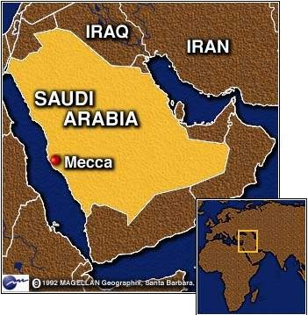
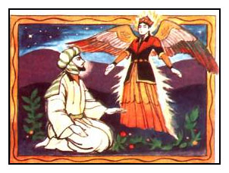
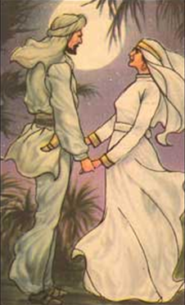
How did it develop?
Islam was founded by Muhammad; He was born in the city of Mecca.
Muhammad was troubled by the moral ills of Meccan society. To escape, he would go to caves to meditate. He began to hear the voice of angel Gabriel & was asked to be the messenger of God.
Muhammad’s wife Khadija encouraged him to spread the word of Allah (God); she was the first to convert to Islam.

Slide 4
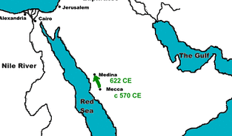
Muhammad the Prophet
At first, Muhammad’s teachings were rejected and he was threatened. He took his followers to Yathrib (renamed Medina or “city of the Prophet”).
This migration became known as the Hijrah.
While there he fashioned an agreement that joined his own people with the Arabas and Jews of Medina as a single community.

Slide 5
Muhammad Returns
To Muslims, Allah is the same God that is worshiped in Christianity and Judaism; however, Muslims view Jesus as a prophet, not as the Son of God.
Their holy scripture is the Qur’an – to them it is the final book, and Muhammad is the final prophet.
All three religions believe in heaven and hell and a day of judgement.
After fighting battles with the Meccans, Muhammad returned to conquer Mecca and lead it to become the most holy place in Islam.

Slide 6
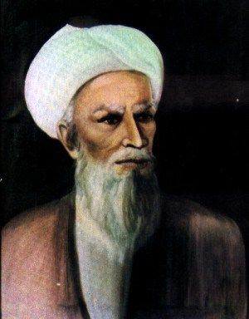
The Caliph
The first caliph, or successor to Muhamad, was his father-in-law, Abu Bakr.
Abu Bakr faced many challenges. Many followers (especially Arab tribal leaders) depended on Muhammad’s personal command & refused to be loyal to someone else.
Abu Bakr united Muslims through alliances and war.
The united Arab tribes surprised and defeated the Byzantines and Persians.

Slide 7
Islam
Muslims generally tolerated conquered peoples who followed monotheistic religions, but they taxed them.
Over time, Muslim scholars developed the Sharia, which regulates moral conduct, family life, business practice, government, & community life.
Muslims were divided into four social classes.
The upper class included those who were Muslims at birth.
The second class were those who convert to Islam.
The third class consisted of the “protected people” and included Christians, Jews, and Zoroastrians.
The lowest class was composed of slaves, which were mostly prisoners of war.
By increasing tolerance of other religions, ending discrimination against non-Arab Muslims, and encouraging learning, Islam became a more universal faith.

