Slide 1
Rise of Russia
Unit 3 Notes (pg. 4 – 6)

Slide 2
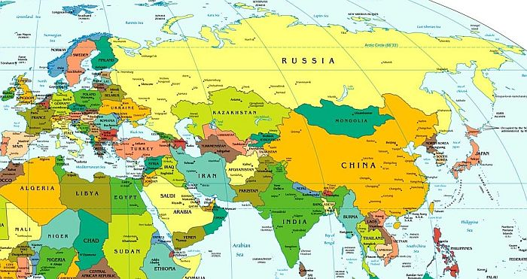
Why Russia?
As the Byzantine Empire was thriving in Eastern Europe, Russia (which connects Europe & Asia) began to grow.
Russia’s unique geography attracted settlers from Europe (mostly slavic farmers & hunters) & Asia (nomadic conquerors / vikings).
Northern forests supplied lumber, and animals
Southern Steppe – open, treeless, grassland land; offered pasture for the herds and horses of nomadic people.
Vikings in this area were known as Rus, which is where the name “Russia” comes from.

Slide 3
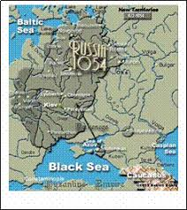
The city of Kiev
In 882 A.D. (which is considered the beginning of Russian history), Oleg, leader of the “Rus” seized Kiev & set up trade with the Byzantines (who now recognized “Russia” as a state).
The city of Kiev (the present-day capital of Ukraine) grew as a result of the two distinct cultures (Slavic and Vikings) mixing together. It was Russia’s first civilization.
The Kiev became an important city because its location is at the center of vital trade network between the Baltic and Black seas, is has strong Christian influences, and a steady economy.

Slide 4
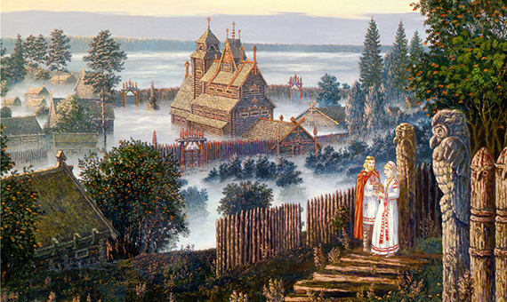
The fall of “Russia”
Vladimir was the ruler who lead Kiev to be Christian. In 989, he had all his citizens baptized in the Dnieper River.
In 1019, Vladimir’s son Yaroslav the Wise came to throne and led Kiev to even greater glory, but also its defeat.
He divided his realm among his sons, instead of the custom of passing the throne to the eldest. After Yaroslav’s death, the sons tore the Kingdom apart fighting for territory. In addition, the crusades destroyed its economy. Leaving it weak to fall to the Mongols.

Slide 5
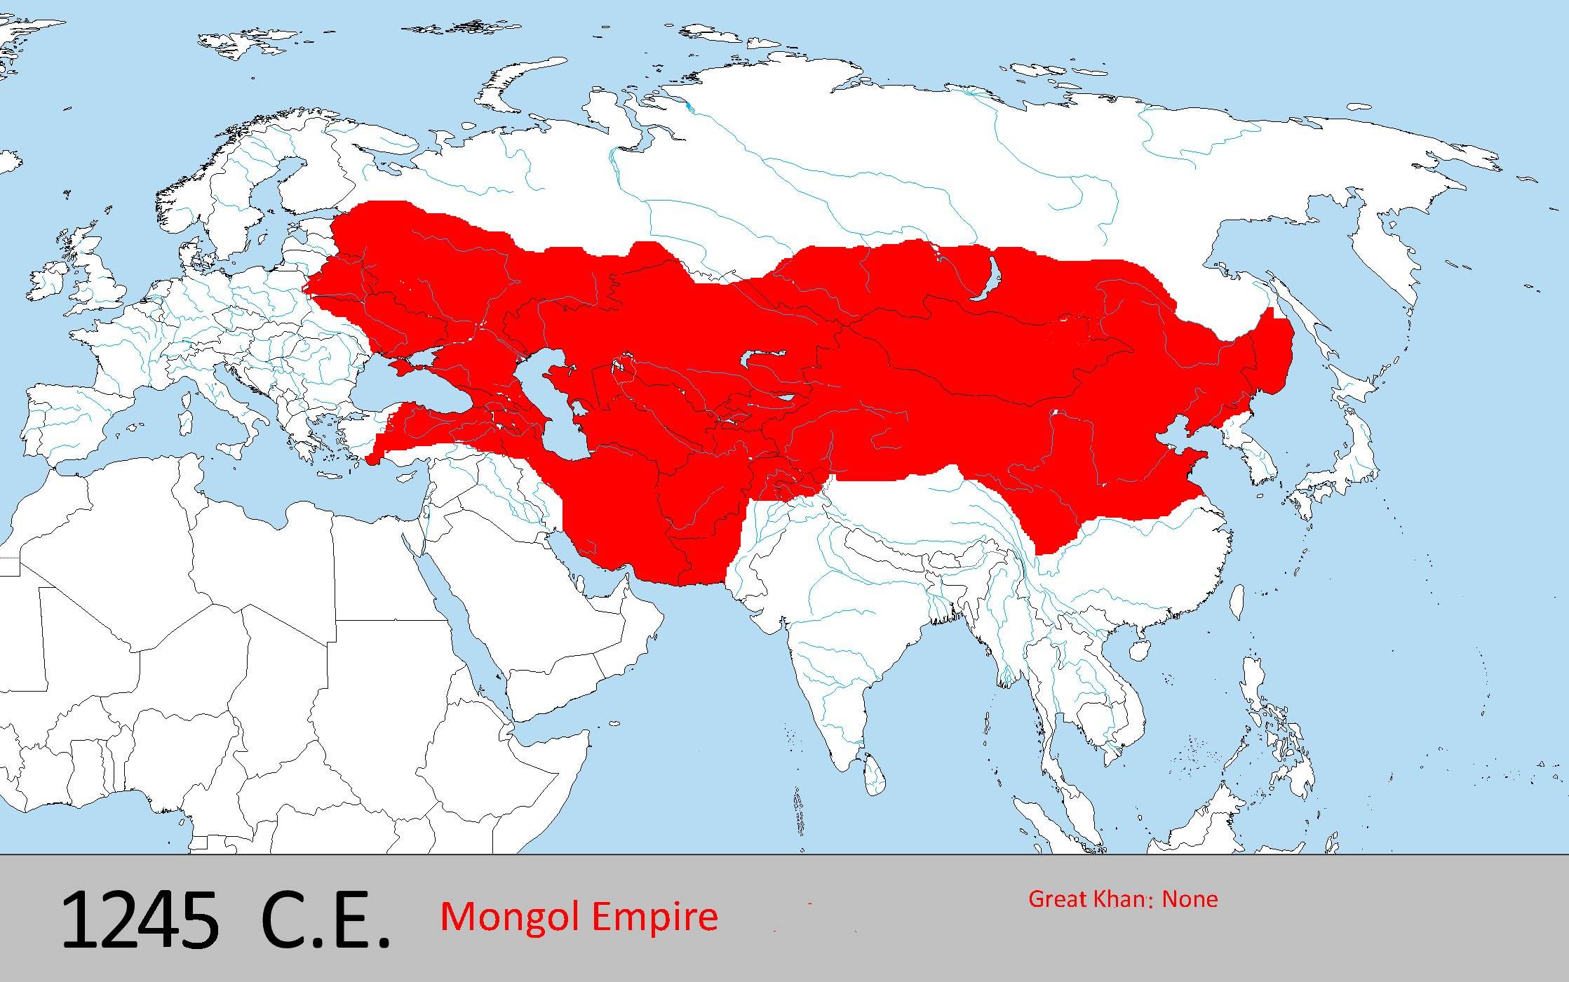
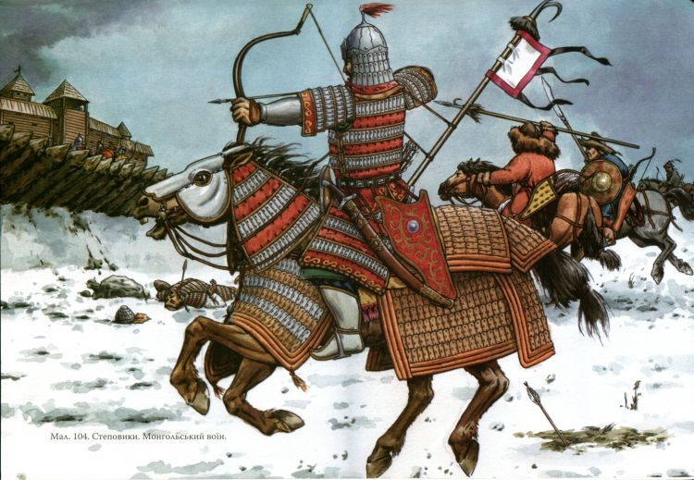
The Mongols in Russia…
Mongol leader Genghis Kahn (whose name means “World Emperor”) was one of the most fearsome warriors. They destroyed cities by burning them down and then ruling.
The Mongols were a ferocious group of horsemen from central Asia.
The Mongol empire stretched from the Yellow Sea to the Baltic sea, and from the Himalayas to northern Russia.

Slide 6
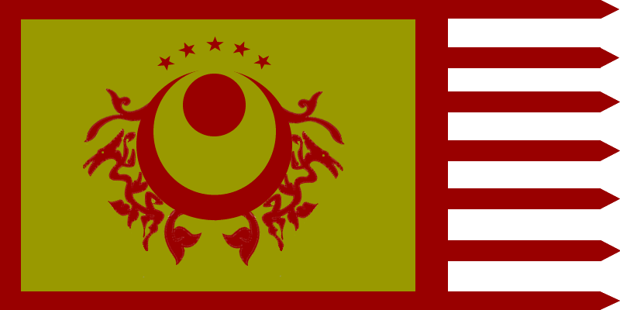
The Mongols
When the Mongols took over Kiev they renamed it “Khanate of the Golden Horde”. Kahante is Mongol for “kingdom”, Gold was their royal color, and Horde means “camp.”
Mongol rule surprisingly brought peace. Russian merchants benefited from new trade routes; Russian princes ruled without much interference; Orthodox Church (Religion in Russia) grew and served as a mediator between citizens and rulers.
Mongols demanded just two things: (1) absolute obedience and (2) massive amounts of tribute.
Mongols did isolate Russia from Western Europe fearing foreign invaders, which means little access to new ideas and inventions.

Slide 7
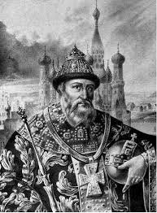
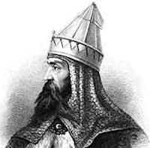
Ivan moneybag & Ivan the Great
Prince Ivan I of Russia was the first to start building up Russian forces under the Mongols nose. He helped calm a revolt and do other services and was continuously rewarded by the Mongols. They gave him the title “Grand Prince.” Eventually he had so much money that he became “Ivan Moneybag.”
Years later when his grandson, Ivan III, rose to power the Russians finally broke free.
Ivan III refused to pay his father’s debt and called himself the czar (Russian word for Caesar).
He claimed his intent was to make Russia the “Third Rome”
Russian and Mongol forces faced off; however, neither side claimed “victory”, but the Russians finally earned liberation.

Slide 8
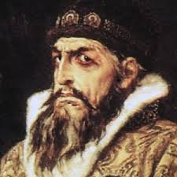
Ivan the Terrible
Controlling Russia, Ivan the Great (Ivan III), spent FORTY years unifying northern Russia
Ivan III recovered lost territories, limited power of boyars (great landowning nobles), and set a frame work for absolute rule.
Ivan the Terrible, Ivan VI, (son of Ivan III) crushed any opposition with violence & terror.
Ivan IV further limited the power of boyars, reinforced serfdom, increased military strength, organized oprichniki (agents of terror who enforced the tsar’s will).

Slide 9
Peter the Great…. Guess what he made!
https://youtu.be/u5EdfXPTllY

