Slide 1
The Age of Absolutism
Unit 4; Ch. 16

Slide 2
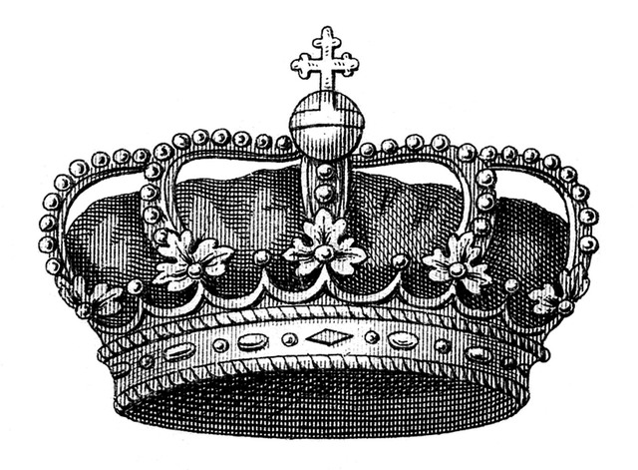
What is Absolutism?
The Age of Absolutism describes a period when Monarchs successfully ruled the wealth and power of the states themselves. Most believed in divine right.
The Monarchs are ruling the state themselves as opposed to who?

Slide 3
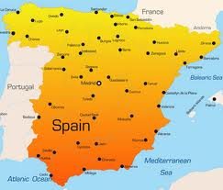
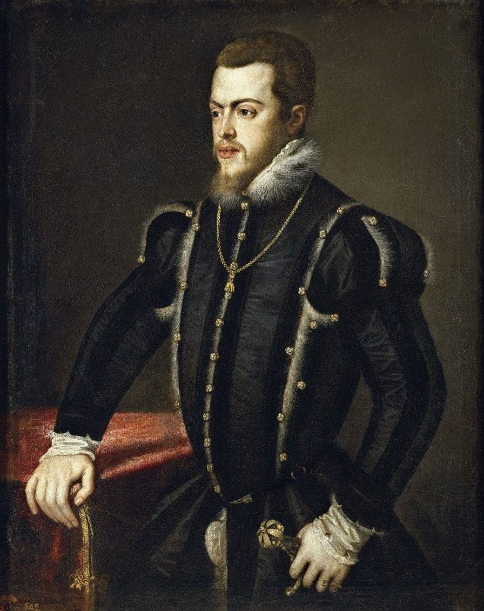
King Phillip II of Spain
King Phillip II was the absolute ruler in Spain. He expanded Spanish influence and strengthened the Catholic Church.
King Phillip II battled many powerful enemies. He surpassed Ferdinand (Holy Roman Emperor) and Isabella.
He kept the Ottoman Empire from invading his Italian territories in the Battle of Lepanto.
His success came to an end after the Spanish armada.
This was an attack to take over England. The Spanish were outmaneuvered by the lighter, faster English ships.

Slide 4
King Louis XIV
The successful absolute ruler of France was King Louis XIV.
He also believed in divine right and took the sun as a symbol of his absolute power.
He did not call one meeting with the Estates General.
He secured support from the nobles by tying them to the court and exempting them from paying taxes.
Louis XIV also built the Versailles, which signified power and brilliance.

Slide 5
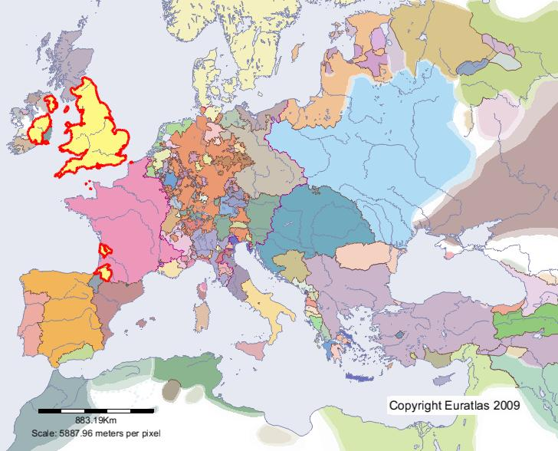
Parliament in England
Henry VIII was absolute monarch in England. When he needed his divorce, he broke his ties with the Roman Catholic Church for not granting him one. This made him need Parliament’s approval to levy new taxes and obtain a divorce. This began Parliaments rollercoaster to ruling England.
After a series of kings preaching divine right, Parliament implemented Archbishop Laud.
It executed the kings chief ministers and refused to be dissolved.
Later, Parliament forced King William to accept the English Bill of Rights, which ensured Parliament’s supremacy over the monarchy.

Slide 6
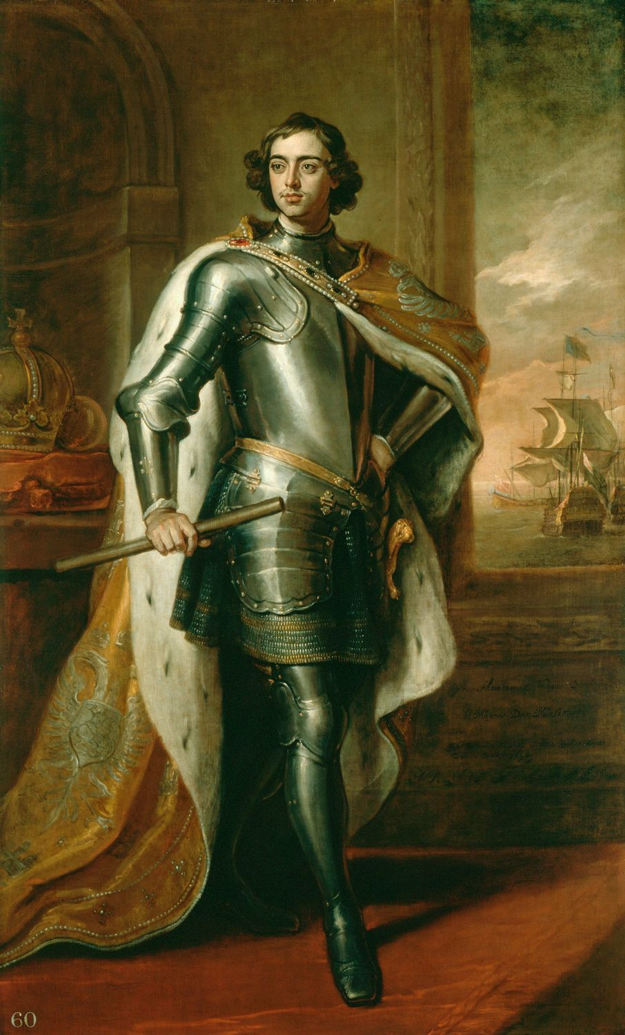
Peter the Great of Russia
Peter the Great became the tsar of Russia at the age of ­10, but began truly ruling at 17.
He implemented westernization; imposed requirements on boyars, improved waterways, developed mining, and backed new trading companies.
Peter solidified his control over nobles by passing laws that favored them such as strengthening serfdom, but punished them by making them serve the state.
Peter increased trade by building Russia’s new capital, St. Petersburg.

Slide 7
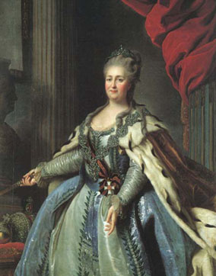
Catherine the Great of Russia
Catherine the Great was originally a German princess. She was arranged to marry Tsar Peter III. She embraces Russian Orthodox faith and won the loyalty of the people.
In 1762, a group of Russian army men murdered her mentally unstable husband, and thus she ascended the Russian throne.
Catherine is known for success through her gain of a warm-water port from the Ottoman Empire and her involvement in the partition with King Fredrick II of Prussia and Emperor Joseph II of Austria.

