Slide 1
Renaissance
Unit 4 Notes (Pg. 1 – 2)

Slide 2
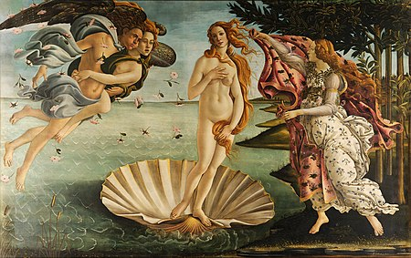
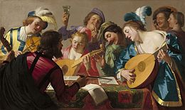
What is it?
The Renaissance was a time when creative thinking and new technology let people comprehend and describe their world more accurately.
During the Renaissance, artistic minds felt it was time rebirth after the disorder of the medieval world.
Due to disease and war, there were less people in Europe. Less people means more food for everyone else. Ultimately, increased the standard of living.
Ending of the 100-years war, the Reconquista, and other disputes ending brought peace across the continent.

Slide 3
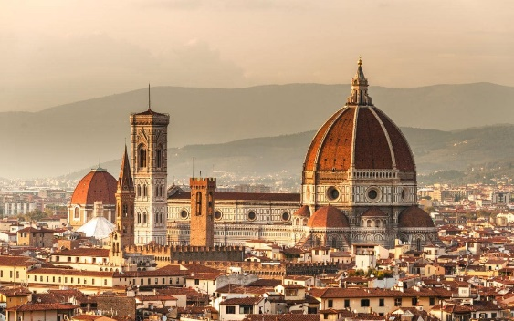
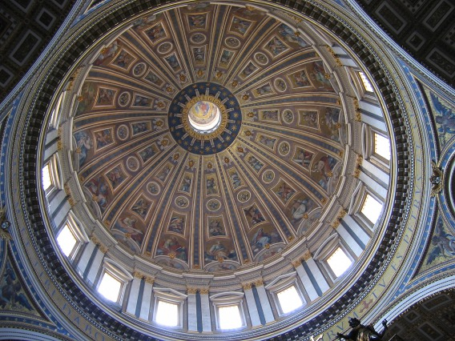
Where is it?
The Renaissance emerged in Italy. Renaissance thinkers had a new interest in ancient Rome, and Italy had been the center of the Roman Empire.
Many Romans who lived in the Byzantine Empire learned the wisdom of ancient Greeks. When the Ottomans attacked Constantinople, Byzantines fled back to Italy.
Humanism encouraged people to be curious (or to “challenge” classic wisdom).
The basic spirit of Renaissance society was secular – worldly rather than spiritual

Slide 4
The beginning of trade as we know it…
The Renaissance begins the modern world as we know it. Traditionally, wealth in Europe was based on land ownership. The growth of trade created an economy based on commerce rather than agriculture.
Merchants need the ability to transfer money from one place to another. This led to the rise of banks. Crucial aspects of finance were pioneered by the banks of northern Italy.
Unlike nobles, merchants did not inherit land and social rank. To succeed in business, they used their wits. This belief in individual achievement became important during the Renaissance.
The most successful city-states were Venice, Milan, Naples, Florence, and Rome.
These city-states started to become ruled by patrons, or financial supporters of the arts.
The apex of this artwork occurred during the High Renaissance (1450-1550 AD). The best-known artists (i.e. Leonardo, Michelangelo, & Raphael) thrived during this period.

Slide 5
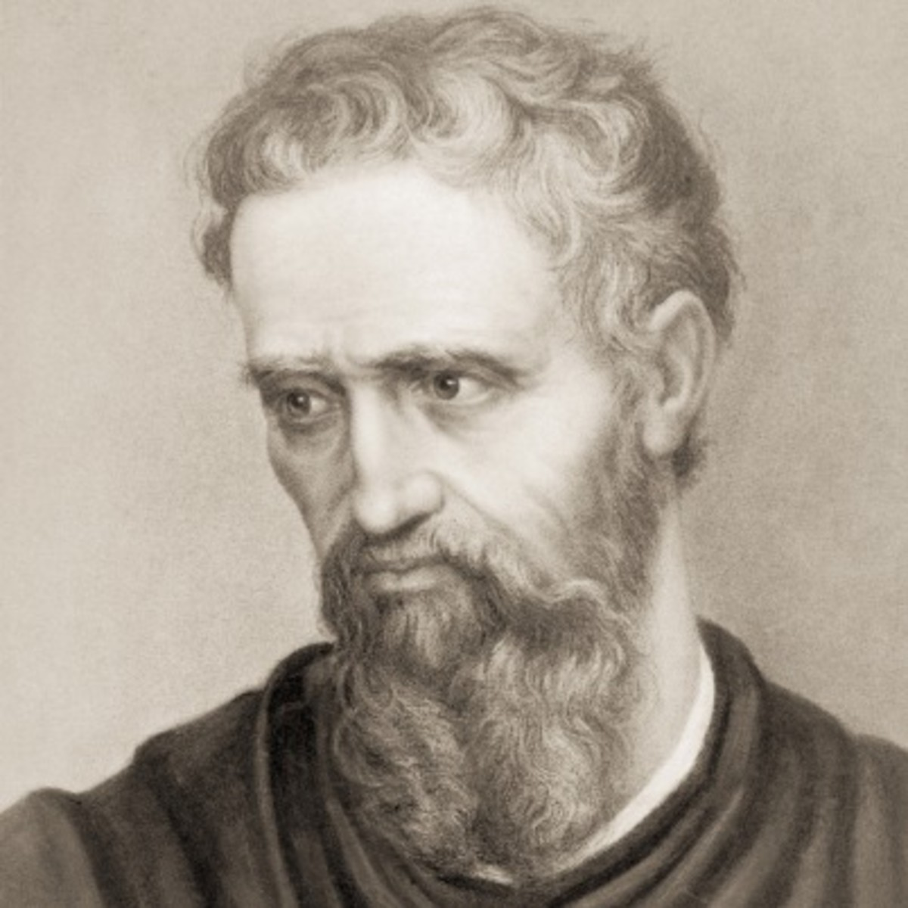
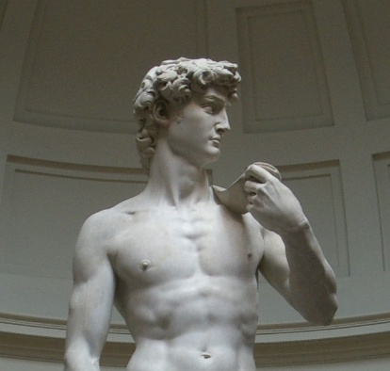
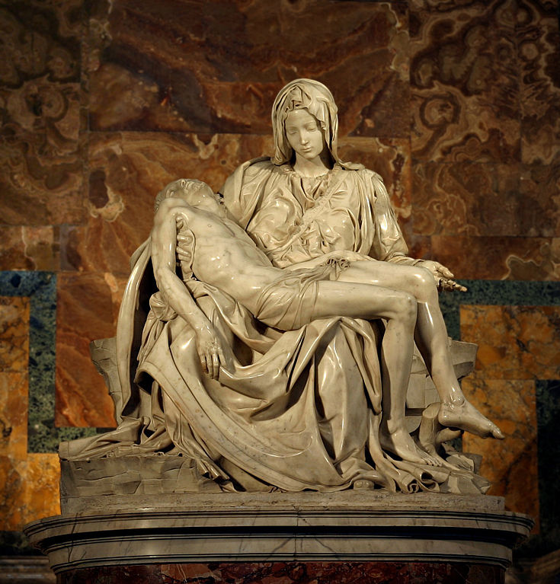
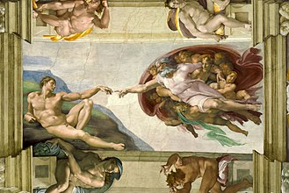
Ninja Turtle #1
Michelangelo was arguably the most talented & diligent artist of his time. His belief that he had a divine calling from God led him to Rome at age 23.
His most famous masterpieces include the Statue of David, the Pieta, & the Sistine Chapel (his greatest work).

Slide 6
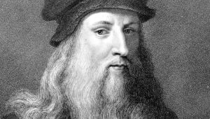
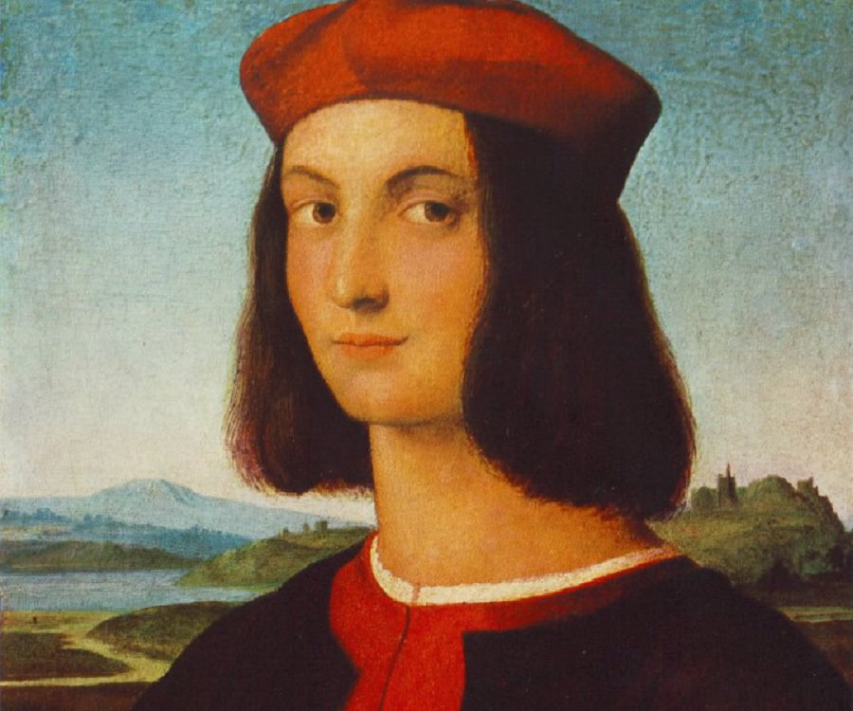
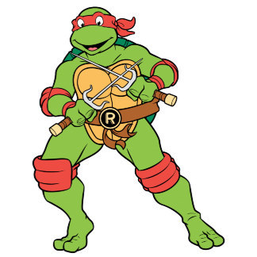
Clever or Creepy?
The most influential figure of the Italian Renaissance was Leonardo da Vinci. Not only did he paint (i.e. Mona Lisa) & sculpt, he was also a brilliant military engineer.
http://www.history.com/topics/italian-renaissance/videos
Raphael advances realism and perspective.
Donatello (not mentioned in books) was a sculptor.

Slide 7
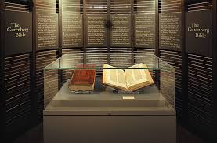
Writing advances
Writing as an art began with famous writers like William Shakespeare. His works display a masterful command of the English language and a deep understanding of human beings.
The printing press improves under Johann Gutenberg and books are not produced quickly and cheaply.
First full-sized book printed was the Gutenberg Bible.

Slide 8
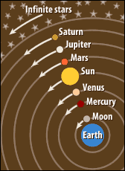
Scientists!
Renaissance scientists began focusing on defining & understanding laws of nature & the physical world.
Scientist Galileo debunked countless myths (i.e. Earth being the center of the solar system) & developed the telescope.
As a result, scientists & thinkers started using observation & experimentation to solve problems.
Toward the end of the 14th century (near the end of the Dark Ages), a handful of Italian thinkers decided that they were living in a new age.

Slide 9
Reformation & Upheaval
They declared that the barbarous & unenlightened days of the Dark Ages in Europe were over.
Many people looked for ways to shape a society that made more sense to them; as people began to use humanist ideas it questioned a central force in their lives – the Church.
Church leaders began to rule some places in live a life of luxury. One way they afforded this life was through indulgences.
In 1517, protests started to rise against Church abuses. The leader of this reformation was Martin Luther.
His “95 Theses,” which advocated two central beliefs—that the Bible is the central religious authority and that humans may reach salvation only by their faith and not by their deeds—was to spark the Protestant Reformation
Luther’s teachings lead to the establishment of a new church and sparked a period of social upheaval and violence as people fought over religious belief.
There were other reforms such as that of John Calvin. They believed in predestination, and Calvin set up a theocracy.

