Slide 1
World Wide Depression
WWII Notes

Slide 2
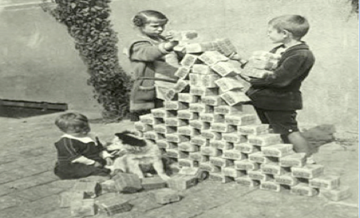
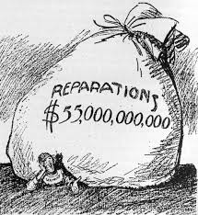
Inflation
The Great War left every major European country nearly bankrupt.
During the war, most countries like Britain and France increased wartime taxes. However, Germany did not and instead printed money.
After Germany’s defeat, its money lost value.
When it came time to pay reparations, Germany printed more money.
In Berlin a loaf of bread cost less than a mark in 1918, and more than 160 marks in 1922.

Slide 3
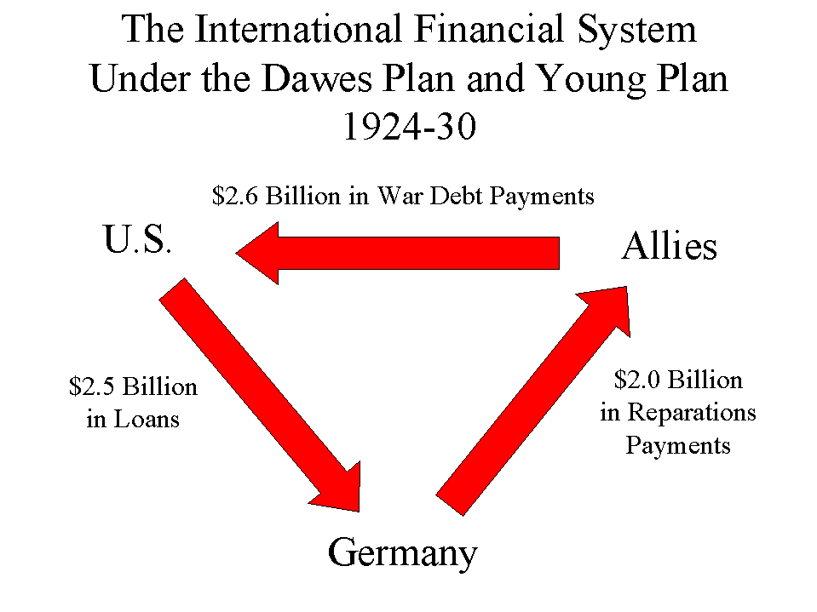
Dawes Plan
What saved Germany: Dawes Plan
Created by an American banker
The U.S. banks loaned $200 million and set up a more realistic schedule for Germany’s reparation payments.

Slide 4
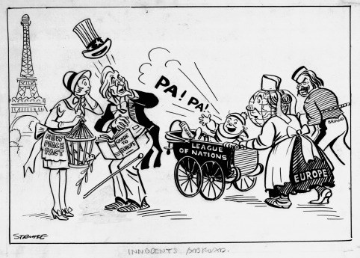
Kellogg-Briand Pact
As Germany prosperity returned, they tried to mend relations with others.
In 1928, almost every country in the world (including Germany, Soviet Union, Britain, France, and the U.S.) signed the Kellogg-Briand peace pact.
Stating “to renounce war as an instrument of national policy.”
Unfortunately, there was no one to enforce this pact. The League of Nations had no armed forces.

Slide 5
Fake Success
The U.S. had a façade of prosperity.
Reality: uneven distribution of wealth, overproduction by business and agriculture, and Americans are spending less.
Many people buy goods on credit (buy now, pay later); Business give easy credit and consumers pile up large debts. Consumers have trouble paying off debt and cut back on spending.
In the 1920s, rich get richer and the poor get poorer. Between 1920 and 1929 the income of the wealthiest 1% of the population rose by 75% compared with a 9% increase for Americans as a whole
70% of families earn less than minimum ($2,500) for decent standard of living. Families buy new outfits once a year; 1 in ten houses own an electric refrigerator
Seeds of trouble were taking root as many engaged in speculation – they bought stocks and bonds on the chance of a quick profit, while ignoring the risks; Others began buying on margin – pay small percent of price and borrow the rest. The government remained uninvolved and if the value of stocks declined, people who had bought on margin had no way to pay off the loans

Slide 6
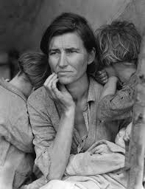
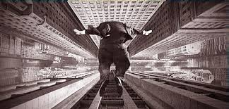
Stock Market Crash
On October 29th, 1929 or Black Tuesday, the bottom fell out of the market and the nation’s confidence. The number of shares dumped onto the market that day was a record of 16.4 million. People frantically sell their shares and those who once had 100,000 now had 10. People who had bought stocks on credit were stuck with huge debts. Others lose most of their savings. There were not great retirement plans and many invested their life savings into the stock market. When the stock market crashed, suicide rate went from 12 per 100,00 and then 19 per 100,000.
The stock market crash signaled the beginning of the Great Depression – economy plummets and unemployment skyrockets
By 1933, 25% (1 in every 4 Americans) of workers were jobless

Slide 7
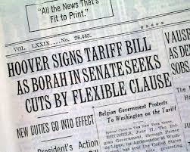
Great Depression
Great Depression limits U.S. ability to import European goods.
Congress passed the Hawley-Smoot Tariff Act sets highest protective tariff ever in the U.S. It was designed to protect American farmers and manufactures from foreign competition. The tariff made unemployment worse in industries that could no longer export goods to Europe. Many countries retaliated by raising their own tariffs.
Other countries cannot earn American currency to buy U.S. goods and international trade drops causing unemployment to soar around the world
Factors leading to Great Depression: tariffs, war debts, farm problems, easy credit, income inequality.

Slide 8
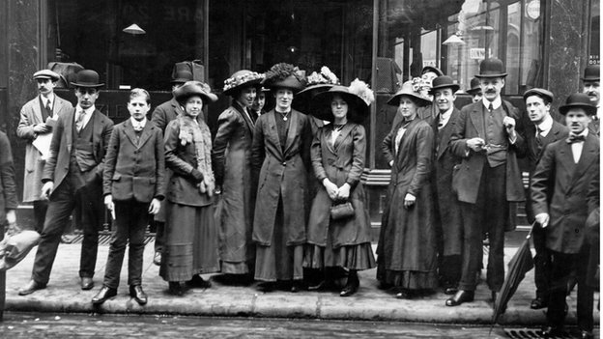
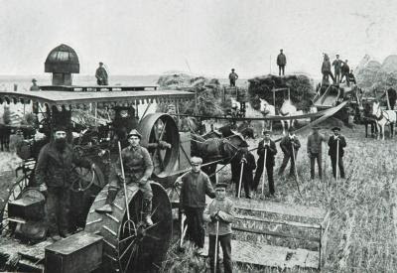
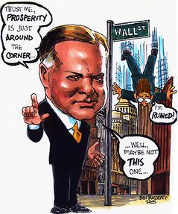
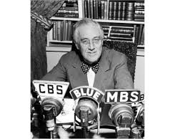
Approaches to the depression
Britain confronted the crisis by passing high protective tariffs, increased taxes, and regulated currency. Able to preserve democracy.
France was more agricultural and less dependent on foreign trade, but unemployment remained high. Communists, socialists, and moderates formed the popular front, but France resisted.
President Herbert Hoover was not successful with ending the recession because of his focus on rugged individualism.
President Franklin D. Roosevelt (FDR) would help lessen the recession with his New Deal, a series of large public works projects helped to provide jobs for the unemployed.

