Slide 1
WW1 Propaganda Posters
AH Coyle

Slide 2
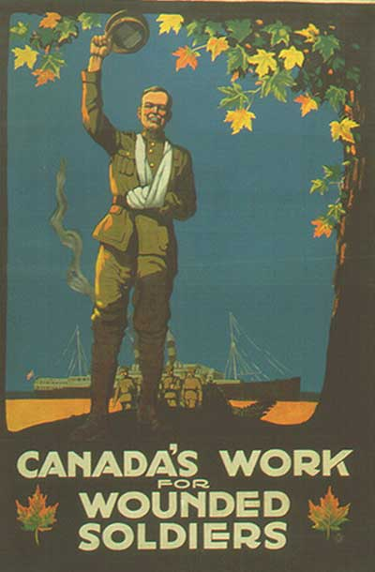

Slide 3
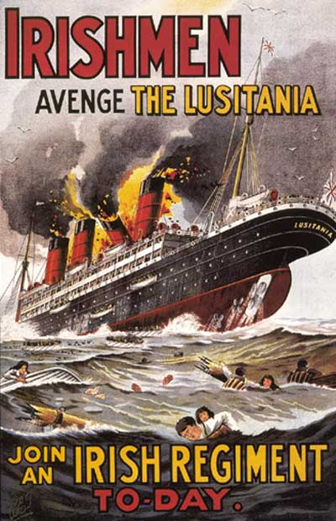

Slide 9
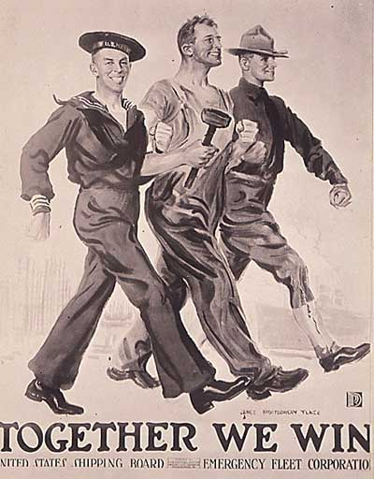

Slide 11
