Slide 1
Industrialization
Unit 3 Notes (pg. 1 – 2)

Slide 2
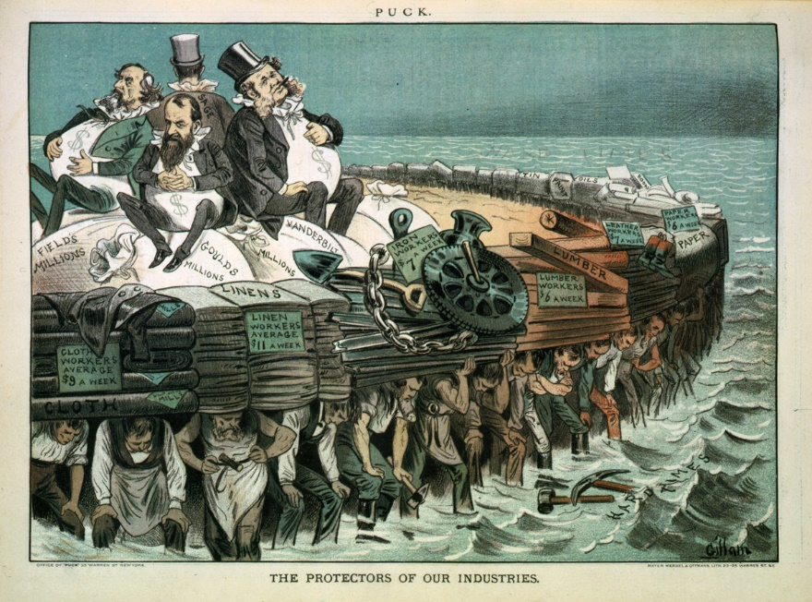
Natural Resources fuel industrialization
During the early 1800s an industrial revolution brought new technology and industries to the U.S. However by the end of the Civil War, the nation was still largely agricultural. At the end of the 19th century, natural resources, creative ideas, and growing markets fuel an industrial boom.
By the 1920s, the U.S. is the world’s leading industrial power due to: (1) Wealth of natural resources, (2) Government support for business, (3) Growing urban population

Slide 3
Black Gold
Although Native American tribes had made fuel and medicine from crude oil long before Europeans arrived on the continent, early American settlers had little use for it.
Edwin I. Drake successfully used a steam engine to drill for oil in 1859 and made it practical.
Petroleum refining industry first made kerosene (used for lamps) and then gasoline.

Slide 4
Bessemer Steel Process
Oil was not the only natural resource that was plentiful; there is also an abundant deposits of coal and iron
Iron is a dense metal, but it is soft and tends to break and rust. To strengthen it, Bessemer process was created.
Later replaced by the open-hearth process of making steel from scrap or raw materials.
Steel is used in railroads, barbed wire, farm machines, and more.
Changes construction – one of the early remarkable structures was the Brooklyn Bridge: Steel cables were supported by towers higher than any man-made and weight-baring structure except the pyramids of Egypt.

Slide 5
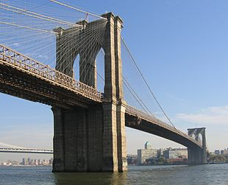
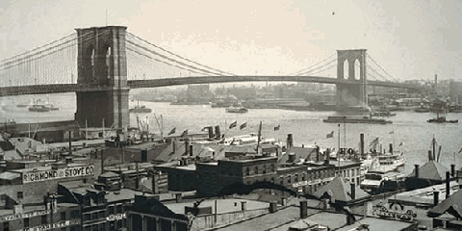

Slide 6
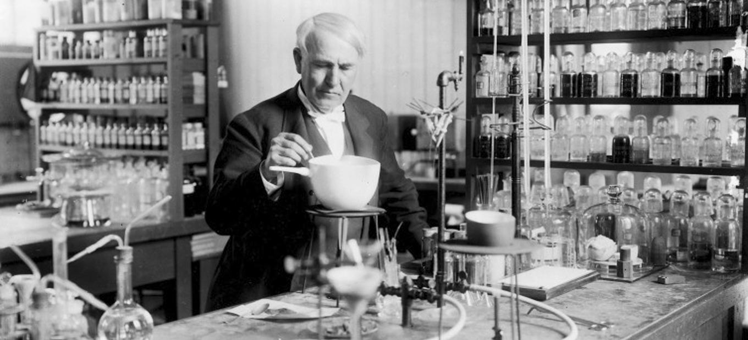
The Power of Electricity
In 1876, Thomas Edison establishes the first research laboratory, in 1880 he patens the light bulb, and he creates systems for producing and distributing electricity.
Changes business; by 1890 it runs numerous machines; allowed business owners to locate anywhere.
This inexpensive, convenient source of energy soon became available in homes and encouraged the invention of appliances.

Slide 7
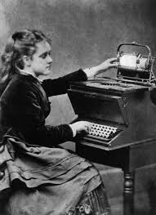
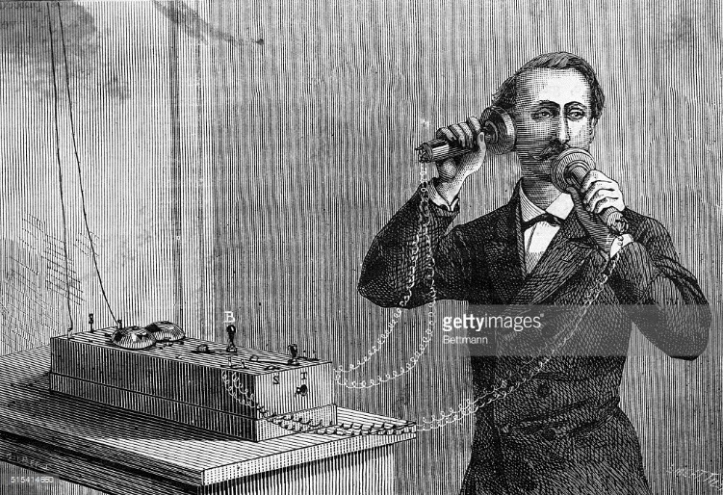
Inventions Change Lifestyles
Inventions begin to change lifestyles: Christopher Sholes invents the typewriter in 1867, Alexander Graham Bell invent the telephone.
Office work changes; by 1910 women are 40% of clerical workers
Impact on factory world, leads to industrialization, which makes jobs easier and improves standard or living.

Slide 8
Unit 3 Note Questions 9/29 & 10/02
How did the Bessemer process improve manufacturing?
It produced a dense metal that was soft and tended to rust.
It enabled manufactures to produce quality steel from scrap metal.
It provided an efficient process to create a flexible, rust-resistant metal.
It allowed manufactures to remove oil from beneath the earth’s surface.
How did the availability of electricity affect the decision of where to locate factories?
Business owners could now consider factors such as population in their decision.
Business owners now had less freedom in deciding where to locate a factory.
In order to have power, factories now had to be located near rivers or streams.
Since travel was more expensive, factories now had to be located near where workers live.

Slide 9
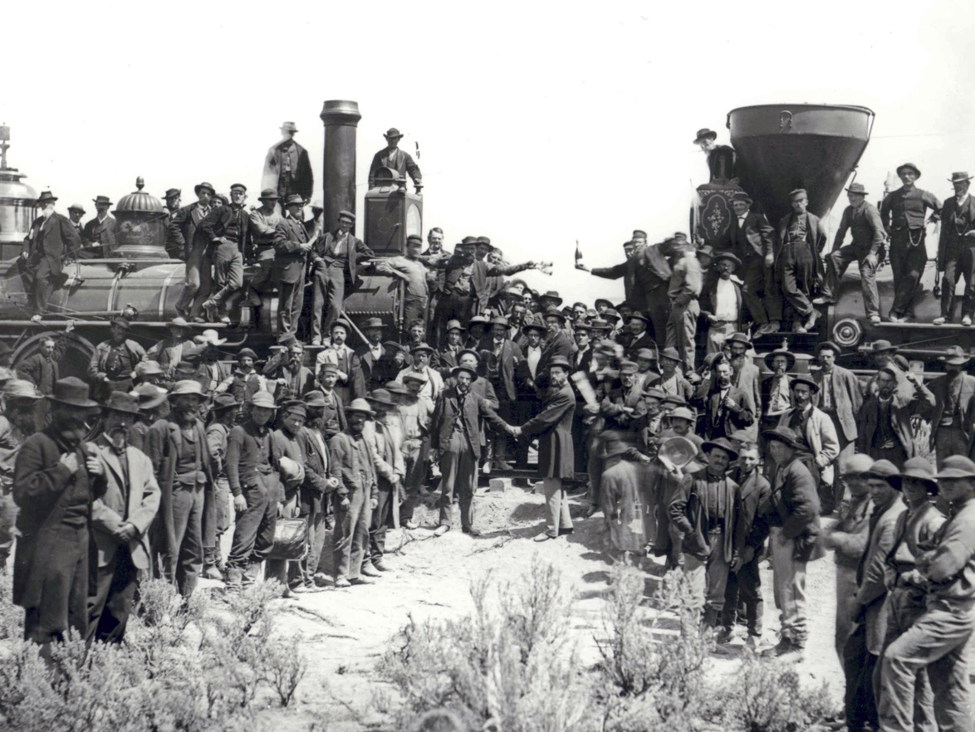
A National Network
The growth and consolidation of railroads benefits the nation, but also leads to corruption and requires government regulation.
Rails make local transit reliable and westward expansion possible; Government makes land grants (federal loans) to help settle the west and to develop the country.
In 1869 the first transcontinental railroad was completed.

Slide 10
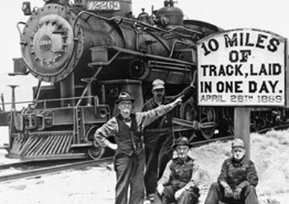
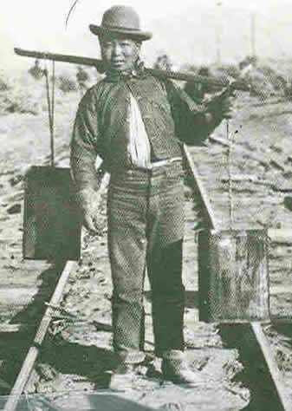
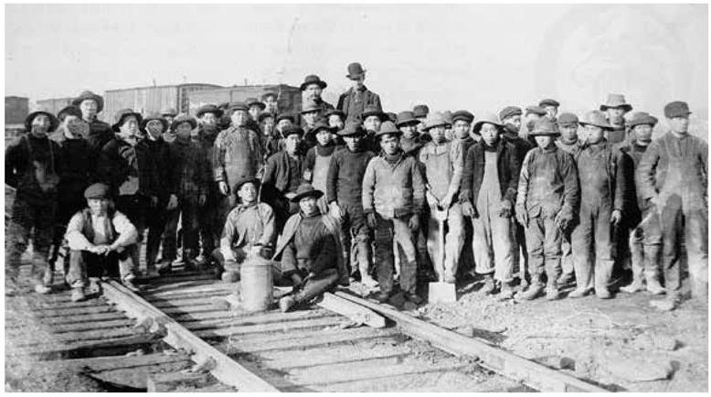
Romance & Beauty
Rails offer land, adventure, and fresh start to many.
People of diverse backgrounds build under harsh
conditions.
Central Pacific hires Chinese immigrants and the
Union Pacific hires Irish immigrants and desperate Civil War veterans.
Railroad pay is poor; Asians earned less than whites; prone to accidents and disease that kill thousands every year.

Slide 11
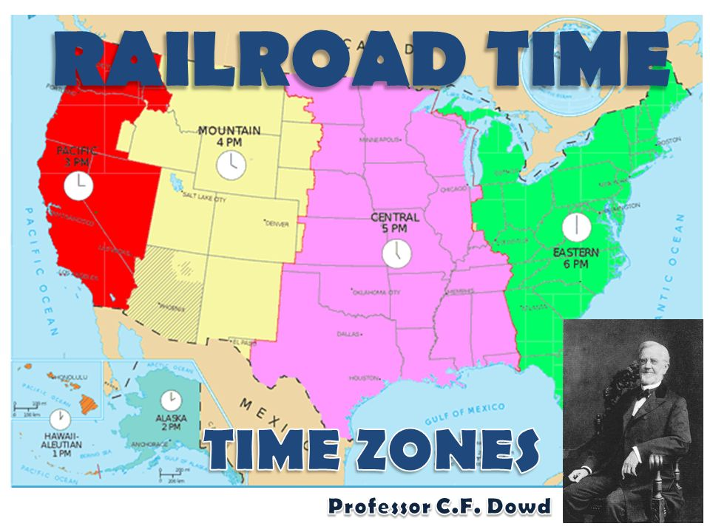
Railroad Time
To end the confusion of dealing with thousands of local times, Professor C. F. Dowd proposed dividing earth’s surface into 24 time zones.
There would be 4 in the U.S.: Eastern, Central, Mountain, and Pacific.
In 1883 the railroads towns adopt time zones.
In 1883 international conference sets world zones
Congress adopts in 1918…

Slide 12
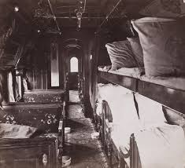
Pullman
Railroads grow industries, link isolated towns, promote trade and interdependence, create nationwide network of suppliers and markets, and new towns grow along the lines.
In 1880, George M. Pullman develops Pullman Palace Car Company known for creating sleeper cars.
Builds factor on Illinois prairie; provides for workers the housing, doctors, shops, and sports field.
Company tightly controls residents to ensure stable work force.

Slide 13
Unit 3 Notes questions 9/29 & 10/02
3. Which of the following did George Pullman provide to his workers to ensure a stable work force? Pick two
Flexible rent payments
Well-constructed homes
Few restrictions during free time
The availability of doctors’ office
A relaxed environment with few rules
4. Why did George Pullman create a town that provided for the basic needs of his workers?
He wanted to allow workers as much freedom as possible.
He was more concerned with workers’ happiness than his profit.
He wanted his town to attract visitors to create a tourism industry.
He thought it was the best way to ensure a stable work force .

Slide 14
Credit Mobilier
Pullman was driven by profit motive, which for railroads leads to corruption.
In 1864, Union Pacific stockholders formed a construction company, Credit Mobiller, and gave it contracts to build the railroad.
The construction company charged the railroad far higher rates than usual, but the stockholders (creator of construction company) sold or gave shares to influential congressman; the congressman helped themselves by approving federal aids for the cost without paying much attention to expenses.
Republican Party was tarnished.

Slide 15
Credit Mobilier

Slide 16
Credit Mobilier
“Every Public Question With An Eye Only To The Public Good"
"Well, the wickedness of all of it is, not that these men were bribed or corruptly influenced, but that they betrayed the trust of the people, deceived their constituents, and by their evasions and falsehoods confessed the transaction to be disgraceful."--New York Tribune, February 19, 1873.
This Harper’s Weekly cartoon by Thomas Nast indicts the congressmen involved in the Credit Mobilier scandal as well as an irresponsible press corps for violating the public trust. Credit Mobilier was the holding and construction company of the federally subsidized Union Pacific Railroad. Its managers were accused of siphoning off huge amounts of public money for personal gain, and of attempting to cover up by bribing congressmen with discounted stock and bonds.

Slide 17
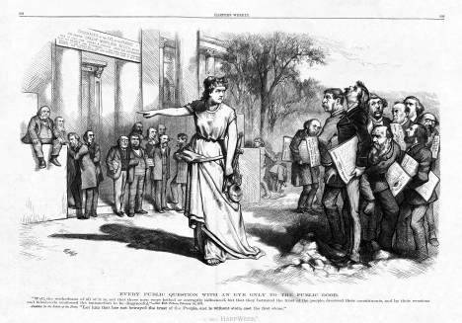
Credit Mobilier
5. How did railroad owners use Credit Mobilier to make profits?
6. How do you think people felt towards Railroad Companies after it?

Slide 18
Panic and Consolidation
Railroads were unjust to settlers; the Grange brought it to the Supreme Court. In the case of Munn v. Illinois.
The case was developed because the legislature of Illinois responded to pressure from the National Grange, an association of farmers, by setting maximum rates that private companies could charge for the storage and transport of agricultural products.
The Chigaco grain warehouse firm of Munn and Scott was found guilty of violating the law.
Set principle that federal government can regulate private industry.
In 1887 Interstate Commerce Act stated the federal government can supervise railroads and establishes ICC.
Abuses, mismanagement, and competition almost bankrupt many railroads, which contribute to panic of 1893.

